Slide 1


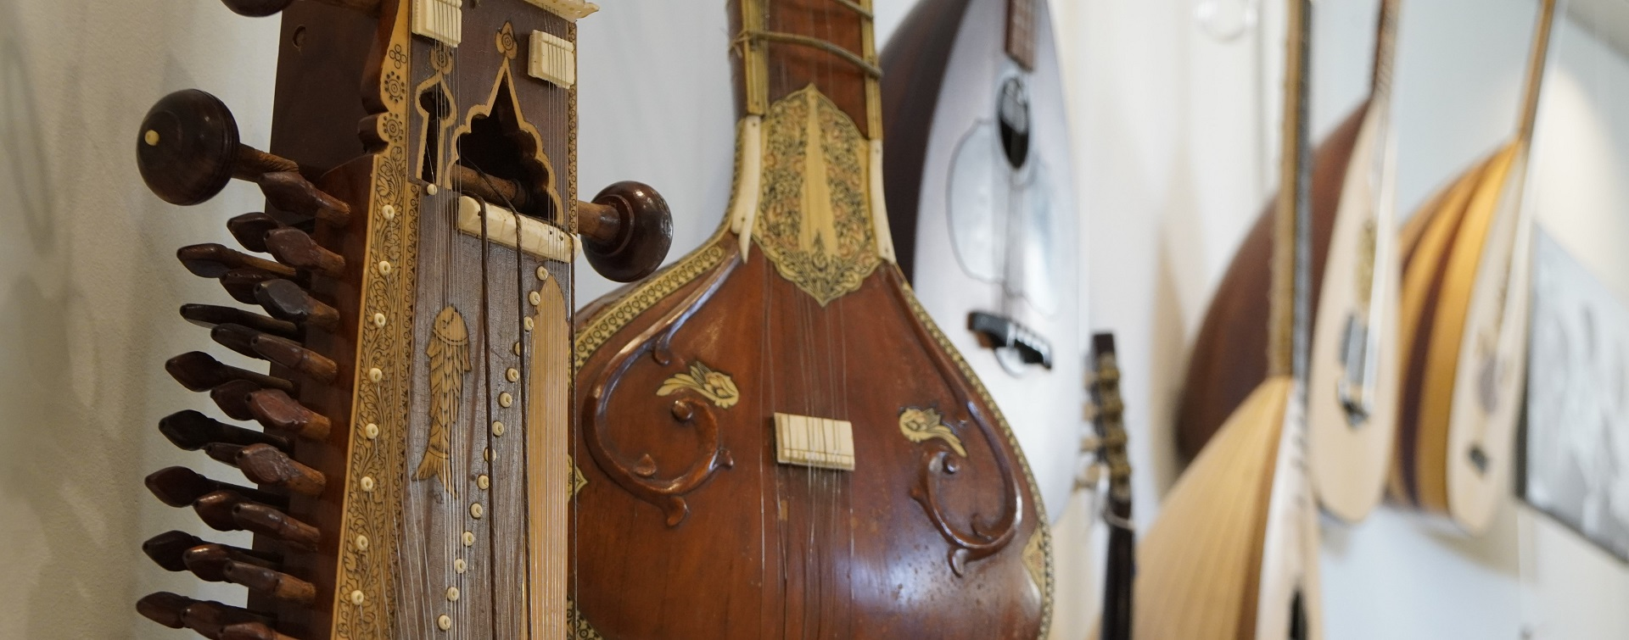
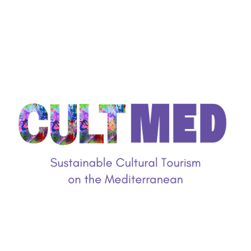

Authenticity and Sounds: The Cultural Heritage of Traditional Music and Instruments
Thirathen, Krousonas, Crete. Traditional Music & Instruments
#CreativeEurope

Slide 2
Introduction
Primary Goals, what is key focus, who initiated it and what is the current status
Enhancing Knowledge and Recognition: Strengthening the knowledge and recognition of the region's traditional music and instruments, with the aim of preserving this heritage for future generations.
Creating authentic and sustainable experiences for visitors, combining cultural heritage with tourism, boosting the local economy, and attracting culturally interested tourists.
Contributing to the enhancement of the tourism sector through the development of cultural tourism products and services that support the local economy, businesses, and workers in the cultural sector.
Creating educational programs and workshops for the public to enhance knowledge and appreciation of traditional music and instruments, both among locals and visitors.
Strengthening local cultural identity and pride by highlighting local musical traditions and connecting tradition with the contemporary cultural environment.
Promoting sustainability in cultural tourism, focusing on the protection of cultural heritage and the responsible use of local resources.
Museum of Traditional Music, Instruments, Research and Documentation 'Thirathen’
Ongoing project
WHERE HERITAGE
MEETS COMMUNITY
#CreativeEurope

Slide 3
The Practice
Overview, Activities Involved, Target Groups and Stakeholders
The Best Practice concerns the preservation and promotion of the cultural heritage of traditional music and instruments through education and the strengthening of local identity. It focuses on the promotion of sustainable tourism activities, the empowerment of local producers, and the development of infrastructure that fosters authentic experiences.
Furthermore, community education initiatives are supported to underscore the significance of preserving tradition, enhancing collaboration between local entities and tourists, as well as developing opportunities to increase demand for local products and services.
A key element is the sustainable management of cultural heritage, thereby strengthening local communities in a responsible manner.
WHERE HERITAGE
MEETS COMMUNITY
#CreativeEurope

Slide 4
The Practice
Overview, Activities Involved, Target Groups and Stakeholders
Tourists: Participating in exhibitions and educational programs, discovering the local musical heritage.
Local Communities: Participating as musicians and educators, strengthening the connection with the local tradition.
Collaborating Organizations: Contributing to the development of educational and tourism programs.
WHERE HERITAGE
MEETS COMMUNITY
#CreativeEurope

Slide 5
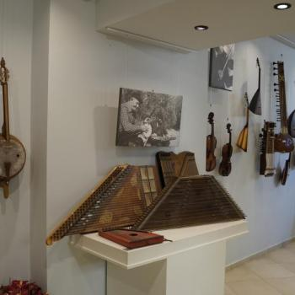
Local Benefits and Impact
Economic, Cultural, Environmental, Social Impact
Generated Revenue:
Income from museum admissions, product sales, and participation in events.
Indirect Economic Benefits: Enhancement of the Tourism Sector
Attraction of more tourists, boosting demand for local services.
Development of Local Infrastructure: Improvement of infrastructure due to increased tourist traffic.
WHERE HERITAGE
MEETS COMMUNITY
#CreativeEurope

Slide 6
Local Benefits and Impact
Economic, Cultural, Environmental, Social Impact
Contributes to the preservation and promotion of local cultural heritage by highlighting traditional music and instruments. It offers educational programs and activities that enhance knowledge and appreciation of local tradition, while also engaging the community in the active preservation and transmission of this heritage to visitors.
Promotes sustainability through the enhancement of cultural tourism with respect for the environment. It aims to reduce its environmental footprint through the use of local and ecological resources, the promotion of sustainable tourism practices (e.g., limiting energy and water waste), and the protection of the area's natural and cultural landscapes, reducing the impacts of mass tourism.
Strengthens social cohesion and community well-being by promoting the inclusion of vulnerable groups through participation in cultural activities. It creates employment opportunities and empowers local identity, fostering pride in cultural heritage. It also promotes cooperation between residents and other stakeholders, strengthening social solidarity and the well-being of the region.
WHERE HERITAGE
MEETS COMMUNITY
#CreativeEurope

Slide 7
Visitors Benefits and Impact
Cultural Engagement and Education, Behavioral Impact on Visitors, Immersive experience
The practice engages visitors through educational programs, workshops, and live events, where they discover the local musical tradition and traditional instruments. Visitors have the opportunity to participate in interactive activities, learn about instrument-making techniques, and understand the history and significance of the local heritage, enhancing their connection with the tradition.
Visitors learn and adopt practices of respecting local customs and traditions, as well as responsible behavior during their travels. Through educational programs and interactive activities, they are encouraged to respect the local culture, recognize the value of cultural heritage, and adhere to sustainable practices that protect the environment and local communities.
Tangible Cultural Experiences and Community Impact: Visitors have gained meaningful experiential cultural experiences by participating in interactive workshops and events that brought them into contact with local music and traditional instruments. The Best Practice has actively contributed to the development of the community, boosting the local economy through tourism and promoting sustainable practices that respect cultural heritage and the environment.
WHERE HERITAGE
MEETS COMMUNITY
#CreativeEurope

Slide 8
Sustainability Measures
Cultural Preservation, Economic Sustainability, Resource Preservation
Creation of educational programs to promote local music and traditional instruments. Highlighting and protecting traditional instrument-making techniques through workshops and exhibitions. Collaboration with the local community to preserve musical traditions and integrate them into tourism activities. Promotion of sustainable tourism practices that respect and protect local cultural heritage and the environment.
For long-term economic sustainability and community benefit, initiatives include:
Creation and promotion of tourism packages that combine cultural and sustainable tourism products. Development of partnerships with local businesses (catering, accommodation) to strengthen the local economy. Creation of sustainable revenue streams (e.g., sales of local products, participation in events). Education and training of the local community to enhance its participation in tourism and cultural development.
Initiatives for heritage protection and preservation include: Encouraging sustainable tourism with limited use of natural resources and respect for cultural heritage. Supporting local production through collaborations and the use of natural resources with respect for the environment.
WHERE HERITAGE
MEETS COMMUNITY
#CreativeEurope

Slide 9
Community Involvement
Role of Local Community, Ownership, Management
Locals and local communities are actively involved in the decision-making, planning, and implementation of the Best Practice through:
Participation in meetings and consultations to document community needs and proposals.
Collaboration with the museum to develop educational programs and events that promote local tradition.
Active involvement in actions and workshops that promote local cultural heritage and strengthen the local economy.
Collective planning of sustainable tourism practices that respect the community and the environment.“
Local ownership and co-management are achieved through the active participation of local communities in decision-making and the implementation of actions. Local stakeholders and organizations assume a leadership role, ensuring that the benefits remain within the community and are not extracted by foreign chains. This is achieved by strengthening cooperation with local businesses and encouraging local production and consumption.
WHERE HERITAGE
MEETS COMMUNITY
#CreativeEurope

Slide 10
Monitoring, Evaluation and Financing
Evaluation Metrics, Feedback Mechanisms, Continuous Improvement, Funding Sources and budget information
Visitor satisfaction questionnaires for evaluating their experience.
Economic indicators (e.g., revenue from visitors, increase in tourist flow).Preservation indicators (e.g., number of education programs, protection of traditional practices).
Feedback mechanisms include:
Visitor questionnaires to evaluate their experience.
Meetings with community members to collect opinions and suggestions.
Online platforms for continuous communication and monitoring of participant satisfaction and needs.
WHERE HERITAGE
MEETS COMMUNITY
#CreativeEurope

Slide 11
Monitoring, Evaluation and Financing
Evaluation Metrics, Feedback Mechanisms, Continuous Improvement, Funding Sources and budget information
Based on evaluation results, adjustments were made such as:
Improving educational programs for better interaction with visitors.
Adjusting operating hours to better serve the tourist public.
Upgrading infrastructure to reduce the environmental footprint and enhance sustainability.
The Best Practice is funded through private and public resources. Implementation costs include the development of educational programs, infrastructure maintenance, and promotion of tourism activities. Maintenance costs relate to the upkeep of exhibitions and program management.
WHERE HERITAGE
MEETS COMMUNITY
#CreativeEurope

Slide 12
Replicability and Scalability
Transferability, Challenges and Barriers, Potential For Expansion
The lessons learned include the value of active local community participation and the importance of sustainability. The Best Practice can be adapted to other contexts by integrating local traditions and partnerships with local organizations, tailoring activities to the specific needs and resources of each area.
The main challenges included the initial lack of community participation and economic sustainability. Strategies for addressing these included strengthening communication with the community through meetings and seeking multiple funding sources to ensure the continuity of actions.
The Best Practice can be expanded to other regions with similar cultural traditions, adapting activities to local needs. It can also be expanded internationally through transnational collaborations and the promotion of sustainable tourism models that protect cultural heritage."
WHERE HERITAGE
MEETS COMMUNITY
#CreativeEurope

Slide 13
Key Conclusions&Takeaways
https://www.thirathen.com/gr
Traditional music and instruments as a means of preserving local heritage.
Local music workshops for tourists, enhancing the interconnection of culture and tourism.
Participation of the local community in the preservation and promotion of cultural heritage.
Attracting tourists, increasing demand for local services.
Improvement of infrastructure due to increased tourist traffic.
Reduced environmental footprint through the use of local products and traditional practices.
Highlighting local production and the use of environmentally friendly materials.
Enrichment of the tourist experience, visitor satisfaction questionnaires.
Improvement of educational programs for better visitor interaction.
Collaboration with local producers, organizations, and businesses for sustainable tourism.
WHERE HERITAGE
MEETS COMMUNITY
#CreativeEurope

Slide 14
Thank You !
WHERE HERITAGE
MEETS COMMUNITY

