Slide 1
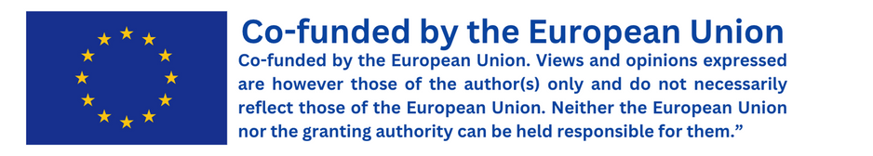


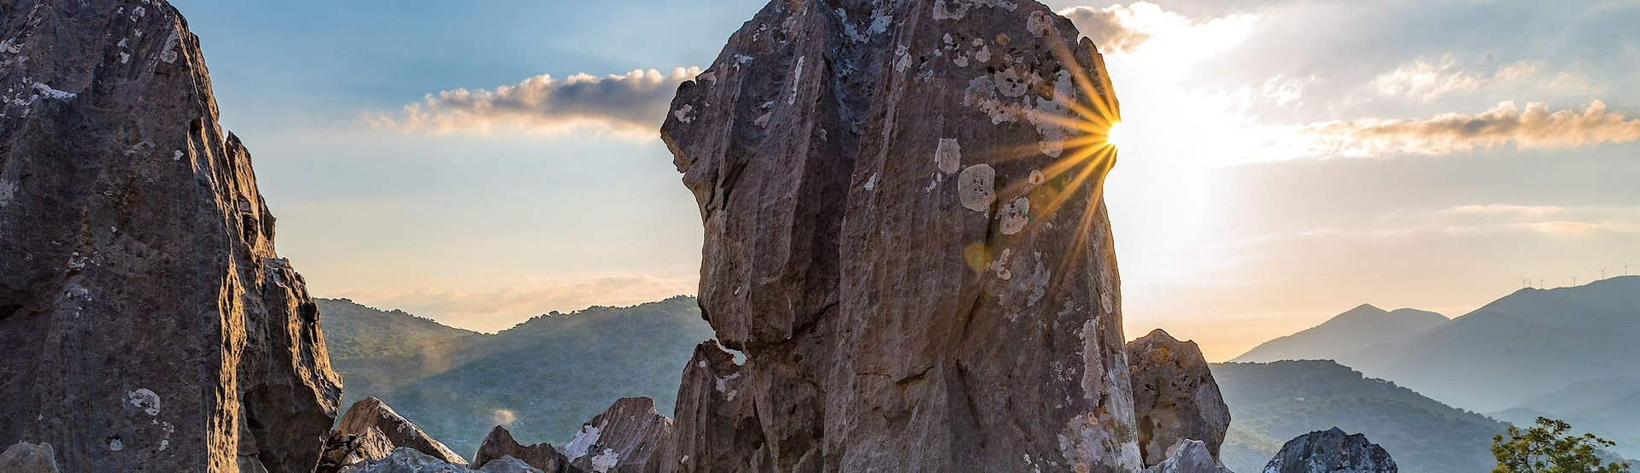
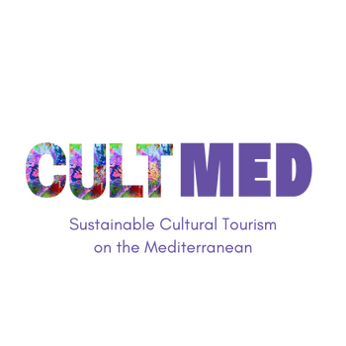

Digital tools of Psiloritis UNESCO Global Geopark
Psiloritis UNESCO Global Geopark. Digital tools
#CreativeEurope

Slide 2
Introduction
Primary Goals, what is key focus, who initiated it and what is the current status
These digital tools are accessible remotely (with the exception of the 'e-geodiscover' application) and pertain to various sites within the Psiloritis UNESCO Global Geopark.
They facilitate familiarization with the natural and cultural heritage, promote the preservation of both natural and cultural heritage, advance environmental and cultural awareness, and enhance accessibility.
Preservation of natural and cultural heritage, promotion of the environment and culture, and enhancement of accessibility are key objectives.
Projects were completed within the framework of previous program cycles, utilizing internal resources.
WHERE HERITAGE
MEETS COMMUNITY
#CreativeEurope

Slide 3
The Practice
Overview, Activities Involved, Target Groups and Stakeholders
Interactive Geopark Map for geosites, monuments, and partner businesses (comprising a wealth of information regarding points of interest, products, and activities offered within the Psiloritis Geopark, displayed on maps with diverse background layers, such as satellite and road views), Story Maps (digital tours through interactive maps, digital panoramas, and images of Amari monuments, the Nida Plateau, Platy River, Vosakos folds, and partner businesses and supporters of the geopark), Virtual Tours (with the option for Virtual Reality device usage for 3D exploration), and the e-geodiscover educational application (interactive on-site quizzes within two of the Geopark's geo-routes).
WHERE HERITAGE
MEETS COMMUNITY
#CreativeEurope

Slide 4
The Practice
Overview, Activities Involved, Target Groups and Stakeholders
The aforementioned can be utilized in preparation for visits to Psiloritis Geopark via personal devices (e.g., tablets, laptops, smartphones) for interactive and narrative maps, at the Geopark Information Center, and wherever travelers have access to relevant tools (e.g., interactive screens at the Museum of Natural History of Crete, VR glasses at the Geopark Information Center or personal devices, if compatible), or during educational visits to the Geopark by schools or visitor groups, or within the context of Geopark events.
Targeting tourists, permanent residents, students, and online visitors, these tools can be used individually or as part of group visits (e.g., cultural associations, schools) to Psiloritis Geopark, or during events, to introduce visitors to the area's natural and cultural heritage through digital exploration of various destinations (e.g., geosites).
WHERE HERITAGE
MEETS COMMUNITY
#CreativeEurope

Slide 5
Local Benefits and Impact
Economic, Cultural, Environmental, Social Impact
Increased visibility for featured businesses.
Showcasing natural and cultural heritage through a lens of respect, sustainable interaction, fostering familiarity, and promoting local identity and tradition.
WHERE HERITAGE
MEETS COMMUNITY
#CreativeEurope

Slide 6
Local Benefits and Impact
Economic, Cultural, Environmental, Social Impact
Minimizing environmental impact through virtual tour capabilities and/or enhanced preparation for more targeted outdoor visits after initial digital exploration; contributing to the protection and preservation of sensitive geosites/destinations by offering a virtual alternative to on-site visits; raising awareness of the region's natural and cultural wealth.
Accessibility for individuals with limited mobility, lack of hiking experience (e.g., digital tour to the peak of Psiloritis), or travel constraints due to season or weather (e.g., inaccessibility during winter due to heavy snowfall).
WHERE HERITAGE
MEETS COMMUNITY
#CreativeEurope

Slide 7
Visitors Benefits and Impact
Cultural Engagement and Education, Behavioral Impact on Visitors, Immersive experience
Many of the digital options include a monument (e.g., virtual visit to the Ideon Cave) or an experience characteristic of the local pastoral culture (e.g., milking at a 'mitato' on Nida Plateau).
Enhanced experiences:
Indirectly, by highlighting the close relationship between natural and cultural heritage, and people and their environment.
Also, by showcasing and familiarizing with the cultural heritage of the area, and by increasing visibility for featured businesses.
WHERE HERITAGE
MEETS COMMUNITY
#CreativeEurope

Slide 8
Sustainability Measures
Cultural Preservation, Economic Sustainability, Resource Preservation
The described good practices overall are resource and economy resilient.
WHERE HERITAGE
MEETS COMMUNITY
#CreativeEurope

Slide 9
Community Involvement
Role of Local Community, Ownership, Management
Many of the destinations/points of interest were incorporated following suggestions from collaborators and partners of the Geopark from the local community.
WHERE HERITAGE
MEETS COMMUNITY
#CreativeEurope

Slide 10
Monitoring, Evaluation and Financing
Evaluation Metrics, Feedback Mechanisms, Continuous Improvement, Funding Sources and budget information
User satisfaction: Through the use of tools/visits to the Information Center, email, social media messages.
Minor corrective adjustments to the digital tools, due to technical issues that occasionally arise in their operation.
Different sources of funding depending on each tool (Interreg Greece-Cyprus, RURITAGE), internal resources.
WHERE HERITAGE
MEETS COMMUNITY
#CreativeEurope

Slide 11
Replicability and Scalability
Transferability, Challenges and Barriers, Potential For Expansion
Interdisciplinarity is crucial, especially when the target audience is primarily online. For the same reason, this best practice can be applied to numerous other contexts and locations.
Challenges: Time-consuming initial field data collection, challenging digital processing to integrate information into a unified platform.
Some digital tools already represent extensions of previous ones to additional locations.
WHERE HERITAGE
MEETS COMMUNITY
#CreativeEurope

Slide 12
Key Conclusions&Takeaways
Integration of culture, natural and cultural heritage, local identity, and business promotion through digital tools.
Increased visibility for local businesses.
Accessibility for individuals with mobility impairments.
Focus on the relationships between nature and cultural heritage to connect with the local environment.
Customization of points of interest in collaboration with the local community to enhance experiential engagement.
Utilization of social media and digital promotion tools for information dissemination.
Linkage with funding instruments and programs to support development.
Flexibility in applying the best practice in numerous diverse contexts and locations.
https://www.psiloritisgeopark.gr/
WHERE HERITAGE
MEETS COMMUNITY
#CreativeEurope

Slide 13
Thank You !
WHERE HERITAGE
MEETS COMMUNITY

