Slide 1


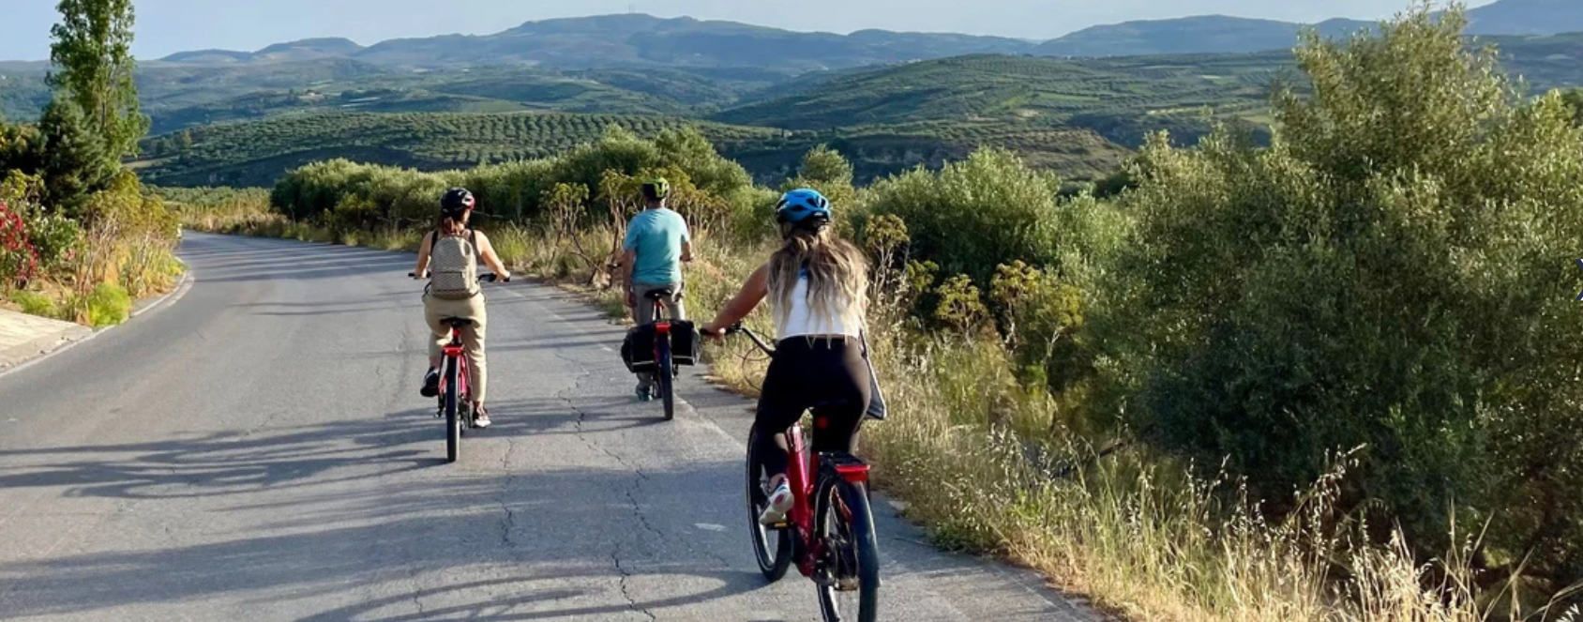


Soulouksina
Episkopi Pediados, Crete. Electric bicycle tour
#CreativeEurope

Slide 2
Introduction
Primary Goals, what is key focus, who initiated it and what is the current status
Promotion of culture and cultural heritage, gastronomy, economic development, promotion of the electric bicycle as an alternative form of transportation.
Environmental sustainability, local cuisine, local community, local products.
The initiative focuses on the promotion of culture and cultural heritage, highlighting local gastronomy, fostering economic development, and promoting electric bicycles as a sustainable and alternative mode of transportation.
Founder-initiated good practice
Ongoing project, currently in the process of preparing for the next tourist season
WHERE HERITAGE
MEETS COMMUNITY
#CreativeEurope

Slide 3
The Practice
Overview, Activities Involved, Target Groups and Stakeholders
The best practice in Episkopi Pediados, Crete, promotes cultural heritage, gastronomy, local culture, and sustainability through a unique experiential electric bicycle tour.
Storytelling plays a central role, as visitors meet locals and learn about local history and products. The route includes stops at traditional cafes and churches, where interaction with residents creates an authentic experience. The local founder and guide, with roots in the village, contributes to the authenticity of the experience, while the initiative strengthens the local economy by operating as a supplier of products. Sustainability is enhanced by the use of electric bicycles and the minimization of environmental impact through the use of recyclable materials.
WHERE HERITAGE
MEETS COMMUNITY
#CreativeEurope

Slide 4
The Practice
Overview, Activities Involved, Target Groups and Stakeholders
The electric bicycle cycling experience takes place in Episkopi Pediados, Sgourokefali, Agkarathos Monastery and Voni, Crete. The guide narrates the story of a Crypto-Christian Cretan girl who wanders through Pediada to meet her beloved. The route includes churches, a monastery, and the ruin where Soulouksina lived and was born. Through this journey, messages of sustainability, culture and values are conveyed to the guests.
Tourists and local communities
WHERE HERITAGE
MEETS COMMUNITY
#CreativeEurope

Slide 5
Local Benefits and Impact
Economic, Cultural, Environmental, Social Impact
This experience is people-centered, as we meet locals in the cafe who mingle with the guests; through the narration, they learn the history of Crete.
Usage of electric bicycles, therefore zero carbon dioxide emissions, use of paper and glass packaging, local products.
WHERE HERITAGE
MEETS COMMUNITY
#CreativeEurope

Slide 6
Local Benefits and Impact
Economic, Cultural, Environmental, Social Impact
Increased self-esteem of the local community and the village.
The entire narration concerns the habits and good practices in relation to nature. Thus, life in harmony with nature is enhanced.
WHERE HERITAGE
MEETS COMMUNITY
#CreativeEurope

Slide 7
Visitors Benefits and Impact
Cultural Engagement and Education, Behavioral Impact on Visitors, Immersive experience
Through this experience, guests gain insights into the traditional village way of life, develop an understanding of the significance of religion in people's daily lives, cultivate environmental awareness, and ultimately acquire a deep respect for our cultural heritage. This is facilitated through activities such as attending vespers services, engaging in conversations with monks, and connecting with the local community at the village cafe.
WHERE HERITAGE
MEETS COMMUNITY
#CreativeEurope

Slide 8
Sustainability Measures
Cultural Preservation, Economic Sustainability, Resource Preservation
Sustainability is reinforced by the involvement of visitors in cultural events that may be held within the village, partnerships with both national and international tourism agencies.
The local community is strengthened by functioning as a supplier of regional products.
Sustainable transportation is supported via electric bicycles, the utilization of paper and glass packaging, and the sourcing of local goods.
WHERE HERITAGE
MEETS COMMUNITY
#CreativeEurope

Slide 9
Community Involvement
Role of Local Community, Ownership, Management
As a supplier, the local resident is involved.
The founder, guide, and storyteller originates from and spent his childhood years in the village, and as such, his local authenticity is a strong point that makes the experience unique.
WHERE HERITAGE
MEETS COMMUNITY
#CreativeEurope

Slide 10
Monitoring, Evaluation and Financing
Evaluation Metrics, Feedback Mechanisms, Continuous Improvement, Funding Sources and budget information
Evaluation is assessed by online reviews
Provision of feedback from customers and suggestions during the experience
Following their suggestions, home beautifications, naming of bicycles
No funding involved
WHERE HERITAGE
MEETS COMMUNITY
#CreativeEurope

Slide 11
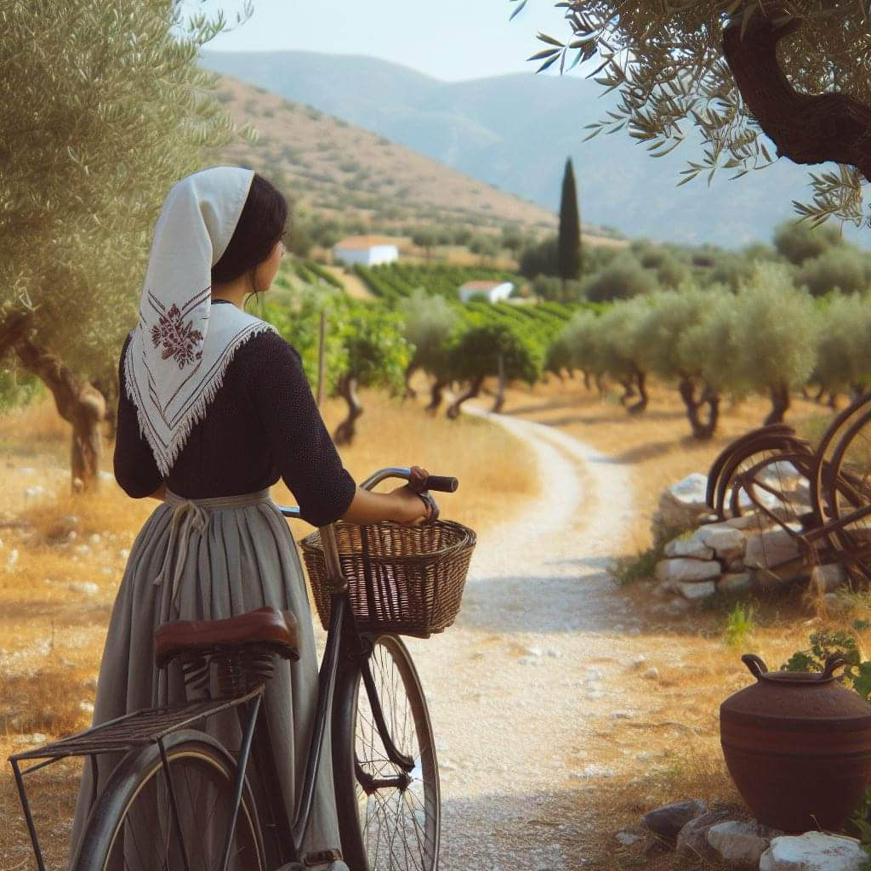
Replicability and Scalability
Transferability, Challenges and Barriers, Potential For Expansion
The electric bicycle is an effective means of transport in the Cretan countryside and could be used broadly.
Challenge: The market’s ignorance about the electric bicycle.
New routes design
WHERE HERITAGE
MEETS COMMUNITY
#CreativeEurope

Slide 12
Key Conclusions&Takeaways
https://soulouksina.com/
Promotion of cycling and cultural heritage, gastronomy, economic development.
Environmental sustainability, local cuisine, local community, local products, history.
New activities for the tourist season.
Excursions, traditional cafes and churches of Crete, village lifestyle.
Human-centered experience, storytelling.
Zero carbon emissions, use of paper and glass packaging.
Collaboration with travel agencies, local community-locals as suppliers.
New routes design.
WHERE HERITAGE
MEETS COMMUNITY
#CreativeEurope

Slide 13
Thank You !
WHERE HERITAGE
MEETS COMMUNITY

