Slide 1


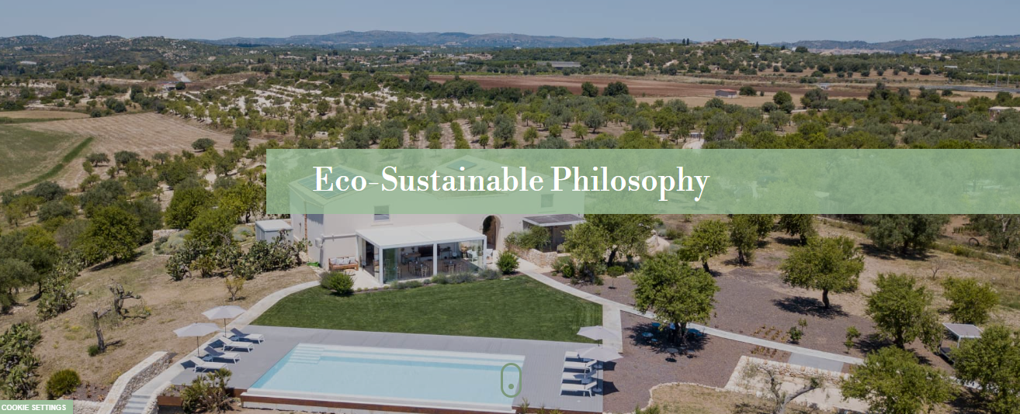
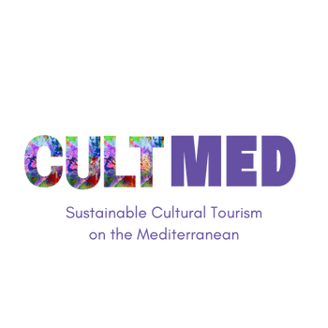

I Carusi Bio-Relais
Photo taken from I Carusi website: https://www.icarusi.it/en/
Noto, Sicily, Italy.
#CreativeEurope

Slide 2
Introduction
The primary objectives of the initiative are centered around fostering economic growth while also promoting the rich cultural heritage of the local area. By focusing on these important pillars, the initiative aims to create a sustainable future that benefits both the economy and the community.
A key focus of the project is placed on advancing economic development, with a strong emphasis on ensuring that this growth is achieved in a way that supports environmental sustainability. The initiative aims to prove that it is possible to grow economically while also respecting and preserving the environment.
The project was initiated by I Carusi S.s.a in 2006 and has since become an ongoing effort to contribute positively to the Sicilian territory.
WHERE HERITAGE
MEETS COMMUNITY
#CreativeEurope

Slide 3
Introduction
I Carusi is a social and cultural initiative aimed at addressing youth unemployment, preserving local traditions, and revitalizing communities in Sicily. By engaging young people with their rich cultural heritage, the hotel not only helps empower them but also encourages entrepreneurship and sustainable development. The goal is to create a bridge between the younger generation and the tradition skills, crafts, and values that form the foundation of the region’s identify, all while fostering economic growth though sustainable practices. In fact, in the buildings, everything is designed to be eco-sustainable and reduce the environmental impact to a minimum.
WHERE HERITAGE
MEETS COMMUNITY
#CreativeEurope

Slide 4
Introduction
The boutique hotel operates on clean energy, ensuring that guests enjoy all the comforts of modern living without contributing to global warming. The energy required for the building is provided by state-of-the-art solar panel technology. Additionally, heating and air-conditioning systems rely on natural energy, sourced from the photovoltaic installation on the roof. Wastewater is filtered and repurposed for irrigation, contributing to waste reduction and creating a sustainable, closed-loop system that minimizes consumption and benefits the environment.
WHERE HERITAGE
MEETS COMMUNITY
#CreativeEurope

Slide 5
The Practice
Activities involved:
Sensory experience
Cultural Events
Guided Tours
  These are educational sessions focused on exploring the Sicilian environment. Young people not only reconnect with their cultural roots but also learn more about rue, helichrysum and salvia plants through an eco-friendly method.
  The strategic position of the boutique hotel can help to reach the Baroque towns in the south-eastern Sicily giving the possibility to the guest to celebrate Sicilian traditions and know about the cultural heritage.
  These tours provide an opportunity to explore historical sites, giving both locals and visitors a deeper understanding of the island’s cultural and historical significance. One of the tours is the excursion on Mount Etna, Europe’s highest active volcano.
WHERE HERITAGE
MEETS COMMUNITY
#CreativeEurope

Slide 6
The Practice
The target groups for this initiative are diverse, with a focus on addressing the specific needs of different segments of the population in Sicily.
First and foremost, the initiative aims to support young people, particularly those facing challenges such as unemployment, by involving them in sustainable and cultural activities.
Another key target group is the local communities, particularly the residents of Noto area who are deeply invested in preserving their local traditions. These individuals are essential to the success of the initiative, as their active participation and support are crucial for maintaining the rich cultural identify of the region.
WHERE HERITAGE
MEETS COMMUNITY
#CreativeEurope

Slide 7
The Practice
The stakeholders involved in this project play an important role in its success:
Local authorities, including government bodies, are instrumental in supporting the social objectives of the project, proving the necessary backing to help it thrive.
Cultural organisations organise events and initiative that bring local traditions to the forefront and engage the wider community.
Private sector partners collaborate to offer training opportunities that benefit the participants. These companies help bridge the gap between cultural heritage and moder-day skills, ensuring that the youth have access to valuable resources and expertise.
Educators are vital stakeholders in guiding the youth through the process of learning and engagement.
WHERE HERITAGE
MEETS COMMUNITY
#CreativeEurope

Slide 8
Local Benefits and Impact
What about the Economic Impact?
  Job Creation: As the hotel provides employment opportunities for local residents, offering them the chance to contribute to the region’s growing tourism sector.
  Sustainable Business Models: The hotel’s sustainable practices, such as recycling of wasterwater, have a positive economic effect. This not only helps the environment but also fosters a more self-sustaining local economy, benefiting both the hotel and the wider community.
  Revenue generated: The products of I Carusi’s farm business are the most important revenue. They produce conserves and extra-virgin olive which are truly zero-kilometre and they sell to not only guests but also to the ones who want to try the products by their website.
WHERE HERITAGE
MEETS COMMUNITY
#CreativeEurope

Slide 9
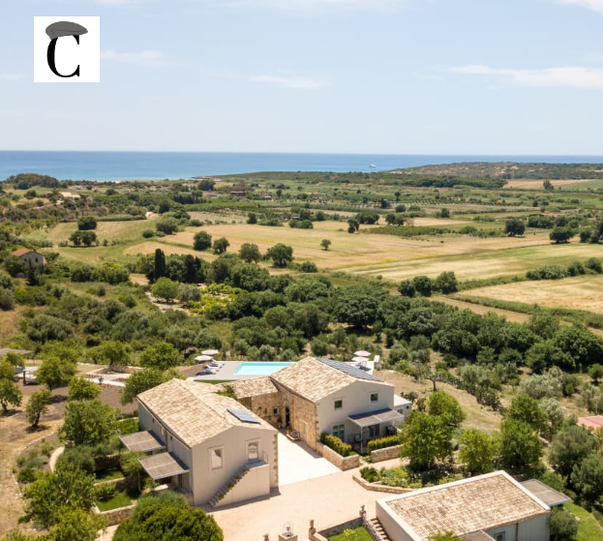
Local Benefits and Impact
What about the Cultural Impact?
  The cultural impact of the hotel extends beyond simply offering a place to stay, it plays a crucial role in preserving and promoting the rich cultural heritage of the region.
  Preservation of Heritage Sites: Rather than treating these sites as distant relics of the past, the hotel fosters an ongoing connection between guests and the nature around it.
  Cultural Preservation: The hotel becomes a space where the cultural elements (traditions and ways of life) are not only protected but celebrated.
WHERE HERITAGE
MEETS COMMUNITY
Photo taken from I Carusi website: https://www.icarusi.it/en/
#CreativeEurope

Slide 10
Local Benefits and Impact
What about the Environmental Impact?
  Eco-Friendly Tourism Infrastructure: The use of solar panels, which provide clean and renewable energy to power the hotel’s electricity needs. In addition, a photovoltaic system is employed to efficiently heat and cool the building
  Waste Management and Water Conservation: In each guest room, there is an option to turn off the Wi-Fi, which not only conserves energy but also helps reduce unnecessary electromagnetic fields, particularly during the night.
WHERE HERITAGE
MEETS COMMUNITY
#CreativeEurope

Slide 11
Local Benefits and Impact
What about the Social Impact?
  Inclusivity: it is a core value, ensuring that all the guests, regardless of background, have access to the opportunities and benefits created by the hotel. This approach fosters a sense of belonging and community, where everyone is valued.
  Strengthened Local Identity: the hotel’s role also contribute to improving the overall well-being of the local community. By offering employment opportunities, supporting local businesses, it plays an active role in enhancing the quality of life for residents.
WHERE HERITAGE
MEETS COMMUNITY
#CreativeEurope

Slide 12
Visitors Benefits and Impact
Cultural engagement and education:
One of the highlights of the experience is the chance to sleep surrounded by history. The property is home to a remarkable Roman-period mosaic, dating back to the 2nd century BC, which stands as an open-air archaeological artifact, inviting guests to marvel at the intricacies of ancient craftsmanship. This experience offers not only a glimpse into the past but also a unique opportunity to connect with Sicily’s cultural and historical landscape in a way that few other destinations can offer.
WHERE HERITAGE
MEETS COMMUNITY
#CreativeEurope

Slide 13
Visitors Benefits and Impact
Behavioral impact on visitors:
As part of their stay, guests are encouraged to embrace the sustainable practices that the retreat has adopted, helping to cultivate a deeper sense of environmental responsibility. For example, the hotel’s use of solar panels and a photovoltaic system is a step toward reducing its carbon footprint, and visitors are invited to reflect on how these practices can be integrated into their own daily lives. By understanding and participating in these eco-friendly actions, guests have the opportunity to bring these lessons home with them, adopting similar sustainable practices in their own routines. This creates a meaningful connection between the guests and the environment.
WHERE HERITAGE
MEETS COMMUNITY
#CreativeEurope

Slide 14
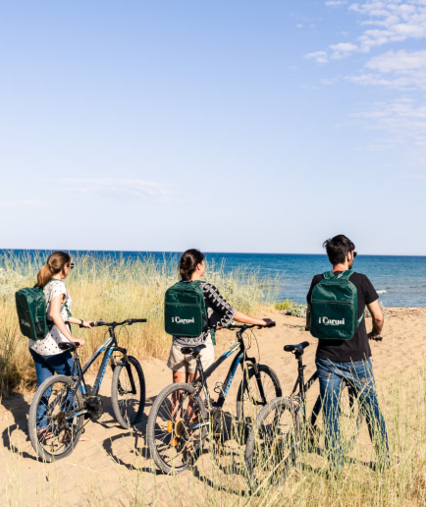
Visitors Benefits and Impact
Immersive experience:
Guests can take full advantage of the hotel’s bike hire service. This not only allows for a more sustainable journey but also enhances the sense of immersion in nature. Once at the beach, guests can indulge in a delightful picnic whit a brunch basket filled with organic, zero-kilometer products. These locally sourced ingredients highlight the region’s commitment to sustainability and freshness.
WHERE HERITAGE
MEETS COMMUNITY
Photo taken from I Carusi website: https://www.icarusi.it/en/
#CreativeEurope

Slide 15
Sustainability Measures
The hotel’s strategic location offers guests easy access to Baroque towns present across southeastern Sicily, making it an ideal base for exploring the region’s rich cultural history. In addition to this cultural treasure trove, guests also have the opportunity to explore Mount Etna, the highest active volcano in Europe thanks to the guided tours.
The retreat also recognises the importance of ensuring long-term profitability while benefiting the local community. Through sustainable practices the hotel is committed to creating a business model that supports the economy of the surrounding area thanks to the presence of guests all around the world.
The structure is designed with a deep commitment to sustainability and resource conservation. In an effort to minimize waste, the hotel allows guests to turn off the Wi-Fi, this small but impactful action encourages a mindful approach t the connection to the natural world around them.
CULTURAL PRESERVATION
ECONOMIC SUSTAINABILITY
RESOURCE PRESERVATION
WHERE HERITAGE
MEETS COMMUNITY
#CreativeEurope

Slide 16

Community Involvement
Role of local communities:
The project encourages co-management where both local residents and external stakeholders work together. This inclusive approach ensures that the local community remains at the forefront of the project’s development and that the benefits of this growth are shared among those who live and work in the area.
I Carusi aims to limit the influence of foreign businesses or large corporations ensuring that the economic and social benefits generated by the project remain within the community, minimizing external exploitation.
WHERE HERITAGE
MEETS COMMUNITY
#CreativeEurope

Slide 17
Community Involvement
Role of ownership and management:
The project does not just offer top-notch hospitality in the traditional sense, but also serves as a model for how business can align with environmental considerations. The owner and the chef of I Carusi combine her personal passions to integrate sustainability and gastronomy. All the chefs involved in the hotel represent a shared commitment to creating a space that is not just about enjoying food but experiencing a deeper connection to the region’s heritage, values, and natural environment.
WHERE HERITAGE
MEETS COMMUNITY
#CreativeEurope

Slide 18
Monitoring, Evaluation and Financing
Feedback mechanism:
One of the core principles behind the retreat’s approach to guest satisfaction is maintaining a Google site for feedback. To make this process as accessible and convenient as possible, the hotel uses the feedback provide by the guests to improve the experience. By encouraging this kind to direct and candid input, the hotel ensures that it remains responsive to the need and desires of its guests, creating a dynamic dialogue that fosters trust and transparency.
Continuous Improvement:
The act of gathering feedback is more than just a way to measure guest satisfaction, it is an essential part of the retreat’s ongoing commitment to continuous improvement. Whether it is a suggestion about the quality of services, the comfort of accommodations, or ways to better incorporate sustainability practices, the goal is always to improve the structure’s offerings.
WHERE HERITAGE
MEETS COMMUNITY
#CreativeEurope

Slide 19
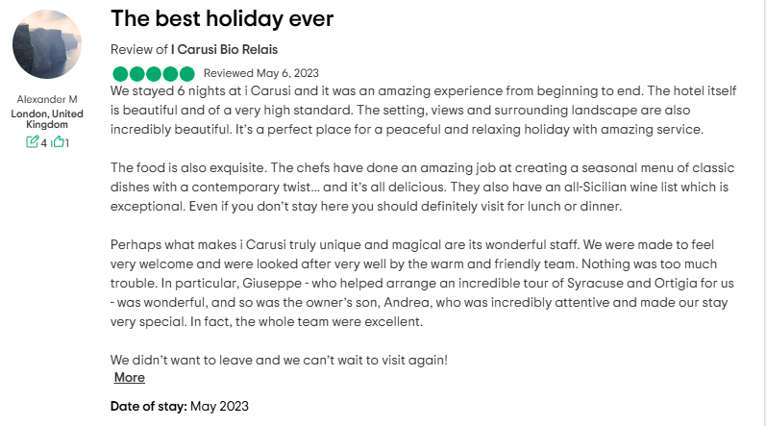
Monitoring, Evaluation and Financing
WHERE HERITAGE
MEETS COMMUNITY
#CreativeEurope

Slide 20
Replicability and Scalability
Transferability and potential for expansion:
The model’s emphasis on local engagement, sustainable practices, and cultural preservation has the potential to be replicated in communities across the world. This initiative shows how development can be both sustainable and socially responsible. Moreover, it ensures that the local community is equipped with the skills and knowledge needed to sustain the project over the long term.
The potential for expanding the I Carusi model is immense, both within Sicily and on an international scale. In Sicily, there are numerous regions that could benefit from the same approach, each with its own unique cultural heritage and socio-economic challenges.
WHERE HERITAGE
MEETS COMMUNITY
#CreativeEurope

Slide 21
Key Conclusions&Takeaways
Sustainability Measures
Cultural: Proximity to Baroque towns, Etna volcano, local heritage
Resource: Organic, local, and seasnoal food, reducing environmental impact
Media coverage: https://www.icarusi.it/en/
Reports/Studies: https://siciliadagustare.com/i-carusi-bio-relais-quando-e-la-connessione-con-la-natura-a-dare-la-carica/
Testimonials: https://www.tripadvisor.it/Hotel_Review-g12501328-d21160197-Reviews-I_Carusi_Bio_Relais-Lido_di_Noto_Noto_Province_of_Syracuse_Sicily.html
WHERE HERITAGE
MEETS COMMUNITY
#CreativeEurope

Slide 22
Thank You !
WHERE HERITAGE
MEETS COMMUNITY

