Slide 1


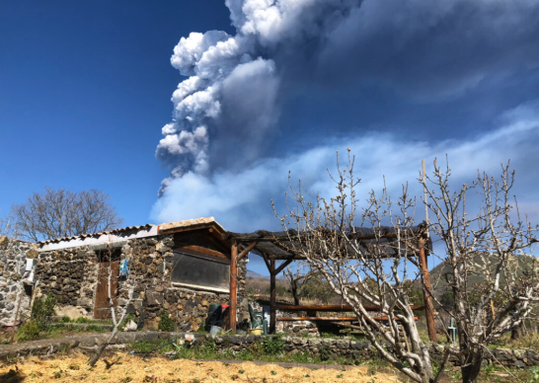
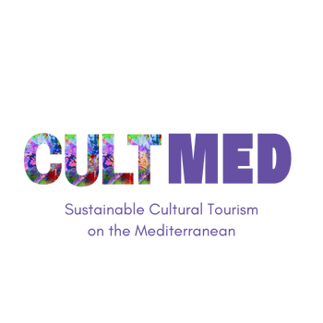

Montata Grande Etna Agricoltour
Photo taken from Montata Grande web site: https://www.montatagrande.it/
Trecastagni, Sicily, Italy
#CreativeEurope

Slide 2
Introduction
The initiative, spearheaded by Montata Grande S.r.l. has been a vital force in the Sicilian region since its inception in 2015. The aim of this project is to promote sustainable development, not just for the environment, but also in terms of fostering local culture and supporting communities through responsible tourism.
By emphasizing responsible tourism, Montata Granda S.r.l. is actively working to shift the paradigm from mass tourism, which often leads to environmental degradation, to a more mindful approach that enhances the quality of life for both locals and visitors.
WHERE HERITAGE
MEETS COMMUNITY
#CreativeEurope

Slide 3
Introduction
Environmental sustainability is a crucial part of this vision. The increase in tourist number has led to various challenges, such as the degradation of natural resources, waste management issues, and the pressure on local ecosystems. Through this initiative, the emphasis is places on educating both visitors and locals about the importance of environmental stewardship. Local cultural preservation is equally important. Sicily’s rich cultural heritage, marked by centuries of history, architecture, art, and traditions, is both a valuable resource and a vulnerable asset. By encouraging tourism that respects and celebrates local culture, Montata Grande S.r.l. ensure that elements of Sicilian identify remain vibrant and pass on to future generations.
WHERE HERITAGE
MEETS COMMUNITY
#CreativeEurope

Slide 4
The Practice
Activities involved:
Sensory experience
Pet Therapy
Agricultural Experience
Itineraries have been created for exploration guided by the owners or naturalist guides. The experience includes: touch by feeling the fruit trees, tast by picking fruit directly from the plants and a rustic aperitif with zero-kilometres products.
There is the possibility to join the Pet Therapy with the two Ragusan donkeys, as it has been demonstrated how important are the therapeutic effect of these animals on humans, particularly on children.
Participate in some agricultural activities such as grape harvesting in early autumn, olive picking, fruit tree pruning and more more.
WHERE HERITAGE
MEETS COMMUNITY
#CreativeEurope

Slide 5
The Practice
The target groups for these agricultural experiences are both tourists and local communities:
For tourists. They are eco-conscious travelers who prioritize sustainable tourism. Not only does this provide a unique opportunity to learn about sustainable farming methods, but it also allows them to support environmentally friendly practices while contributing to the local economy.
For local communities. They are able to benefit directly from the influx of tourists, as they engage in activities that highlight traditional farming methods. This helps to foster a deeper connection between the local population and visitors, allowing for the sharing of knowledge and cultural heritage.
WHERE HERITAGE
MEETS COMMUNITY
#CreativeEurope

Slide 6
The Practice
The key stakeholders involved in this project are local authorities, and tourism organizations, each playing a vital role in the initiative's success.
Local authorities also play a crucial role in supporting the project, as government bodies are essential in fostering an environment conducive to sustainable tourism. They help stimulate economic growth while preserving the cultural and natural heritage of the area.
Tourism organizations are responsible for promoting the Sicilian region as an eco-tourism destination. Their efforts help raise awareness of the project and its offerings, attracting tourists who are interested in sustainable travel experiences.
WHERE HERITAGE
MEETS COMMUNITY
#CreativeEurope

Slide 7
Local Benefits and Impact
What about the Economic Impact?
Job Creation: It creates job opportunity especially for the locals, who have the possibility to contribute to the dissemination of the growing tourism sector.
Revenue generated: Thanks to the sale of locally produced handmade products (such as jams, oils, honey, pesto, etc. through their online page, MontataGrande is able to carry out the activities planned by the facility.
WHERE HERITAGE
MEETS COMMUNITY
#CreativeEurope

Slide 8
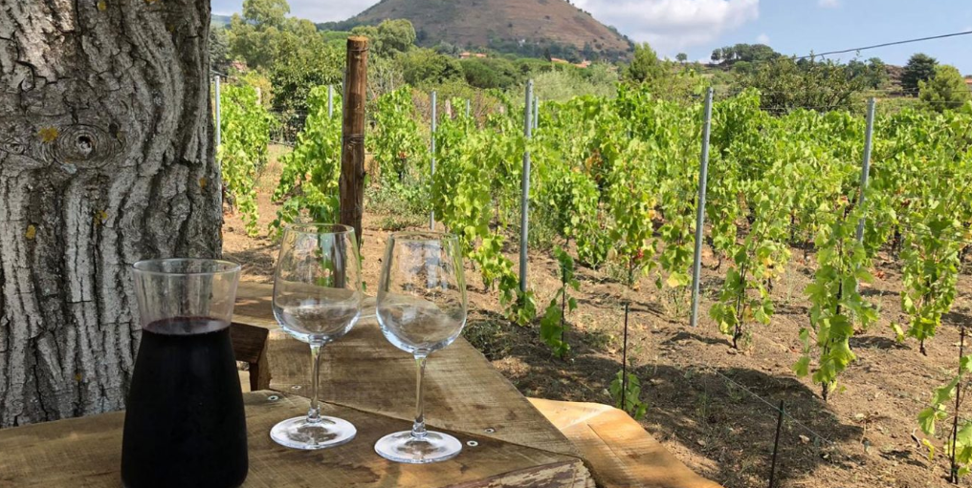
Local Benefits and Impact
What about the Cultural Impact?
The promotion of local cultural heritage is fostered through hands-on activities that allow visitors to engage directly with traditional agricultural practices. Activities such as grape harvesting, olive picking, and pruning fruit trees provide a unique opportunity to connect with the region's agricultural roots. Visitors gain a greater appreciation for the cultural significance of local farming practices, while also supporting sustainable agriculture and fostering a sense of shared heritage.
Photo taken from Montata Grande web site: https://www.montatagrande.it/
WHERE HERITAGE
MEETS COMMUNITY
#CreativeEurope

Slide 9
Local Benefits and Impact
What about the Environmental Impact?
Efforts to reduce the environmental impact and minimize the ecological footprint are at the heart of MontataGrande Etna Agricoltour’s philosophy. By offering activities like fruit picking directly from the trees, the aim is dual: providing a sustainable experience but also on promoting a deeper connection with nature. This direct engagement with the land encourages visitors to appreciate the environmental resources we often take for granted, while fostering a greater awareness of the need for conservation.
WHERE HERITAGE
MEETS COMMUNITY
#CreativeEurope

Slide 10
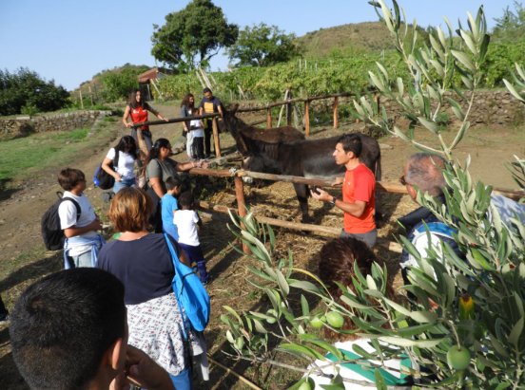
Local Benefits and Impact
What about the Social Impact?
In addition to its environmental efforts, MontataGrande Etna Agricoltour also places a strong emphasis on inclusivity, community well-being, and the empowerment of youth, all of which contribute to sustainable and equitable growth
Photo taken from Montata Grande web site: https://www.montatagrande.it/
WHERE HERITAGE
MEETS COMMUNITY
#CreativeEurope

Slide 11
Visitors Benefits and Impact
Cultural engagement and education:
MontataGrande is an ideal place for educational activities dedicated to students of all levels. The landowners, who are qualified nature guides, will lead school groups through the countryside, explaining in simple and clear language the many curiosities hidden in the nature of the countryside and the relationship with agriculture.
WHERE HERITAGE
MEETS COMMUNITY
#CreativeEurope

Slide 12
Visitors Benefits and Impact
Behavioral impact on visitors:
Visitors can learn and adopt a range of agricultural and sustainable practices through their rural experience, including learning sustainable planting, animal care, and the creation of artisanal products like cheese, olive oil, and bread. Additionally, they can gain insights into water conservation methods and biodiversity protection practices.
WHERE HERITAGE
MEETS COMMUNITY
#CreativeEurope

Slide 13
Visitors Benefits and Impact
Immersive experience:
Guests at MontataGrande have immersive cultural experiences by participating in traditional farming activities, making artisanal products. Their involvement helps preserve local heritage and sustain the community’s economy. By engaging in sustainable practices, guests contribute to community development, fostering a respectful connection to the region.
WHERE HERITAGE
MEETS COMMUNITY
#CreativeEurope

Slide 14
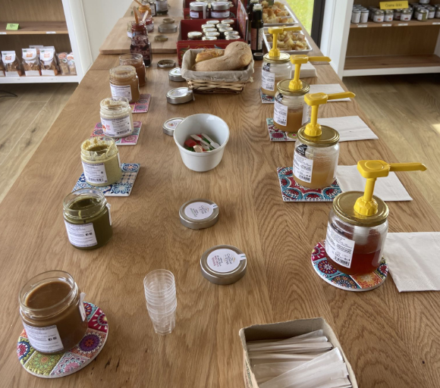
Visitors Benefits and Impact
Photo taken from Montata Grande web site: https://www.montatagrande.it/
WHERE HERITAGE
MEETS COMMUNITY
#CreativeEurope

Slide 15



Sustainability Measures
MontataGrande ensures that both the natural environment and the cultural identity of the region are protected, allowing future generations to experience and benefit from the same authentic Sicilian heritage that visitors enjoy today.
By encouraging guests to purchase locally made products such as artisanal cheeses, olive oils, and fresh produce, the initiative directly benefits local farmers and artisans. This support for local businesses helps sustain the livelihoods of rural communities, ensuring that the economic benefits of tourism are reinvested into the region.
By emphasizing the importance of preserving natural resources, MontataGrande encourages visitors to become more conscious of their environmental footprint, ultimately contributing to the long-term protection of Sicily’s unique landscapes and cultural heritage.
WHERE HERITAGE
MEETS COMMUNITY
#CreativeEurope

Slide 16

Community Involvement
Role of local communities:
The Montata Grande plays an integral role in engaging the local community by encouraging active collaboration with local farmers, artisans, and residents. This approach ensures that the community is not only involved in the decision-making process but also in shaping the experiences offered to guests. By tapping into the skills of those who have a deep connection to the land and traditions, Montata Grande helps preserve local culture and heritage while simultaneously creating authentic and meaningful experiences.
WHERE HERITAGE
MEETS COMMUNITY
#CreativeEurope

Slide 17
Community Involvement
Role of ownership and management:
In the 1930s, the maternal great-grandfather decided to purchase 6 hectares of land on the slopes of Mount Etna to transform it into a flourishing vineyard and orchard. During this time, the project even caught the attention of specialized media due to its success. In fact, the area is still listed in the land registry as C.da Case Gulisano, named after the maternal surname. However, the family preferred to call it Montata Grande, a name that has been passed down through generations and remains in use to this day, maintaining the family tradition. After the grandfather's passing, Paolo and Dario undertook numerous efforts to revive and enhance this special place on the slopes of the volcano.
WHERE HERITAGE
MEETS COMMUNITY
#CreativeEurope

Slide 18
Monitoring, Evaluation and Financing
Feedback mechanism:
At Montata Grande, gathering guest feedback is a central part of enhancing the overall experience. One of the primary channels for this is through online platforms, where guests can easily leave reviews and offer suggestions for improving the facility’s operations.
Continuous Improvement:
The focus on actively seeking feedback is driven by a commitment to continuous improvement at Montata Grande Etna Agricoltour. By inviting guests to share their thoughts, the estate can better understand their needs and preferences.
WHERE HERITAGE
MEETS COMMUNITY
#CreativeEurope

Slide 19
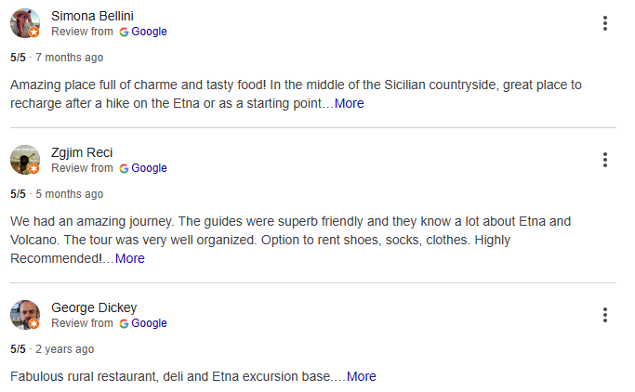
Monitoring, Evaluation and Financing
Photo taken from Google about Montata Grande: https://www.montatagrande.it/en/
WHERE HERITAGE
MEETS COMMUNITY
#CreativeEurope

Slide 20
Replicability and Scalability
Transferability:
Montata Grande’s educational activities are focused on sustainable agriculture and cultural heritage, can be adapted to other regions with similar agricultural backgrounds or sustainability goals.
Potential for expansion:
The initiative has potential for expansion both locally and beyond. It could be scaled by partnering with schools and university. Additionally, expanding to other regions facing similar challenges or offering online platforms could increase its reach internationally.
WHERE HERITAGE
MEETS COMMUNITY
#CreativeEurope

Slide 21
Key Conclusions&Takeaways
Sustainability Measures
Cultural: Guided tours and activities promoting Sicilian agricultural heritage
Economic: Supports local economy though purchases of locally-made products, sustainable tourism practices ensuring long-term profitability
Resource: Eco-friendly techniques that minimise environmental impact, preserve authenticity of the destionation
Media coverage: https://www.montatagrande.it/
Reports/Studies: https://www.cataniatoday.it/eventi/esperienza-rurale-tra-filari-di-viti-ulivi-e-alberi-da-frutto-ai-piedi-dell-etna-sicilia-gaia-eventi-9379277.html
Testimonials: https://www.google.com/search?sca_esv=d4a19772c7ef6077&hl=en-IT&sxsrf=AHTn8zqymbXlkyFQ5CMUYxD74efNwzPk4w:1737716296368&uds=ABqPDvztZD_Nu18FR6tNPw2cK_RROLU6SwVE8STq85NNEyTxMnKkxH-4qj308rBmnorwz_PQuixhqQL7hdOan4HB4UD65DdHKuE2oLA5PGhu4uMubxqhK4GVpVQ6xTzPtZ22mfb2YmxtvjRCxJegfETScLvi6SdbtKhzgOApkBcihjGhCQOq6c8qrz1EZ9QLfHS8BVOlAMvL&si=APYL9bs7Hg2KMLB-4tSoTdxuOx8BdRvHbByC_AuVpNyh0x2KzUBasQCtKlUwNkpL3e-YwNhKAUIILSm7ZblQxGOzE4jjYUUmBFoTUS8F_l3A2ydnb59iA7E%3D&q=MontataGrande+-+AgricolTour+%26+Gusteria+dell%E2%80%99Etna+Reviews&sa=X&ved=2ahUKEwjh1cLUmY6LAxW6nf0HHag5FqwQ3PALegQIRxAF&biw=1366&bih=607&dpr=1
WHERE HERITAGE
MEETS COMMUNITY
#CreativeEurope

Slide 22
Thank You !
WHERE HERITAGE
MEETS COMMUNITY

