Slide 1


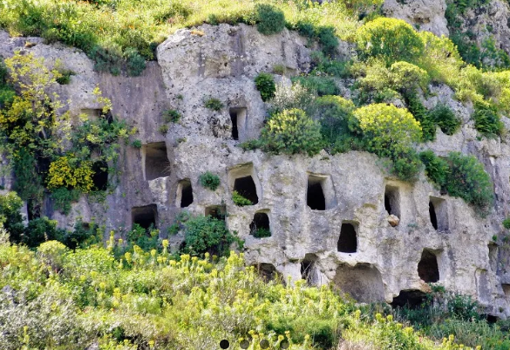
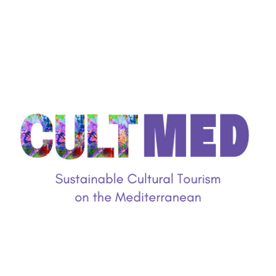

Pantalica Terra Surti Casal dell’Olio
Photo taken from Terra Surti website https://terrasurti.it/esperienze/
Sortino, Sicily, Italy
#CreativeEurope

Slide 2
Introduction
The primary goals of Pantalica Terra Surti are centered around the promotion of heritage preservation in the Sicilian region and the safeguarding of its cultural legacy through responsible tourism. The initiative aims to create a balance where visitors can experience the rich history and natural beauty of the area while ensuring these treasures are protected for future generations.
A key focus is the commitment to advancing environmental sustainability and preserving local culture. By emphasizing sustainable practices and supporting the continuation of local traditions, the project seeks to maintain the region’s unique cultural identity.
WHERE HERITAGE
MEETS COMMUNITY
#CreativeEurope

Slide 3
Introduction
The initiative, founded by TERRA SURTI m&b Agr. S.r.l., has deep roots in the Sicilian territory, dating back to 1947. Since its inception, it has been a steady force for positive change, continuously contributing to the local community and the region’s development. The impact of this initiative has been far-reaching, helping to shape the area in ways that reflect its commitment to sustainable practices and cultural preservation.
WHERE HERITAGE
MEETS COMMUNITY
#CreativeEurope

Slide 4
The Practice
Activities involved:
Sensory experience
Workshop
Guided tours
  Guests can take part in the olive harvest using traditional tools or, if they prefer, assist in the harvesting. Visit to the mill and its processing machinery, active participation to the extravirgin olive oil production stages.
The historical Marietta workshop, known as putia da mbrocia has now been reopened, unchanged in the atmosphere and enriched with ancient tools of agricultural practices for a real dive into the past.
  Guided tour with a qualified guide to discover the largest prehistoric necropolis in Europe, within the Nature Reserve characterised by an extraordinary canyon crossed by a stream.
WHERE HERITAGE
MEETS COMMUNITY
#CreativeEurope

Slide 5
The Practice
The target groups for Pantalica Terra Surti are diverse, yet share a common interest in experiencing and understanding the rich cultural and environmental heritage of Sicily.
One key group is eco-conscious tourists—those travelers who are not only looking to explore new destinations but also seek to immerse themselves in authentic local culture while supporting sustainable practices.
Another important group is educational groups, particularly student organizations that aim to learn more about the promotion of heritage in the region. These groups are interested in gaining deeper insights into how local traditions and cultural preservation efforts can be integrated into modern-day tourism and community development
WHERE HERITAGE
MEETS COMMUNITY
#CreativeEurope

Slide 6
The Practice
The success and richness of Pantalica Terra Surti is made possible through the involvement of various stakeholders, each bringing their own unique expertise and contributions.
One of the most significant groups is the local producers. These individuals are the custodians of traditional crafts and agricultural practices that have been passed down through generations. Their knowledge of local processes, such as soap-making, olive oil production, and other artisan skills, is invaluable.
Another key stakeholder group is educational institutions. Schools, universities, and other educational organizations have a vital role to play in integrating Pantalica Terra Surti's offerings into learning programs that focus on sustainability, environmental preservation, and cultural heritage.
WHERE HERITAGE
MEETS COMMUNITY
#CreativeEurope

Slide 7
Local Benefits and Impact
What about the economic impact?
  Job Creation: One of the most significant contributions of Pantalica Terra Surti to the local community is the creation of jobs. By promoting sustainable tourism and engaging in traditional agricultural and artisanal practices, the initiative not only preserves the region’s heritage but also provides direct economic benefits.
  Revenue generated: it also plays a crucial role in generating revenue for the local area. By attracting visitors who are interested in authentic, sustainable products, the initiative helps to strengthen the region’s reputation as a destination for eco-conscious tourism.
WHERE HERITAGE
MEETS COMMUNITY
#CreativeEurope

Slide 8
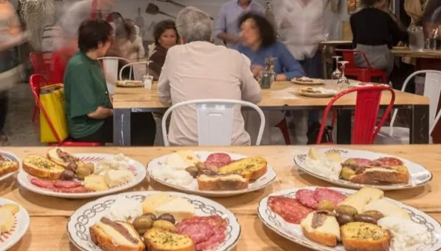
Local Benefits and Impact
What about the cultural impact?
  The cultural impact of Pantalica Terra Surti is multi-dimensions. It is dedicated to preserving and promoting the rich cultural heritage of the region.
  Preservation of Heritage Sites: since it contains archaeological evidence ranging from the Prehistorical to the Byzantine eras, it is a good opportunity to share important cultural heritage
  Cultural Preservation: It provides a tangible link between the past and the present, allowing younger generations to see the value in their heritage and inspiring them to carry forward these traditions.
WHERE HERITAGE
MEETS COMMUNITY
Photo taken from Terra Surti website https://terrasurti.it/:
#CreativeEurope

Slide 9
Local Benefits and Impact
What about the environmental impact?
  Today, the company represents one of the most technologically advanced realities in the sector, with automation and computerization systems that allow temperature control and traceability in every single phase of processing, significantly reducing energy consumption and minimizing the environmental impact of production processes.
WHERE HERITAGE
MEETS COMMUNITY
#CreativeEurope

Slide 10
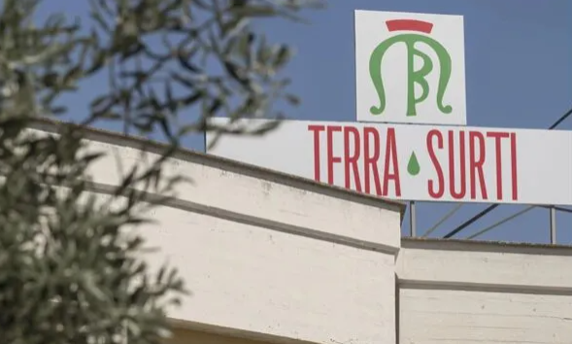
Local Benefits and Impact
What about the social impact?
The commitment to social impact is reflected in the efforts to foster inclusivity, enhance the well-being of communities, empower youth, and promote growth that is both sustainable and equitable for all.
Photo taken from Terra Surti website https://terrasurti.it/:
WHERE HERITAGE
MEETS COMMUNITY
#CreativeEurope

Slide 11
Visitors Benefits and Impact
Cultural engagement and education:
Thanks to the strategical position of Terra Surti, the guests have the possibility to hosts the archaeo-naturalistic of Pantalica, declared a Unesco World Heritage Site, a very deep canyon dug by the Anapo River, containing archaeological evidence ranging from the Prehistorical to the Byzantine eras.
Behavioral impact on visitors:
Visitors can learn and adopt a range of agricultural and sustainable practices through their rural experience.
Immersive experience:
Visitors can visit to the oil mill and its transformation machinery, explanation of the extra olive oil production processes and participation via virtual reality in all the various phases from harvesting to extraction; explanation and demonstration of the production process of the soap.
WHERE HERITAGE
MEETS COMMUNITY
#CreativeEurope

Slide 12
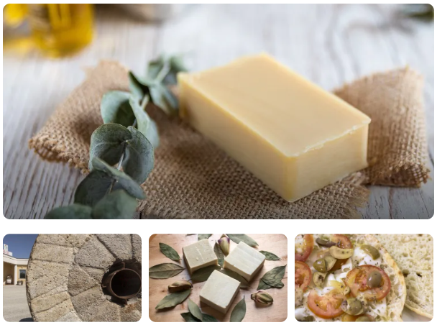
Visitors Benefits and Impact
Photo taken from Terra Surti website https://terrasurti.it/esperienze/
WHERE HERITAGE
MEETS COMMUNITY
#CreativeEurope

Slide 13
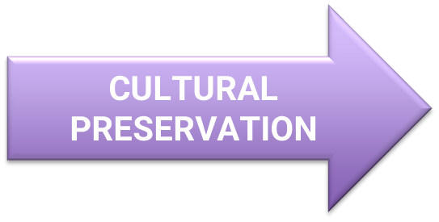
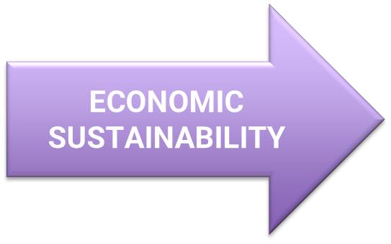

Sustainability Measures
Guided tours are organized not only to highlight the rich cultural heritage of the area but also to promote the preservation of its historical landmarks, such as the largest prehistoric necropolis in Europe.
The experiences provided by Terra Surti contribute significantly to the economic sustainability of the local community by supporting local production and fostering a deeper connection to the region’s agricultural traditions.
In addition, Terra Surti is deeply committed to resource preservation throughout its production process. By minimizing environmental impact at every stage, the company ensures that waste is recycled and that the natural resources are used responsibly.
WHERE HERITAGE
MEETS COMMUNITY
#CreativeEurope

Slide 14

Community Involvement
Role of local communities:
Terra Surti plays an integral role in engaging the local community by encouraging active collaboration with the locals. This approach ensures that the experiences offered to guests would be more complete as possible. By tapping into the skills of those who have a deep connection to the land and traditions, Terra Surti helps preserve local culture.
WHERE HERITAGE
MEETS COMMUNITY
#CreativeEurope

Slide 15
Community Involvement
Role of ownership and management:
The ownership and management of the farm are deeply rooted in family-based leadership. Today the company is in its third-place generation and it represents one of the most technologically advanced realities in the sector.
In 1947, the journey began with the founding of the oil mill by Emanuele Buccheri, whose passion for his craft was the driving force behind its creation. Together with his wife, Marietta Barbagallo, they established the Buccheri & Barbagallo oil mill, which marked the beginning of a family tradition that would span generations.
WHERE HERITAGE
MEETS COMMUNITY
#CreativeEurope

Slide 16
Monitoring, Evaluation and Financing
Feedback mechanism:
The most important way to receive feedback from guests is through the use of online platforms well known by the guests from all the world but also the feedback by Google are present at the bottom of the home page of Terra Surti.
Continuous Improvement:
The decision to actively seek feedback from guests is driven by a commitment to continuously improve the quality of experiences at Pantalica Terra Surti Casal dell’Olio. By listening to their insights and suggestions, the aim is to refine and enhance every aspect of the offering, ensuring that each visit is even more enriching and memorable than the last.
WHERE HERITAGE
MEETS COMMUNITY
#CreativeEurope

Slide 17
Replicability and Scalability
Transferability:
The initiative proposed by Terra Surti could be repeated in the time by the other association which have the same objective.
Challenges and barriers:
Engagement from local schools and communities may be challenging, particularly if generations are less connected to traditional agriculture.
Potential for expansion:
The initiative has potential for expansion both locally and beyond, especially through the online platform in which they sell their products (citrus honey, eucaluptus honey, virgin olive oil, pestos and sauces etc.)
WHERE HERITAGE
MEETS COMMUNITY
#CreativeEurope

Slide 18
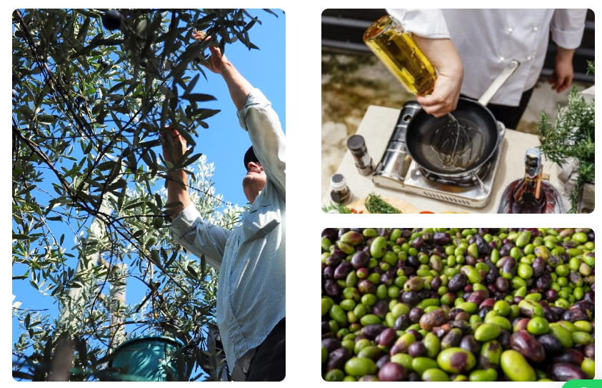
Replicability and Scalability
Photo taken from Terra Surti website https://terrasurti.it/:
WHERE HERITAGE
MEETS COMMUNITY
#CreativeEurope

Slide 19
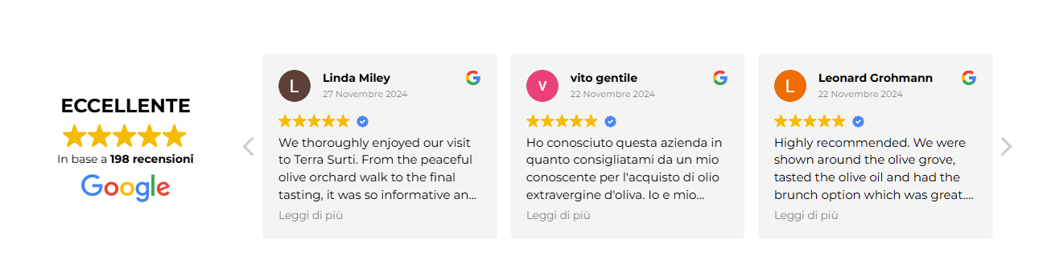
Replicability and Scalability
Photo taken from Terra Surti website https://terrasurti.it/:
WHERE HERITAGE
MEETS COMMUNITY
#CreativeEurope

Slide 20
Key Conclusions&Takeaways
Sustainability Measures
Cultural: guided tours promoting the cultural heritage, including the Pantalica necropolis
Economic: Supports local community by encouraging tourism
Resourse Preservation: Minimised environmental impact, waste recycling, hand harvesting
Media coverage: https://terrasurti.it/en/experience/
Reports/Studies: https://terra.regione.sicilia.it/lolio-terra-surti-produttori-per-passione-le-cultivar-della-valle-dellanapo-in-ogni-goccia/
Testimonials: https://www.tripadvisor.it/Attraction_Review-g1213219-d25339325-Reviews-Terra_Surti-Sortino_Province_of_Syracuse_Sicily.html
WHERE HERITAGE
MEETS COMMUNITY
#CreativeEurope

Slide 21
Thank You !
WHERE HERITAGE
MEETS COMMUNITY

