Slide 1

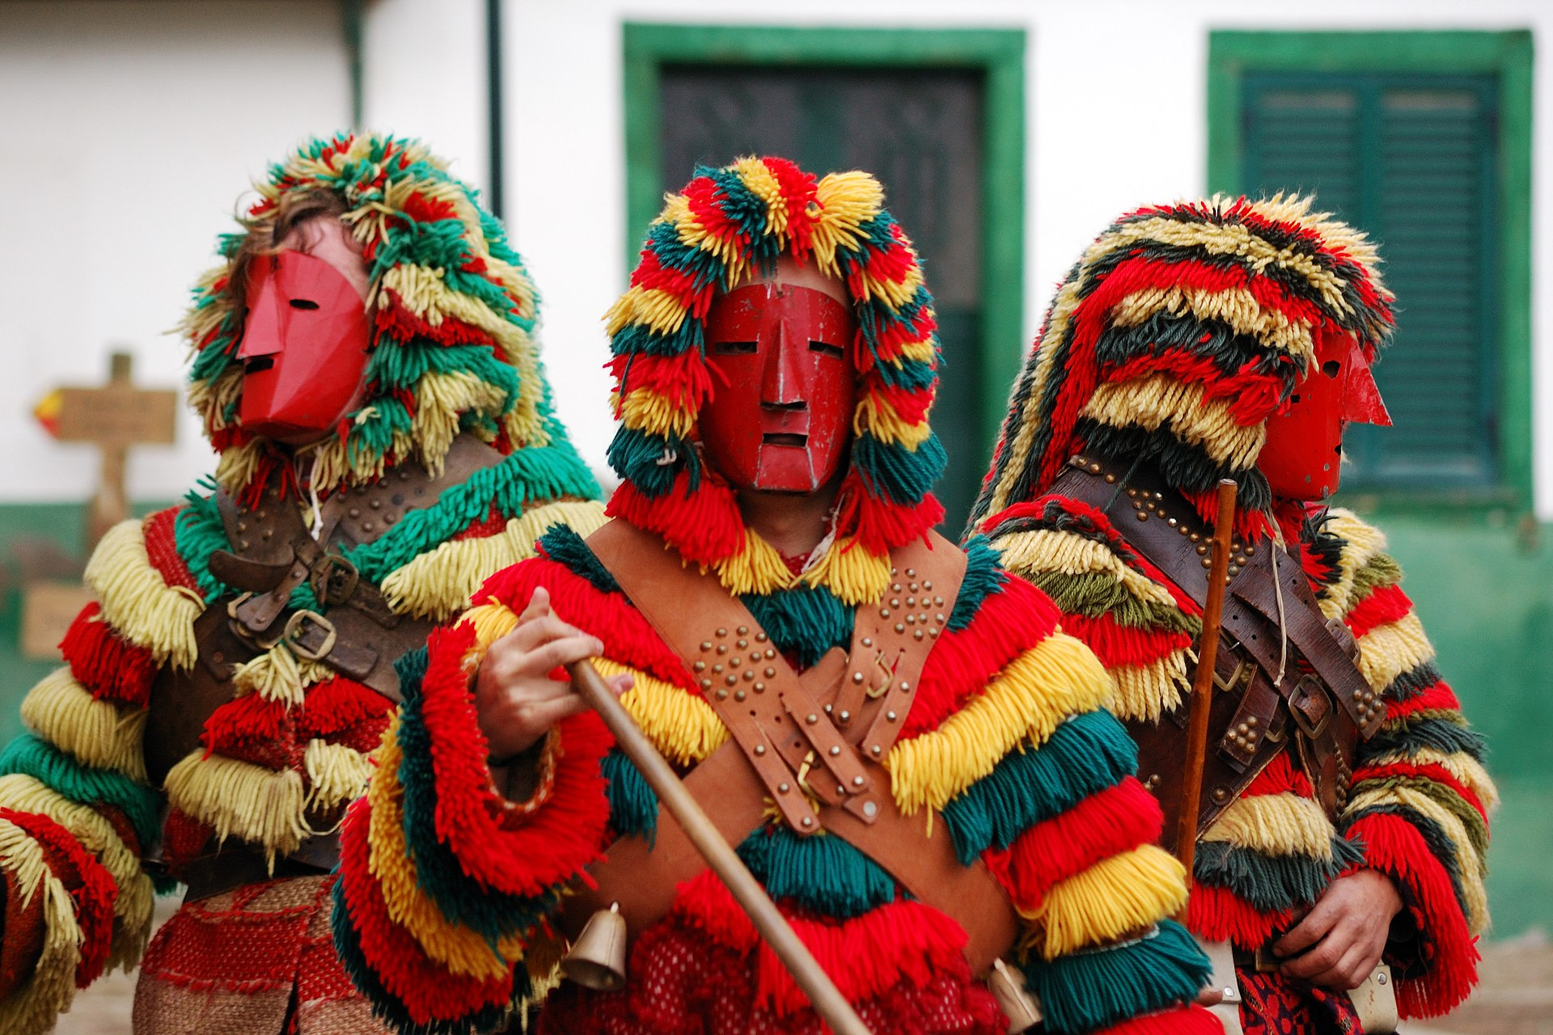
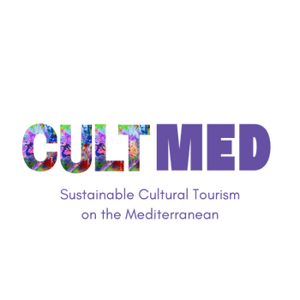

Carnaval de Podence
Podence, Macedo de Cavaleiros – Cultural Tradition
#CreativeEurope

Slide 2
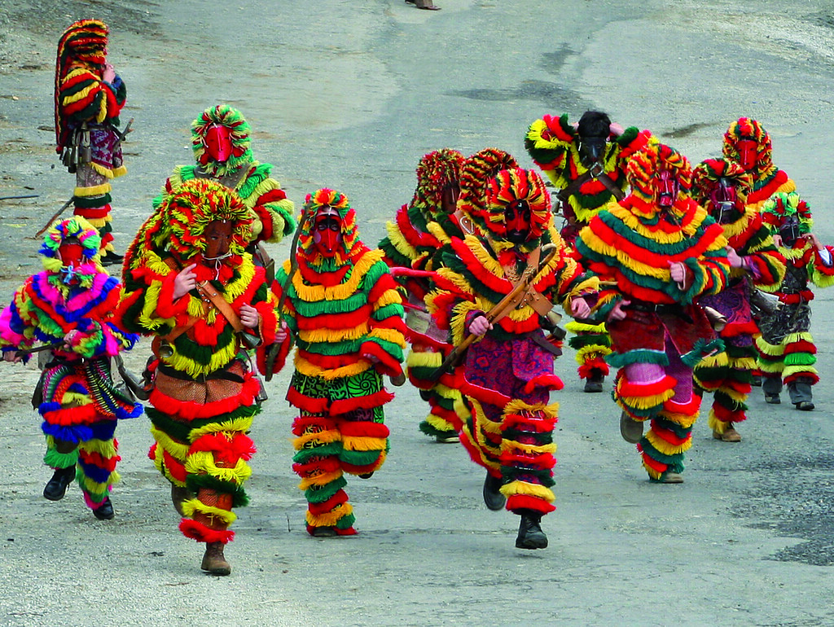
Introduction
In 1985, the Caretos of Podence organised themselves and transformed the group into a cultural association with the primary aim of preserving this traditional event. As a symbol of the culture of northeastern Trás-os-Montes, these masked figures have been invited to take part in various cultural and recreational events.
This Photo by Unknown Author is licensed under CC BY-NC-ND
The Caretos of Podence Group Association, founded on 11 April 2002 as a non-profit, aims to preserve and promote the ethnographic heritage of Podence, especially the Careto tradition. It organises the "Entrudo Chocalheiro" festivities, promotes the Caretos nationally and internationally, manages the Casa do Careto, and partners with other institutions. In 2019, the Caretos of Podence were added to UNESCO’s Representative List of the Intangible Cultural Heritage of Humanity.
WHERE HERITAGE
MEETS COMMUNITY
#CreativeEurope

Slide 3
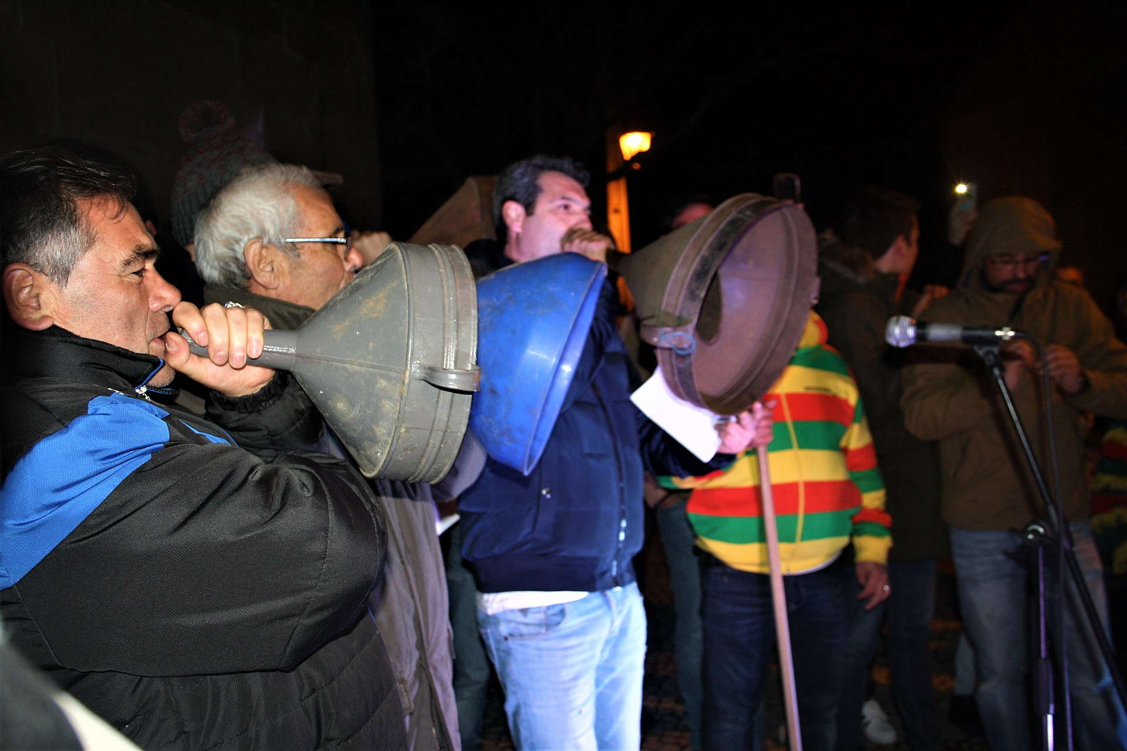
The Practice
The Carnival of Podence is a cultural tradition associated with the end of winter and the arrival of spring. Held from Fat Sunday to Shrove Tuesday in the small northeastern village of Podence, under the jurisdiction of the Macedo de Cavaleiros city council, the Caretos—masked figures dressed in vibrant wool costumes, tinplate or leather masks, and adorned with bells around their waists—joyfully roam the streets, leaping and dashing about.
The Caretos of Podence are known for their lively “chocalhadas,” symbolic acts linked to ancient fertility and agricultural rituals. Today, these masked figures, often descendants of emigrants, visit relatives and neighbours in a gesture of camaraderie. The tradition remains vital, drawing these descendants back each year to uphold the customs of their parents and grandparents.
WHERE HERITAGE
MEETS COMMUNITY
#CreativeEurope

Slide 4
The Practice
Reflecting social change, young women now wear the Caretos costume, with children joining early by imitating the tradition in handmade outfits. The Caretos Group Association has been vital in preserving the Carnival for over 40 years.
Key participants include local residents, emigrant descendants who return to uphold the tradition, domestic and international tourists, and cultural researchers. Younger generations are central to its continuity through active learning and participation.
WHERE HERITAGE
MEETS COMMUNITY
#CreativeEurope

Slide 5
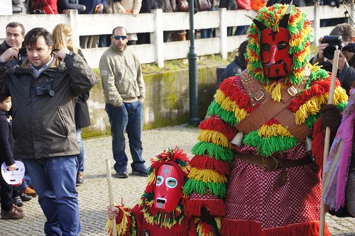
The Practice
The stakeholders involved and benefiting from this tradition include the Caretos of Podence Group Association, which is responsible for organising events, preservation efforts, and promotion; the Macedo de Cavaleiros City Council, which provides local government support and infrastructure for the festival; and the tourism and hospitality industry, including hotels, restaurants, and local businesses that benefit from increased tourism.
WHERE HERITAGE
MEETS COMMUNITY
This Photo by Unknown Author is licensed under CC BY-SA-NC
#CreativeEurope

Slide 6
Local Benefits and Impact
The Caretos de Podence boost the local economy by generating income for hotels, restaurants, and businesses, creating seasonal jobs, attracting national and international tourists, and supporting artisans who craft traditional costumes and souvenirs.
Preserving the tradition ensures generational continuity, strengthens regional identity, and fosters pride in northeastern Trás-os-Montes culture. Its inclusion on UNESCO’s list has increased global recognition and encouraged youth engagement with history, folklore, and craftsmanship.
While tourism can strain local resources, effective waste and recycling programs help manage the impact. The use of traditional materials promotes local artisanship, and sustainable tourism is actively encouraged by event organisers and local authorities.
WHERE HERITAGE
MEETS COMMUNITY
#CreativeEurope

Slide 7
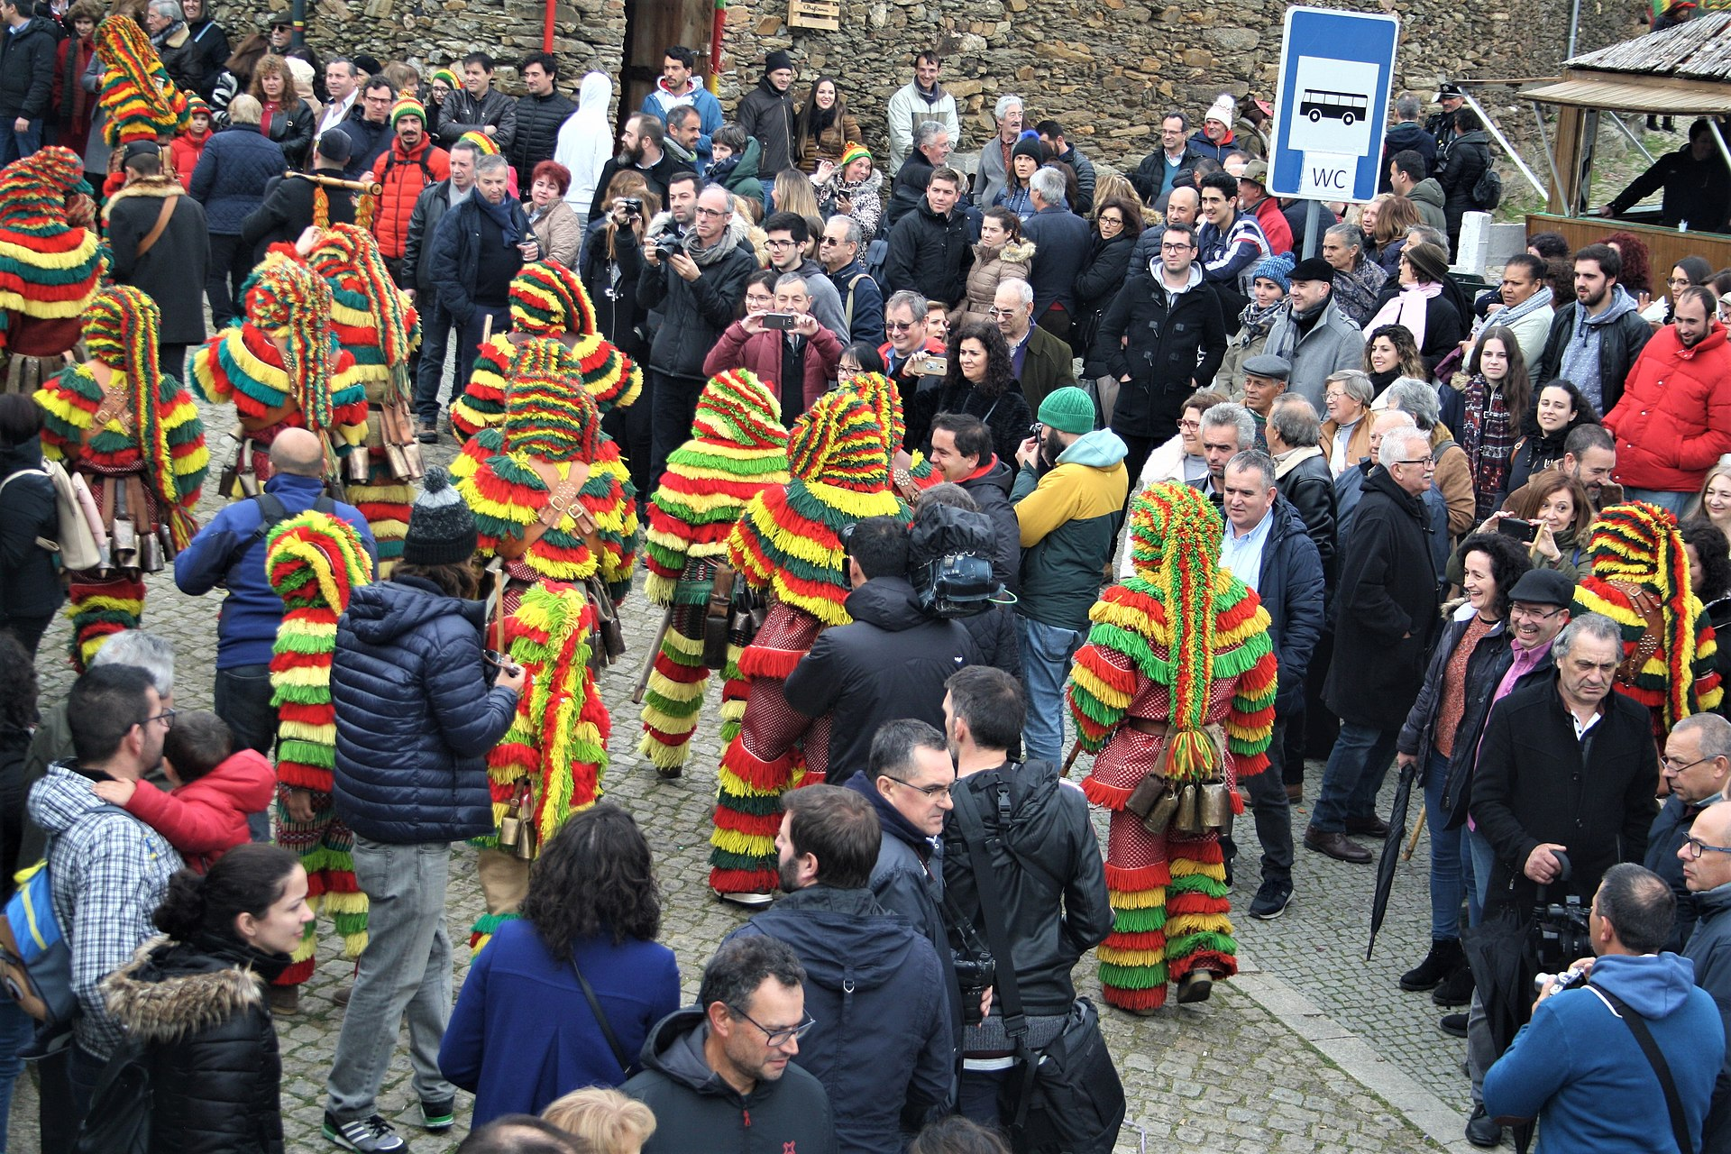
Local Benefits and Impact
This event fosters community bonding, strengthening social ties among locals and returning emigrants. It is gender-inclusive, as the evolving tradition now includes young women, reflecting modern social changes. The festival attracts people from different backgrounds, fostering mutual appreciation and dialogue. It also encourages both children and the elderly to participate, ensuring the festival’s longevity.
WHERE HERITAGE
MEETS COMMUNITY
#CreativeEurope

Slide 8
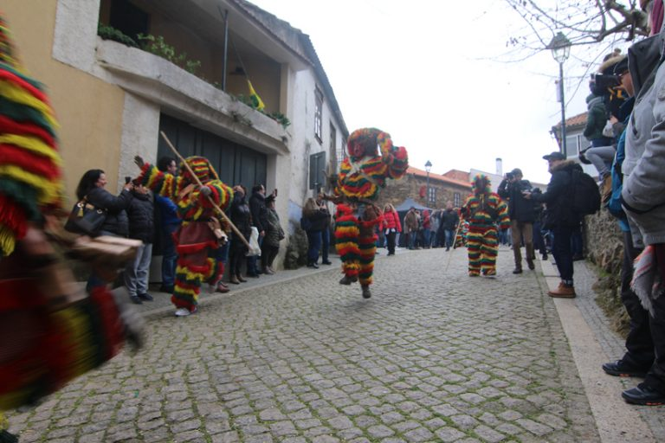
Visitors Benefits and Impact
The Associação Grupo de Caretos de Podence is key to preserving and promoting Podence’s ethnographic and cultural heritage, ensuring its transmission to future generations. Educational efforts, including partnerships with the Instituto Português da Juventude (IPDJ) and local schools, raise awareness of the festival’s importance among youth.
This Photo by Unknown Author is licensed under CC BY-SA-NC
The Casa do Careto museum showcases the history, traditions, and craftsmanship of the Caretos. Through cultural exchanges and international events, the Caretos of Podence promote Portuguese heritage globally. The event also strengthens community ties, uniting locals, emigrants, and tourists in a shared celebration of tradition.
WHERE HERITAGE
MEETS COMMUNITY
#CreativeEurope

Slide 9
Visitors Benefits and Impact
Visitors experience a socially engaging atmosphere, where they are encouraged to interact with the Caretos, embrace the playful nature of the festival, and participate in long-standing customs.
The festival highlights the importance of preserving heritage in a modern, rapidly changing world, inspiring visitors to appreciate and support cultural traditions. The auditory and visual spectacle—the sound of chocalhos (cowbells), the vibrant costumes, and the dynamic performances—leaves a lasting emotional and sensory impact on attendees.
The Entrudo Chocalheiro is an interactive, multisensory event where visitors don’t just watch but actively engage with the festival. Mask-making and costume workshops allow participants to connect with the handcrafted traditions behind the Caretos' attire.
WHERE HERITAGE
MEETS COMMUNITY
#CreativeEurope

Slide 10
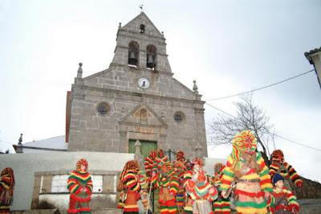
Visitors Benefits and Impact
The event blends ancient rituals with modern inclusivity, as both men and women, young and old, can now participate in a tradition that was once reserved for young men. The rushing, jumping, and playful chaos of the Caretos running through the streets creates an intensely immersive and adrenaline-filled experience for onlookers.
Local food, music, and storytelling further enhance the sense of cultural immersion, making visitors feel like they are part of a living tradition rather than just spectators.
This Photo by Unknown Author is licensed under CC BY-NC-ND
WHERE HERITAGE
MEETS COMMUNITY
#CreativeEurope

Slide 11
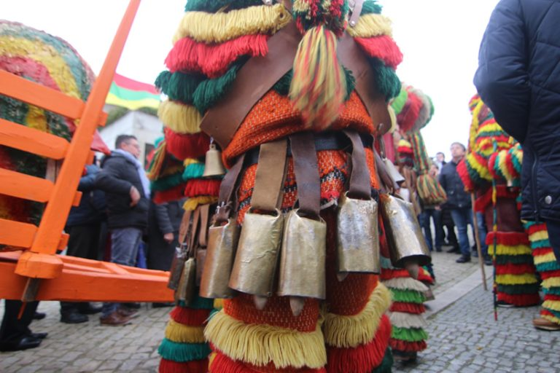
Sustainability Measures
This Photo by Unknown Author is licensed under CC BY-SA-NC
The Associação Grupo de Caretos de Podence plays a vital role in preserving and promoting Podence’s traditions, especially the Entrudo Chocalheiro. Through annual festivities, the Casa do Careto museum, and participation in cultural events, it keeps the Caretos tradition alive.
Intergenerational knowledge transfer is central to its efforts.
The association works with schools, cultural institutions, and youth organizations to teach younger generations about the Caretos’ rituals, costumes, and masks. Children (“facanitos”) actively take part in festivities, and increased female participation reflects the tradition’s evolution without losing its core.
UNESCO recognition as Intangible Cultural Heritage of Humanity has reinforced the tradition’s global significance, strengthening local pride and diaspora engagement.
WHERE HERITAGE
MEETS COMMUNITY
#CreativeEurope

Slide 12
Sustainability Measures
The Caretos festival is a major driver of local economic growth, attracting thousands of visitors and boosting revenue for businesses, including hotels, restaurants, and artisans. The Casa do Careto museum and its tasquinha also support year-round tourism.
Costume and mask production provides income for local artisans, who adapt to scarce traditional materials with new methods while preserving craftsmanship. Festival demand for souvenirs further supports this work.
Partnerships with the Instituto Português da Juventude (IPDJ), the Municipality of Macedo de Cavaleiros, and cultural groups help secure funding and resources, ensuring the festival’s sustainability and reinforcing cultural tourism as a regional economic pillar.
WHERE HERITAGE
MEETS COMMUNITY
#CreativeEurope

Slide 13
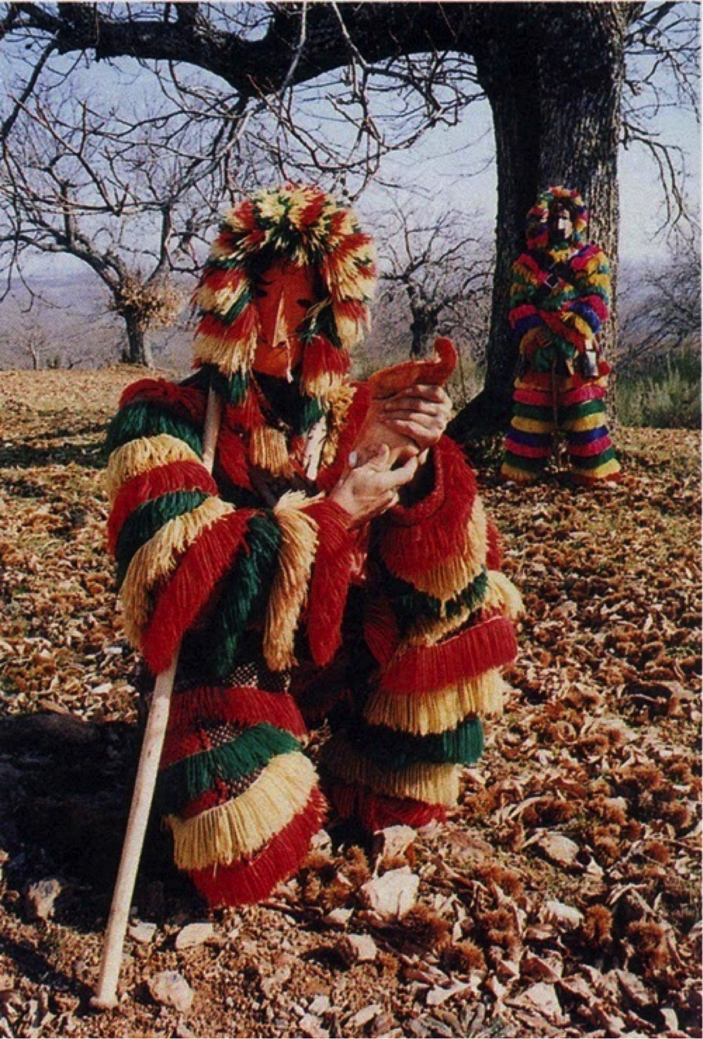
Sustainability Measures
Traditional Careto costumes, once made from wool and local fabrics, have adapted to material scarcity through sustainable methods that maintain authenticity. Artisanal techniques remain central, with skills passed down through generations.
The preservation of heirloom masks reflects the tradition’s sustainability. Artisans combine traditional woodworking with modern methods to ensure durability while honoring original designs. Younger generations are returning to learn ancestral crafts like leather mask-making, helping preserve both tangible and intangible heritage.
WHERE HERITAGE
MEETS COMMUNITY
This Photo by Unknown Author is licensed under CC BY-SA-NC
#CreativeEurope

Slide 14
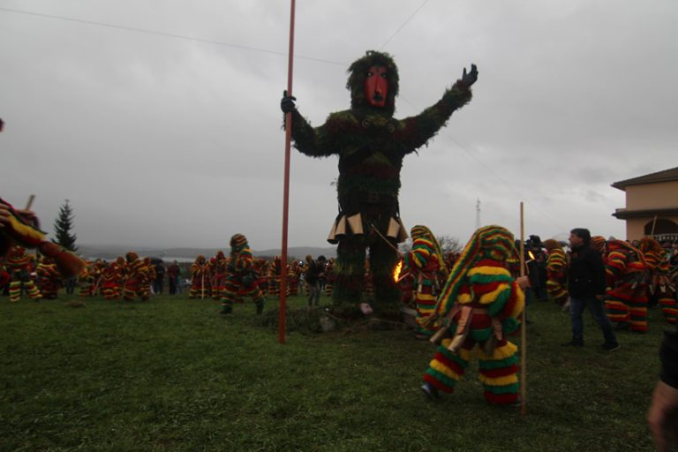
Sustainability Measures
By integrating traditional craftsmanship with contemporary solutions, the capability of using the some “suits” year after year, with just improvements or fixes, the festival sustains its cultural identity while adapting to modern needs. The community’s commitment to upholding these practices, despite demographic challenges such as emigration and aging populations, ensures that the Caretos of Podence remain a thriving and celebrated cultural phenomenon.
This Photo by Unknown Author is licensed under CC BY-SA-NC
WHERE HERITAGE
MEETS COMMUNITY
#CreativeEurope

Slide 15
Community Involvement
The people of Podence are the backbone of the Entrudo Chocalheiro, ensuring its survival through active participation. Generations collaborate—elders pass down skills in mask-making and costume crafting, while youth, including "facanitos," keep the tradition alive. Women, once excluded, now partake, reflecting evolving social norms. Returning emigrants reinforce ties, making the festival a true homecoming event.
The Caretos tradition is deeply embedded in Podence’s identity. The local Associação Grupo de Caretos de Podence, founded in 2002, preserves and promotes it. Recognition by UNESCO as Intangible Cultural Heritage strengthened community pride. Families pass down costumes, artisans continue handmade mask production, and emigrants return annually, reinforcing cultural ties.
WHERE HERITAGE
MEETS COMMUNITY
#CreativeEurope

Slide 16
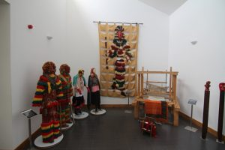
Community Involvement
The festival is managed by the Associação Grupo de Caretos de Podence, which secures funding, organizes events, and collaborates with institutions like IPDJ and the Municipality of Macedo de Cavaleiros. The Casa do Careto museum preserves and educates, ensuring year-round engagement. Facing rural depopulation, the association strategically involves youth and external partnerships to maintain sustainability.
Podence has transformed its tradition into an internationally recognized cultural event while keeping its local essence alive through strong community involvement, ownership, and effective management.
WHERE HERITAGE
MEETS COMMUNITY
This Photo by Unknown Author is licensed under CC BY-SA-NC
#CreativeEurope

Slide 17
Monitoring, Evaluation and Financing
Entrudo Chocalheiro draws over 50,000 visitors, with a 2019 study estimating a €3 million economic impact. UNESCO recognition in 2019 affirms its cultural value. Demand for handmade Careto costumes—priced up to €1,000—shows both sustainability and growing interest. Media attention and public awareness continue to rise.
Strong local participation ensures cultural continuity, while tourists contribute through attendance, social media, and word-of-mouth. The Associação Grupo de Caretos de Podence oversees ongoing improvements, supported by UNESCO and government monitoring.
Youth involvement (Facanitos) secures future tradition. Infrastructure and accommodations are expanding, and Careto masks and costumes are gaining broader cultural appeal. Each year, event organization enhances the overall visitor experience.
WHERE HERITAGE
MEETS COMMUNITY
#CreativeEurope

Slide 18
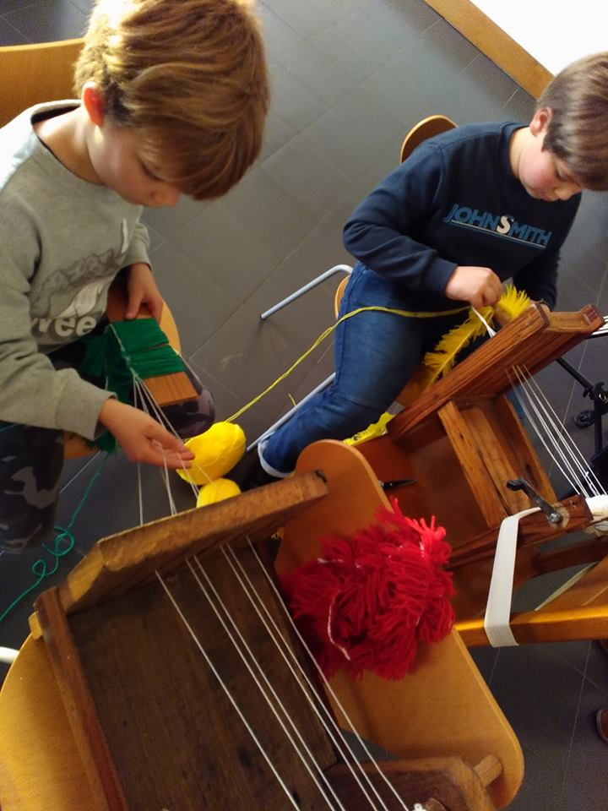
Monitoring, Evaluation and Financing
The Associação dos Caretos that oversee and manages the events confirmed that the 2025 budget for the festivities was 30 thousen euros, relatively small for the size of the event, the budge comes from Government grants and UNESCO support aid preservation. The Tourism revenue from hotels, food, and local businesses contributes to sustainability. Artisan sales of costumes and souvenirs generate income. Sponsorships and partnerships provide additional funding. Event ticketing and merchandising help sustain festival operations.
WHERE HERITAGE
MEETS COMMUNITY
#CreativeEurope

Slide 19
Replicability and Scalability
The success of the Entrudo Chocalheiro can serve as a model for other traditional festivals worldwide. Other regions with similar cultural heritage can adopt the approach of UNESCO recognition to boost tourism and preservation efforts. The integration of youth (Facanitos) ensures long-term sustainability, which can be replicated in other cultural traditions. Collaboration between local artisans, businesses, and government bodies can be a framework for cultural economic sustainability in rural areas.
Demographic decline due to an aging population and rural depopulation threatens the continuity of traditions. Infrastructure limitations arise as the surge in tourism strains local accommodations, transportation, and event logistics. Funding constraints make long-term sustainability uncertain as reliance on government and tourism revenue is not always stable.
WHERE HERITAGE
MEETS COMMUNITY
#CreativeEurope

Slide 20
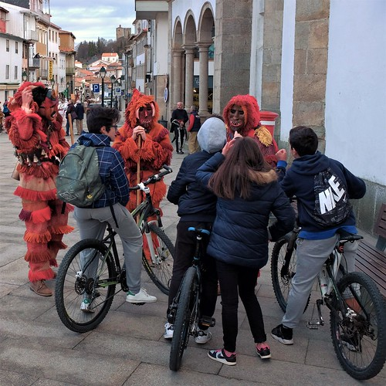
Replicability and Scalability
Commercialization poses a risk to cultural authenticity, while a shortage of skilled artisans makes producing traditional costumes and masks more difficult.
International collaboration with other UNESCO-listed festivals can boost tourism and funding. Educational programs and workshops in schools and cultural institutions help preserve the tradition.
Merchandising and branding—such as careto-themed clothing, souvenirs, and digital content—can increase revenue. Extending festivities year-round and developing virtual or augmented reality experiences can sustain engagement and broaden audience reach.
WHERE HERITAGE
MEETS COMMUNITY
This Photo by Unknown Author is licensed under CC BY-NC-ND
#CreativeEurope

Slide 21
Key Conclusions & Takeaways
The festival keeps an ancient tradition alive, involving youth and artisans to maintain authenticity, of the festival the is recognized by UNESCO.
Generates tourism revenue, supports local businesses, and boosts demand for traditional costumes, ensuring the use of sustainable production methods and training new artisans is essential.
Organized by the local association with strong resident and emigrant participation, evolvement of the youth for participation and also in the creation of the costumes for preservation of the tradition.
The rural depopulation, funding limitations, and balancing tradition with commercialization, are the biggest challenges for the preservation of the tradition.
WHERE HERITAGE
MEETS COMMUNITY
#CreativeEurope

Slide 22

Thank You !
WHERE HERITAGE
MEETS COMMUNITY

