Slide 1


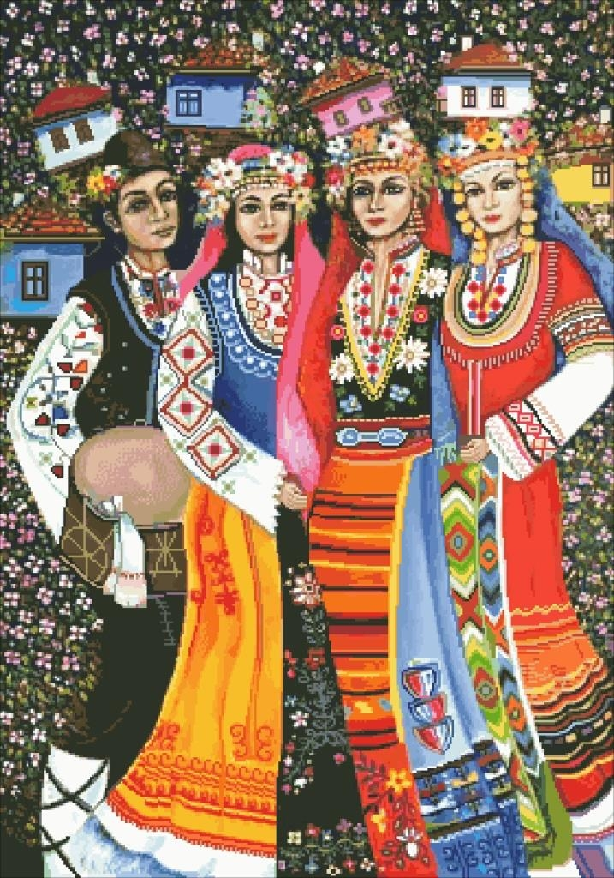
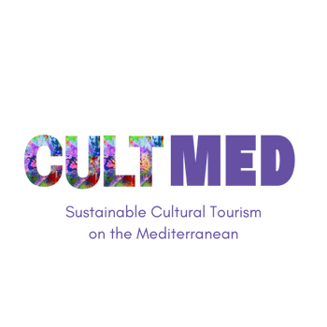

Vevčani Lazarki
Vevčani, Southwestern Region, North Macedonia
Key Focus: Community-led safeguarding of intangible cultural heritage, intergenerational transmission, and gender-inclusive ritual practice
#CreativeEurope

Slide 2
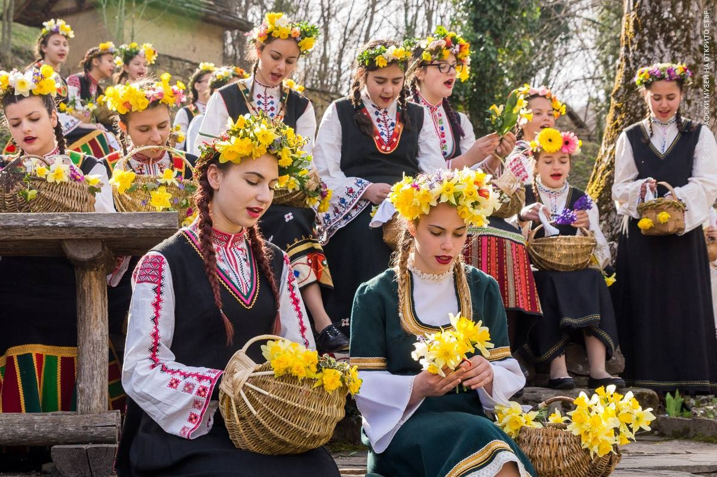
The Vevčani Lazarki is a revived traditional celebration of Lazarus Saturday (Lazarska Sabota), once again taking root in the village of Vevčani, nestled in the foothills of the Jablanica mountain, North Macedonia. After nearly 65 years of silence, this cherished ritual was reintroduced in 2022 thanks to the efforts of local cultural organizations and residents. The celebration honors pre-Easter customs related to springtime, fertility, and young women's social rites of passage. Featuring girls dressed in traditional Vevčani attire, singing ritual songs and visiting homes to bless households, the practice fosters community identity, intangible heritage transmission, and intergenerational connection.
More than just a folkloric event, the Vevčani Lazarki reflects a broader movement of cultural revival, where local traditions are reimagined and re-integrated into modern community life, offering both cultural continuity and potential for sustainable cultural tourism.

Slide 3






Introduction
Name of the Practice: Vevčani Lazarki
Location: Vevčani, Southwestern Region, North Macedonia
Type: Cultural revival, intangible heritage transmission, springtime ritual tradition
Initiating Organization: Cultural Art Association "Drimkol", local female elders, residents, and youth of Vevčani
Year of Establishment: Revived in 2022 (original tradition dates back generations, last performed in the 1950s)
Current Status: Ongoing (annually in April, during Lazarus Saturday – Lazarska Sabota)
WHERE HERITAGE
MEETS COMMUNITY
#CreativeEurope

Slide 4
Primary Goals
Revitalize an endangered tradition by reviving the spring ritual of Lazarki after 65 years of silence, reinforcing the cultural continuity of Vevčani.
Promote sustainable cultural tourism centered around women-led heritage practices, contributing to local tourism diversification.
Support local community participation by engaging girls, families, and cultural groups in song, costume-making, and hospitality rituals.
Safeguard intangible cultural heritage by transmitting oral traditions, ritual songs (lazarski pesni), and community customs to younger generations.
Create opportunities for youth and women to play a central role in shaping and sustaining cultural identity through performance and celebration.
Key Focus Areas
Safeguarding intangible heritage through revival of traditional spring rituals, symbolic songs (lazarski pesni), and oral storytelling passed down through generations.
Women’s cultural leadership, emphasizing the role of girls and women in shaping, performing, and sustaining living heritage.
Intergenerational knowledge transfer through community-based workshops, traditional costumes, and collective rehearsal processes.
Community resilience and visibility, reintroducing the ritual as a source of pride, social unity, and local cultural identity.
Rural cultural tourism grounded in authenticity, seasonality (spring), and respectful interaction between visitors and local traditions.
Current Status
Successfully revived after more than six decades, the Lazarki ritual has re-emerged as a meaningful cultural practice, drawing growing attention from the public, media, and heritage circles.
Actively supported by CAA Drimkol and the Municipality of Vevčani, the initiative engages local youth, women, educators, and cultural activists in its planning and delivery.
Recognized for its contribution to gender-inclusive heritage safeguarding and community revitalization, and increasingly integrated into local cultural strategies and public discussions.
Positioned for EU and national cultural funding, thanks to its alignment with sustainable tourism, intergenerational learning, and intangible cultural heritage preservation..

Slide 5
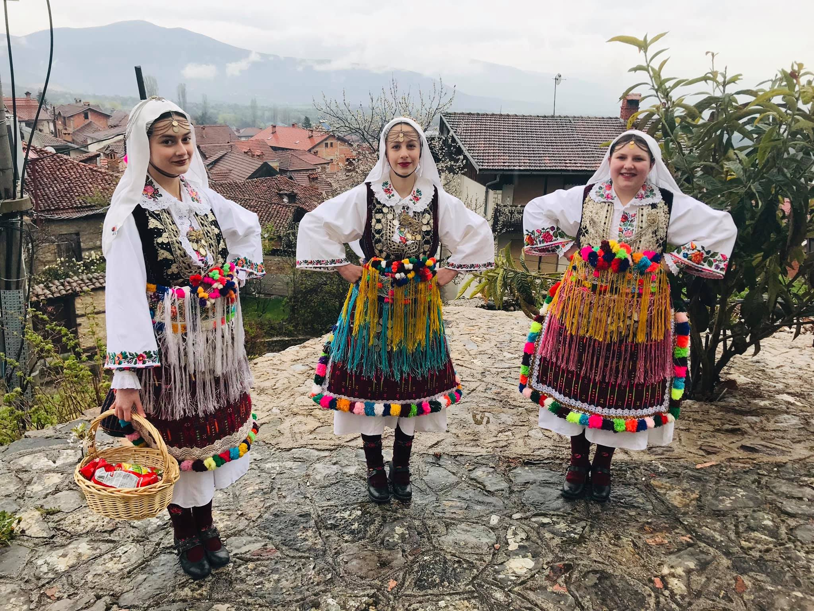
Activities Involved:
Traditional Singing and Dancing: Groups of young women dressed in embroidered folk costumes perform ritual Lazarki songs and dances as they move from house to house, blessing the homes for prosperity and health.
House-to-House Ritual Visits: The Lazarki girls follow a ceremonial route through the village, stopping at each home to perform blessings. In return, they are welcomed with gifts such as food, eggs, or money — a revival of a centuries-old reciprocal tradition.
Costume Revival and Heritage Embroidery: Local women and artisans collaborate in preparing traditional garments, preserving embroidery techniques and authentic attire passed down through generations.
Storytelling and Oral Heritage Transmission: Elders and community members share stories about past Lazarki celebrations, ensuring that younger generations understand the meaning and symbolism behind the songs and rituals.
Community Celebration and Gathering: The event culminates in a communal gathering where locals celebrate together, strengthening social ties and reinforcing shared identity through music, food, and dance.
The Practice
WHERE HERITAGE
MEETS COMMUNITY
#CreativeEurope

Slide 6
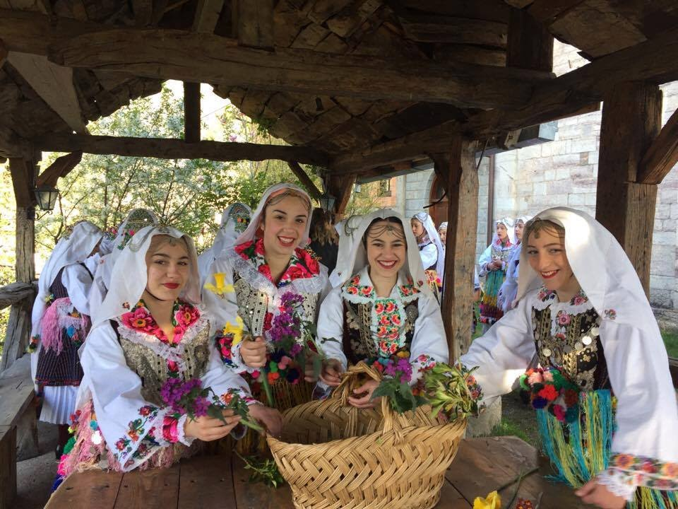
Target Groups:
Cultural heritage travelers interested in authentic rituals, folk music, and traditional dress within living village traditions.
Ethnographic and cultural tourism groups seeking meaningful insight into local customs, community storytelling, and seasonal rites.
Families, educators, and youth organizations looking to engage in educational rural experiences centered on folklore and intergenerational learning.
Diaspora members and local residents who participate in preserving and reviving the Lazarki as a symbol of shared identity and memory.
Researchers, cultural practitioners, and institutions focused on intangible heritage, gendered ritual practices, and community-led preservation.
The Practice
WHERE HERITAGE
MEETS COMMUNITY
#CreativeEurope

Slide 7
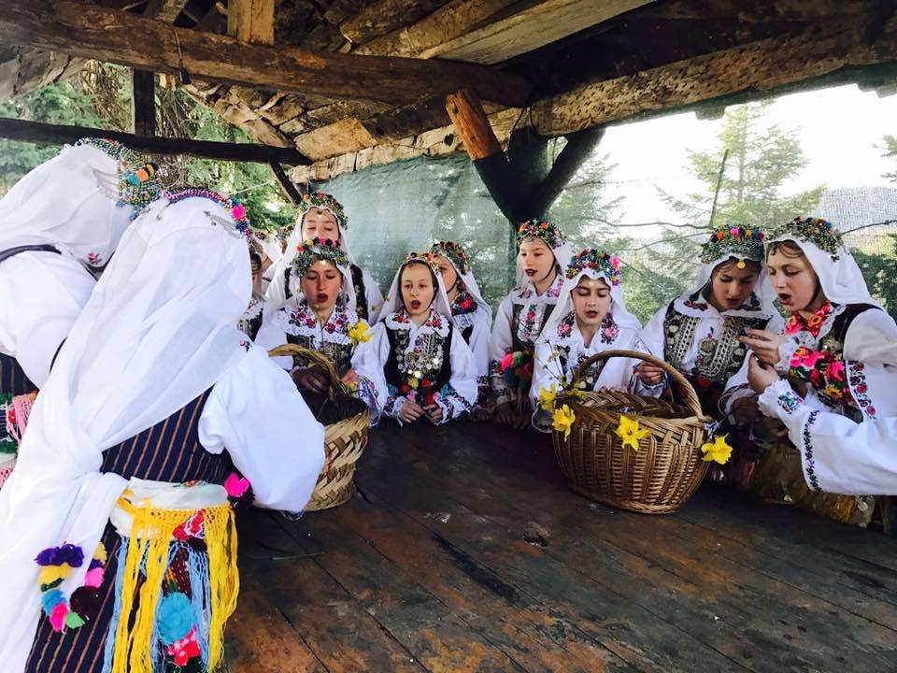
Stakeholders Involved:
Local women and girls performing the Lazarki songs and rituals, preserving oral traditions, and embodying intangible cultural heritage.
Cultural Art Society “Drimkol” facilitating revival efforts, documentation, coordination, and public presentation of the ritual.
Elders and tradition bearers transmitting knowledge, stories, and songs to younger generations through informal mentorship and family memory.
Municipality of Vevčani supporting the initiative through cultural planning, public recognition, and heritage safeguarding.
Community-based associations and educators engaged in cultural mediation, school collaborations, and awareness-raising.
Diaspora members and returning residents contributing to the event’s renewal by reconnecting with roots and supporting intergenerational continuity.
National and regional media outlets amplifying visibility and promoting the Lazarki tradition as part of cultural tourism narratives.
The Practice
WHERE HERITAGE
MEETS COMMUNITY
#CreativeEurope

Slide 8
Local Benefits and Impact
ECONOMIC IMPACT
CULTURAL IMPACT
ECONOMIC IMPACT
Supports the local economy by attracting visitors during the Easter season who spend on local food, crafts, and services.
Reinforces short supply chains by engaging local women, artisans, musicians, and small-scale producers in the preparation and celebration of the Lazarki ritual.
Contributes to economic revitalization of rural Vevčani by encouraging low-impact, culturally driven tourism in springtime.
Appeals to heritage-driven and responsible travelers who value authenticity and contribute to local enterprises and households.
Revives and promotes a nearly forgotten intangible cultural heritage, deeply rooted in ritual, oral tradition, and local identity.
Celebrates the community’s musical and performative traditions through Lazarus Day songs, traditional dress, and ritual movement across the village.
Provides a platform for women and youth to engage in storytelling, performance, and heritage transmission through intergenerational participation.
Strengthens local pride and identity, re-establishing the Lazarki tradition as an active part of Vevčani’s cultural calendar.
WHERE HERITAGE
MEETS COMMUNITY
#CreativeEurope

Slide 9
Local Benefits and Impact
ENVIRONMENTAL IMPACT
SOCIAL IMPACT
ECONOMIC IMPACT
Minimizes environmental impact by following a walkable, community-based route through Vevčani’s traditional neighborhoods, requiring no motorized transport.
Promotes eco-friendly habits through the use of biodegradable floral wreaths, natural fabrics, and handmade decorations sourced locally.
Limits waste through community-led coordination, encouraging reusable items and avoiding disposable plastics during the procession.
Strengthens environmental awareness via symbolic springtime rituals rooted in nature reverence, such as blessings of water and land.
Safeguards Vevčani’s natural and cultural setting by maintaining a small-scale, non-commercial format that avoids overdevelopment and preserves village authenticity.
Strengthens community cohesion by involving girls, families, elders, and local cultural actors in all stages of preparation and performance, fostering a sense of shared identity and intergenerational connection.
Contributes to rural revitalization by reviving a long-dormant tradition, creating meaningful seasonal engagement, and offering opportunities for youth participation and cultural education.
Promotes inclusive and respectful cultural tourism that values traditional female-led rituals, oral heritage, and authentic village life, encouraging visitors to engage with the community in a mindful way.
Acts as a cultural and emotional bridge, bringing together local residents, diaspora, and visitors through the celebration of spring, cultural memory, and collective storytelling, reinforcing social solidarity and pride.
WHERE HERITAGE
MEETS COMMUNITY
#CreativeEurope

Slide 10
Visitors Benefits and Impact
Cultural Engagement & Education
Immersive cultural learning: Visitors experience a rare, revitalized tradition by witnessing or participating in ritual songs, dances, and symbolic performances passed down through generations of women in Vevčani.
Meaningful, emotional experience: The Lazarki celebration offers an intimate and deeply moving atmosphere tied to spring, renewal, and local folklore, creating lasting memories rooted in authenticity and spirituality.
Inspiration for ethical travel: The revival of the Lazarki ritual highlights community empowerment, inviting visitors to engage with heritage respectfully and support slow, sustainable, and community-led tourism.
Connection with place: Guests become part of a unique local story, strengthening appreciation for intangible heritage and forming emotional ties with Vevčani’s landscape, people, and cultural identity.
Behavioral Impact on Visitors & immersive experience
  Fosters cultural humility by immersing visitors in a female-led ritual that emphasizes respect for tradition, nature, and community values, challenging modern stereotypes and showcasing authentic rural identity.
  Encourages slow, mindful mobility as guests follow the procession on foot through the village, deepening their connection with the environment and promoting sustainable travel habits.
  Inspires long-term reflection by engaging visitors in a participatory, intergenerational tradition rooted in symbolic gestures, local storytelling, and spiritual meaning, encouraging new perspectives on culture, community, and continuity.
WHERE HERITAGE
MEETS COMMUNITY
#CreativeEurope

Slide 11
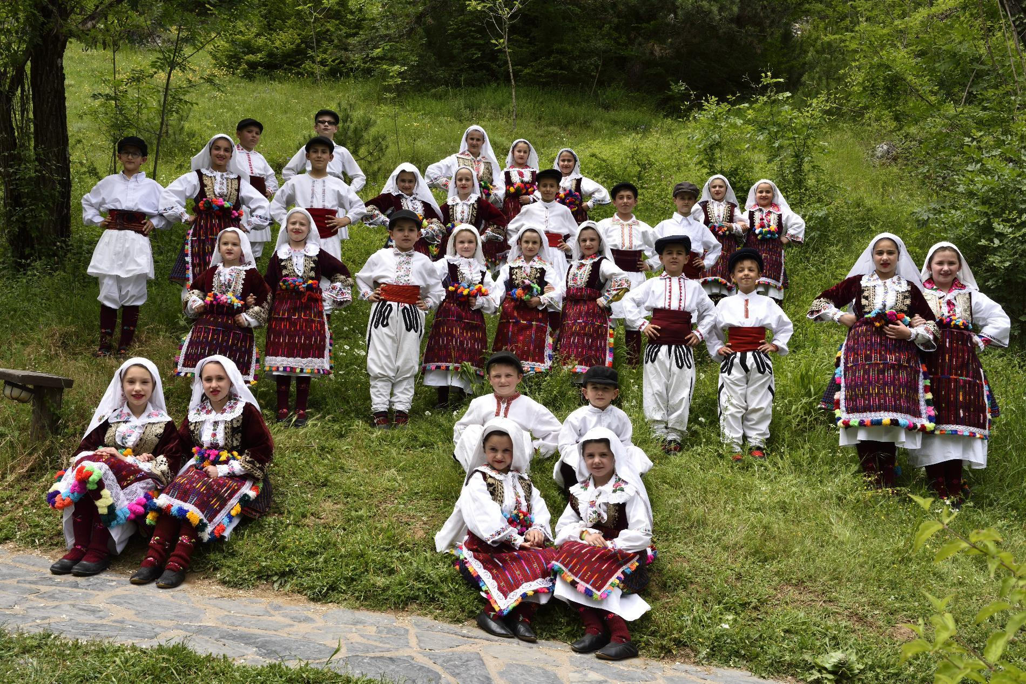
Sustainability Measures
Cultural Preservation
The Vevčani Lazarki tradition is a vibrant form of intangible cultural heritage, safeguarded through active community engagement rather than institutional frameworks. It preserves local identity by maintaining centuries-old spring rituals, traditional songs, and ceremonial costumes passed down through oral tradition and lived practice. Instead of staging culture for tourists, it offers an authentic, co-created experience led by local women and girls of Vevčani.
The practice ensures continuity by involving younger generations in singing, choreography, costume-making, and community storytelling—allowing the tradition to evolve while remaining rooted in its cultural soul.
WHERE HERITAGE
MEETS COMMUNITY
#CreativeEurope

Slide 12
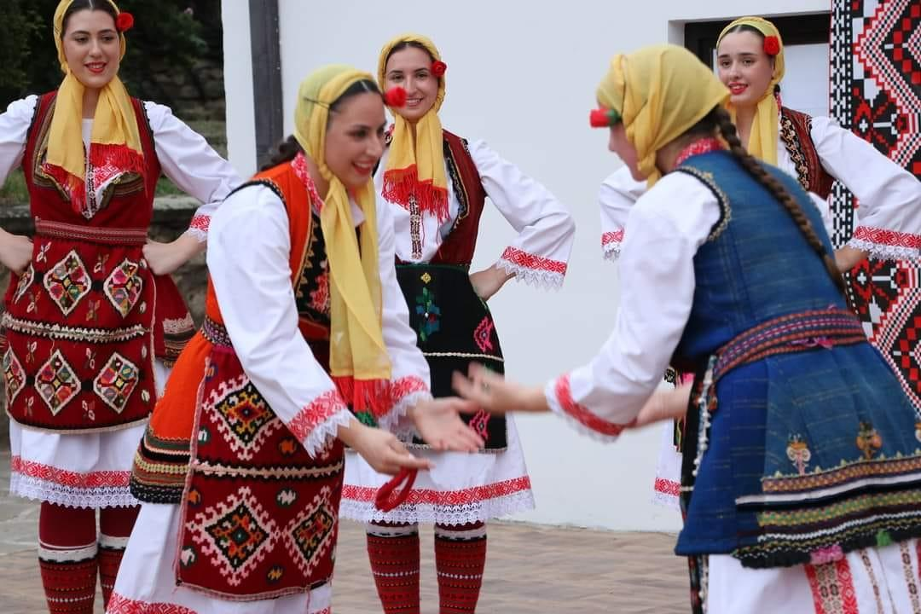
Sustainability Measures
Economic Sustainability
The Vevčani Lazarki tradition strengthens the local economy by anchoring tourism and cultural activity revenues within the village. It stimulates short local supply chains by involving women performers, local musicians, artisans, and food producers — all deeply rooted in the community’s social fabric.
This model supports rural entrepreneurship, empowers women through cultural leadership, and retains economic value locally. By taking place during springtime, the Lazarki celebration contributes to seasonal income diversification, helping the village maintain economic balance and resilience throughout the year.
WHERE HERITAGE
MEETS COMMUNITY
#CreativeEurope

Slide 13
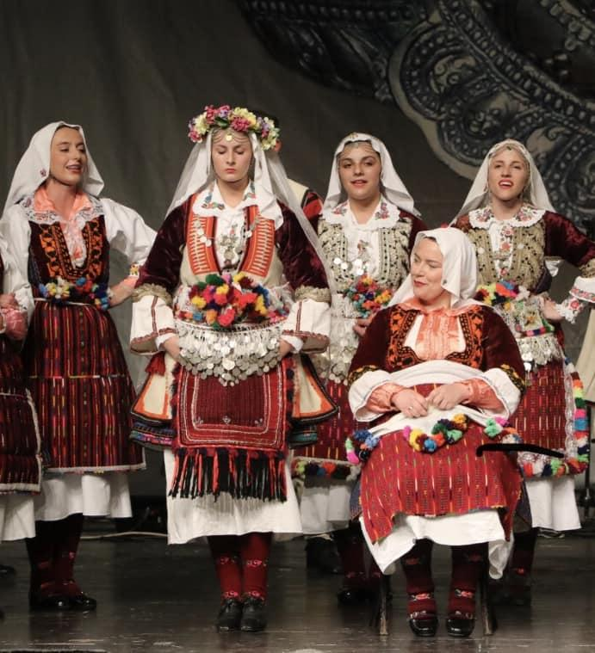
Sustainability Measures
Resource Preservation
The Vevčani Lazarki tradition reflects a strong commitment to environmental stewardship by embedding sustainable practices into its celebration. The event promotes:
Eco-friendly materials: Traditional garments and floral accessories are crafted from natural, biodegradable, and locally sourced materials, showcasing respect for nature and reducing environmental impact.
Minimal waste generation: Lazarki activities prioritize the use of reusable and compostable elements, while encouraging participants and spectators to avoid single-use plastics and maintain a clean environment.
Preservation of natural surroundings: By utilizing village pathways, courtyards, and open fields, the celebration preserves the authenticity and ecological balance of Vevčani's natural and built environment.
Promotion of sustainable transportation: The event is walkable and centered within the village, allowing visitors to move around on foot and reducing the need for motorized transport, which lowers emissions and enhances connection with place.
WHERE HERITAGE
MEETS COMMUNITY
#CreativeEurope

Slide 14
Community Involvement
Local Institutions & Cultural Organizations
Municipality of Vevčani, Cultural Society “Drimkol”, Multicultural Center “Kosta Srbakoski”
Lead the coordination and revival of the Lazarki tradition as part of local heritage preservation
Provide institutional support, visibility, and cultural recognition at municipal and national levels
Facilitate community engagement and access to funding for youth participation and event continuity
Advocate for the safeguarding of intangible heritage linked to seasonal customs and female-led ritual practices
Local Artisans, Businesses & Producers
Offer traditional attire, floral wreaths, handicrafts, and homemade food during the Lazarki celebration
Contribute to the economic vitality of the event through seasonal services and small-scale trade
Highlight the culinary and artisanal heritage of the region, including springtime sweets and herbal products
Strengthen the practice’s sustainability by sourcing locally, supporting women-led initiatives, and promoting circular economy principles
Local Residents, Volunteers, and Lazarki Groups
Rehearse and perform traditional songs and dances passed down through generations of women
Host communal preparations in households, involving costume-making, flower-gathering, and baking
Safeguard cultural authenticity through oral tradition, seasonal symbolism, and ritual choreography
Welcome guests with songs, blessings, and storytelling, offering intimate contact with local heritage
Guide the revival of the tradition through informal leadership, family networks, and collective action
WHERE HERITAGE
MEETS COMMUNITY
#CreativeEurope

Slide 15
Monitoring, Evaluation and Financing
Evaluation Metrics
Number of participants (local girls/women involved in the ritual and performances)
Audience and visitor engagement (local attendance, diaspora interest, tourist observations)
Media visibility and online presence (coverage by regional media, Facebook reach, YouTube video views)
Economic indicators (e.g., local artisan sales, hospitality revenue during the Lazarki period)
Community participation metrics (households visited, songs performed, traditional clothing used)
Heritage transmission indicators (youth involvement, intergenerational learning activities)
Environmental and sustainability metrics (e.g., waste reduction efforts, use of natural costumes/materials)
Feedback Mechanisms
Surveys shared with residents, households visited, and local observers to gather impressions and ideas for improvement
Youth focus groups with girls who participated as Lazarki to reflect on their experience and collect input for future editions
Community assemblies held post-event to evaluate outcomes, document lessons learned, and co-design next steps
Informal consultations through local NGOs, women's associations, and cultural heritage advocates (e.g., Drimkol)
Continuous Improvement
Reviving and adapting rituals annually in alignment with evolving community values and intergenerational input
Introducing sustainable elements such as reusable props and natural fabrics for costumes (e.g., locally sourced linen)
Expanding visibility and outreach by translating songs, rituals, and event materials into multiple languages
Forging partnerships with heritage networks, regional tourism actors, and educational institutions for support and growth
Funding Sources
Municipality of Vevčani – provides core funding, event coordination, and logistical support
Ministry of Culture of North Macedonia – offers cultural preservation grants and revival project support
Local sponsors and small businesses – contribute through donations, services, and in-kind materials (e.g., traditional attire, catering)
Occasional EU and donor project support – via initiatives focusing on intangible cultural heritage and community empowerment
WHERE HERITAGE
MEETS COMMUNITY
#CreativeEurope

Slide 16
Replicability and Scalability
Transferability
  The Lararki Ritual Procession offers an adaptable model for other communities aiming to preserve and promote intangible cultural heritage through participatory and community-led events.
  What can be transferred:
  Community-led organizational model rooted in intergenerational participation
  Integration of pre-Christian rituals with contemporary cultural expression
  Use of symbolic performance and folklore to foster cultural dialogue and collective memory
  Active involvement of multiple age groups in event design, storytelling, and performance
  Environmentally responsible visitor engagement and locally embedded experiences
  Contexts for replication:
  Small rural communities with strong folk traditions and seasonal rituals
  Areas seeking to revitalize rural economies through winter or early spring tourism
  Villages aiming to promote heritage-based tourism through local festivals, folklore, and symbolic performances
Challenges & Barriers
Cultural Sensitivity & Appropriation
Risk of misinterpretation or decontextualization of Lararki’s sacred and symbolic rituals if reproduced outside their original setting or meaning.
Funding Sustainability
The event often relies on local contributions, voluntary work, and limited public support, creating financial unpredictability for long-term planning.
Infrastructure Limitations
The village’s small accommodation capacity and limited transport connectivity may pose constraints for scaling up the event sustainably.
Weather Dependency
As a winter ritual linked to seasonal cycles, Lararki is vulnerable to adverse weather, which can affect participation, visibility, and safety.
Preservation vs. Commercialization
Maintaining the authenticity and community spirit of Lararki while accommodating growing interest from outsiders requires careful cultural stewardship.
Potential for Expansion
Regional Scaling
Joint promotion with other winter festivals in the Balkans or creation of a cross-border “intangible heritage trail” featuring ritual-based events.
Development of a Lararki Heritage Hub offering year-round workshops, exhibitions, and youth programs to ensure continuity and visibility.
International Networking
Potential nomination for UNESCO’s Intangible Cultural Heritage list as a unique example of seasonal ritual continuity and community engagement.
Participation in European ritual heritage networks to exchange knowledge, amplify visibility, and promote responsible tourism.
Youth & Creative Engagement
Co-creation programs with local youth, art schools, and folklore associations to pass on skills like mask-making, singing, and symbolic storytelling.
Use of digital platforms for documentation, educational storytelling, and interactive content to bring Lararki to global audiences in respectful and engaging ways.
WHERE HERITAGE
MEETS COMMUNITY
#CreativeEurope

Slide 17
Key Conclusions & Takeaways
Lazarki embodies a model of sustainable cultural tourism, weaving together ancient seasonal traditions with contemporary community leadership and environmental care.
With roots in centuries-old rituals tied to spring and fertility, Lazarki stands as a rare living heritage practice, enriched by symbolic storytelling, intergenerational knowledge sharing, and vibrant folklore expression.
Community participation is at the heart of Lazarki — families, local artists, youth, and cultural institutions co-create, preserve, and celebrate the tradition collectively.
Sustainability is embedded across the practice: activities emphasize low environmental impact, support local economies, and foster strong social bonds within and beyond the community.
Visitors benefit from meaningful, immersive experiences — gaining deep understanding of local traditions, participating in eco-conscious celebrations, and engaging respectfully with living heritage.
Lazarki shows high potential for replication and adaptation in other rural contexts that seek to promote community-led tourism rooted in intangible heritage.
Digital tools and regional cooperation (e.g., through EU networks such as Creative Europe, CERV, Interreg) help amplify its visibility and enable cross-border collaborations for greater impact.
Challenges remain, such as ensuring stable funding and safeguarding authenticity in the face of external interest — yet Lazarki continues to demonstrate cultural resilience, adaptability, and community strength.
WHERE HERITAGE
MEETS COMMUNITY
#CreativeEurope

Slide 18
Thank You !
WHERE HERITAGE
MEETS COMMUNITY

Slide 19
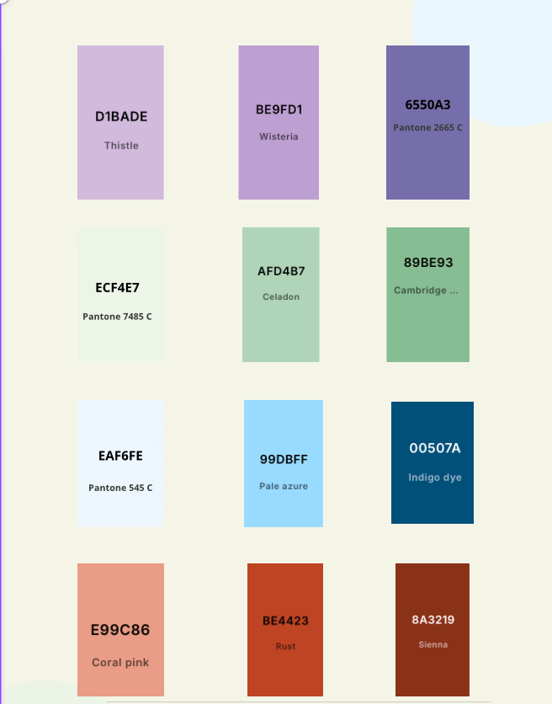
WHERE HERITAGE
MEETS COMMUNITY
#CreativeEurope

