Slide 1


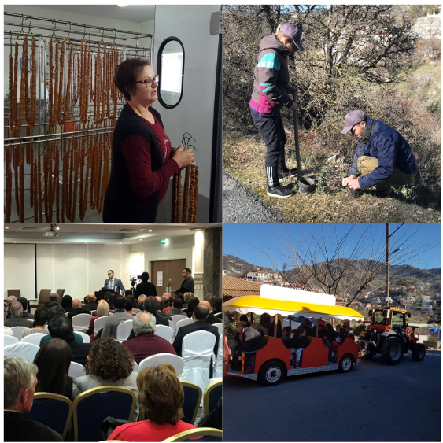


Greening Cyprus for a Sustainable Future – CSTI’s AGM 2020
Subtitle: Agros Village and Cultural Event
#CreativeEurope

Slide 2
Introduction
The primary goals of this event were to:
Promote sustainable tourism and cultural heritage by highlighting Agros' local traditions, products and environmentally friendly practices.
Support local producers and businesses by creating opportunities for networking and collaboration between farmers, artisans, tourism stakeholders and policymakers.
Raise awareness of environmental sustainability through discussions on climate action, waste reduction and responsible tourism development.
Encourage responsible tourism policies by engaging local authorities, businesses and organizations in dialogue about rural economic development.
Key Focus Areas
Cultural and Heritage Preservation: Showcasing Agros' traditional products, crafts and culinary heritage.
Economic Development: Supporting local producers and small businesses by promoting their products and fostering business connections.
Environmental Sustainability: Encouraging eco-friendly tourism practices, waste reduction and climate-conscious policies.
Community Engagement & Networking: Bringing together local producers, tourism operators, policymakers and visitors to exchange knowledge and strengthen partnerships.
WHERE HERITAGE
MEETS COMMUNITY
#CreativeEurope

Slide 3
Introduction
First Initiated in 2008 – CSTI has been hosting AGM meetings with local producers in various marginalised rural villages (i.e. Anogyra, Droushia, Simou, Troodos, Platres, Vavatsinia, Sotira, Phoini, Skarinou etc.).
2020 AGM in Agros as a Best Practice: Hosted ~150-200 participants reinforcing its role as a key networking and development event for rural communities. Similar number of participants each year.
Status: Completed (2008-2020), with potential for revival. While the AGM series concluded in 2020, CSTI in collaboration with other certain villages is considering reviving similar events in the near future, reinforcing its commitment to supporting local producers and promoting sustainable tourism in rural Cyprus.
Initiating Organizations
The event was organized and led by the Cyprus Sustainable Tourism Initiative (CSTI) in collaboration with Agros Municipality, Rodon Hotel, local producers and tourism industry stakeholders
WHERE HERITAGE
MEETS COMMUNITY
#CreativeEurope

Slide 4
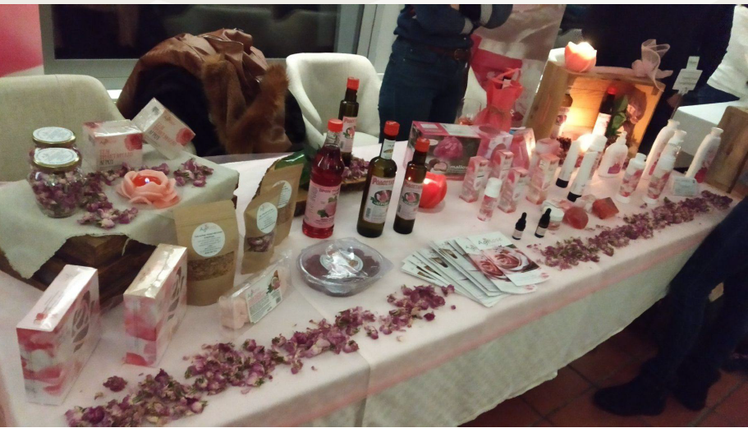
The Practice
“Greening Cyprus for a Sustainable Future” by CSTI (2020), was an annual general meeting (AGM) and networking event held in Agros Village in 2020, as part of a long-running series of events (2008-2020) that promoted sustainable tourism and rural economic development in Cyprus. Organized by the Cyprus Sustainable Tourism Initiative (CSTI), the event brought together local producers, stakeholders within the tourism sector, policymakers and sustainability advocates to discuss and promote eco-friendly tourism practices, responsible rural development and the role of local products in tourism.
This continues series of event aimed to support marginalized rural communities by providing networking opportunities for small-scale producers and artisans, strengthening the connection between local businesses and the tourism industry. However, it also served as a platform for discussing climate-conscious policies, waste reduction and sustainable tourism strategies in Cyprus.
WHERE HERITAGE
MEETS COMMUNITY
#CreativeEurope

Slide 5
The Practice
Key Needs Addressed
Limited exposure and business opportunities for rural producers.
Stronger connections needed between communities, tourism, and policymakers.
Sustainable tourism development in marginalized areas.
Encouraging eco-friendly tourism and responsible business practices.
Activities Involved
Panel Discussions: Experts and policymakers shared insights on sustainable tourism.
Local Producers’ Exhibition: Farmers and artisans networked with tourism businesses.
Eco-Tourism Talks: Sessions on responsible travel and waste management.
Workshops: Hands-on food tastings, craft demonstrations and organic farming sessions.
Site Visits: Attendees explored landmarks, wineries and local artisan workshops.
Networking & Policy Discussions: Government and industry leaders strategized on rural sustainability.
Target Groups & Stakeholders
Local Producers & Artisans: Marketed products, building business connections.
Tourism Industry Professionals: Integrated local products into tourism services.
Local Authorities & Policymakers: Developed strategies for sustainable tourism.
Environmental Organizations & NGOs: Advocated for green initiatives.
Community Members & Visitors: Engaged in cultural exchange and sustainability efforts.
Partnerships (i.e. CSTI, Agros Municipality, Stakeholders within the tourism industry etc): Ensured event success and alignment with sustainability goals.
WHERE HERITAGE
MEETS COMMUNITY
#CreativeEurope

Slide 6
Local Benefits and Impact
Economic Impact
The event played a crucial role in supporting local businesses and producers, generating both direct and indirect economic benefits for the Agros community:
Increased Sales & Exposure for Local Producers: Farmers, food producers and artisans showcased and sold their products to hoteliers, restaurateurs and tourists, expanding their market reach and business opportunities.
Boosted Revenue for Local Hospitality & Services: The event attracted ~150-200 participants, benefiting local accommodations, restaurants, cafés and transportation services.
Strengthened Business Networks: Producers engaged in networking sessions with tourism professionals, leading to potential long-term partnerships and product placements in hotels, restaurants and souvenir shops.
Encouraged Sustainable Business Growth: By promoting eco-friendly tourism and local product integration, the AGM encouraged businesses to adopt sustainability-focused strategies that support long-term economic resilience.
WHERE HERITAGE
MEETS COMMUNITY
#CreativeEurope

Slide 7
Local Benefits and Impact
Cultural Impact
The AGM emphasized the preservation and promotion of local culture and traditions, reinforcing Agros’ identity as a rural tourism destination:
Showcased Traditional Cypriot Products: Attendees experienced Agros’ signature rose products, local wines and artisanal goods, strengthening appreciation for local craftsmanship and agricultural heritage. Revitalized Interest in Traditional Crafts & Practices: Workshops and demonstrations featured traditional food preparation, handicrafts and organic farming, helping to preserve cultural knowledge and pass it on to younger generations. Positioned Agros as a Cultural Tourism Destination: The event highlighted Agros’ rich history, local traditions and its potential for heritage tourism, drawing attention to the village beyond the AGM. Strengthened Community Pride: By celebrating Agros’ cultural heritage and economic potential, the event helped reinforce local identity and pride in traditions.
WHERE HERITAGE
MEETS COMMUNITY
#CreativeEurope

Slide 8
Local Benefits and Impact
Environmental Impact
Sustainability was a core theme of the AGM, with strong eco-conscious initiatives and discussions aimed at minimizing environmental footprints and promoting conservation efforts:
Promoted Sustainable Tourism Practices: Panel discussions and expert presentations emphasized responsible travel, waste reduction and climate-conscious tourism strategies. Encouraged Waste Reduction & Eco-Friendly Packaging: Local producers were introduced to sustainable packaging solutions to reduce plastic waste in tourism-related products. Advocated for Conservation & Biodiversity Protection: The event addressed the importance of protecting Cyprus’ natural landscapes, with a focus on sustainable rural tourism models. In collaboration with Agros Friends of the Forest Association, 100 trees were planted, reinforcing climate resilience, biodiversity protection, and environmental awareness. Supported Local & Organic Farming: Workshops highlighted environmentally friendly agricultural practices, reinforcing the connection between tourism, local food production and conservation.
WHERE HERITAGE
MEETS COMMUNITY
#CreativeEurope

Slide 9
Local Benefits and Impact
Social Impact
Beyond its economic and cultural contributions, the AGM enhanced community well-being and inclusivity, strengthening social ties and rural resilience:
Empowered Local Producers & Small Businesses: The event provided marginalized producers and artisans with opportunities to showcase their work, helping them gain recognition and economic independence. Fostered Cross-Sector Collaboration: The event facilitated stronger connections between local communities, tourism operators, policymakers and sustainability advocates, creating a unified vision for sustainable rural development. Encouraged Youth & Community Participation: By promoting traditional skills, sustainability discussions, and business networking, the AGM engaged younger generations, inspiring future entrepreneurship in rural areas. Enhanced Community Spirit & Rural Tourism Advocacy: The event reinforced the value of local culture and traditions, fostering a sense of belonging and collective effort to make Agros and similar villages sustainable rural tourism hubs.
Sustainability Recognitions & Awards: Recognition through sustainability awards and certifications highlights Agros as a model for balancing tourism growth with conservation.
WHERE HERITAGE
MEETS COMMUNITY
#CreativeEurope

Slide 10
Visitors Benefits and Impact
Cultural Engagement and Education
The AGM Conference in Agros provided visitors with an immersive cultural experience, showcasing the region’s rich traditions, local craftsmanship and commitment to sustainability.
Key Experiences & Learning Opportunities:
Producers Fair & Traditional Delights: Visitors engaged directly with local artisans, food producers and sustainable businesses, learning about traditional Cypriot delicacies and eco-friendly production methods.
Guided Train Tour: Participants explored Agros’ key heritage and eco-tourism sites, visiting local producers:
- Niki Sweets (Traditional sweet production)
- Chris N. Tsolakis Rose Factory (Famous for rosewater and cosmetics)
- Cyprus Traditional Products Kafkalia (Organic farming & artisanal food)
Tree Planting Initiative: Visitors actively contributed to Agros’ environmental sustainability efforts by planting trees, reinforcing the importance of climate action and biodiversity conservation.
WHERE HERITAGE
MEETS COMMUNITY
#CreativeEurope

Slide 11
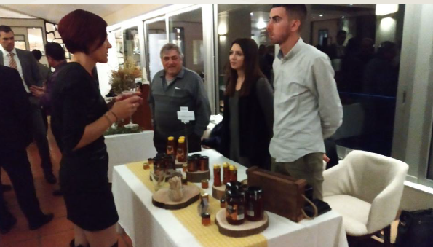
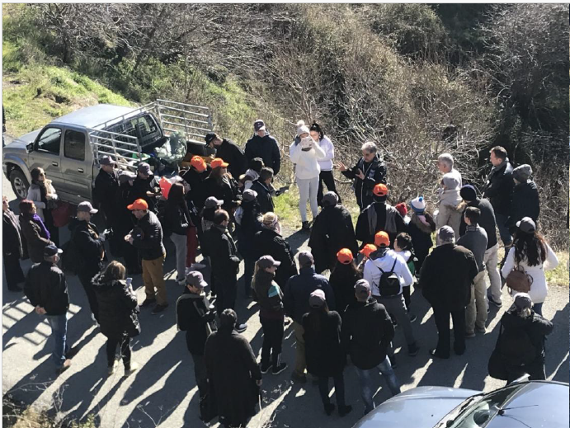
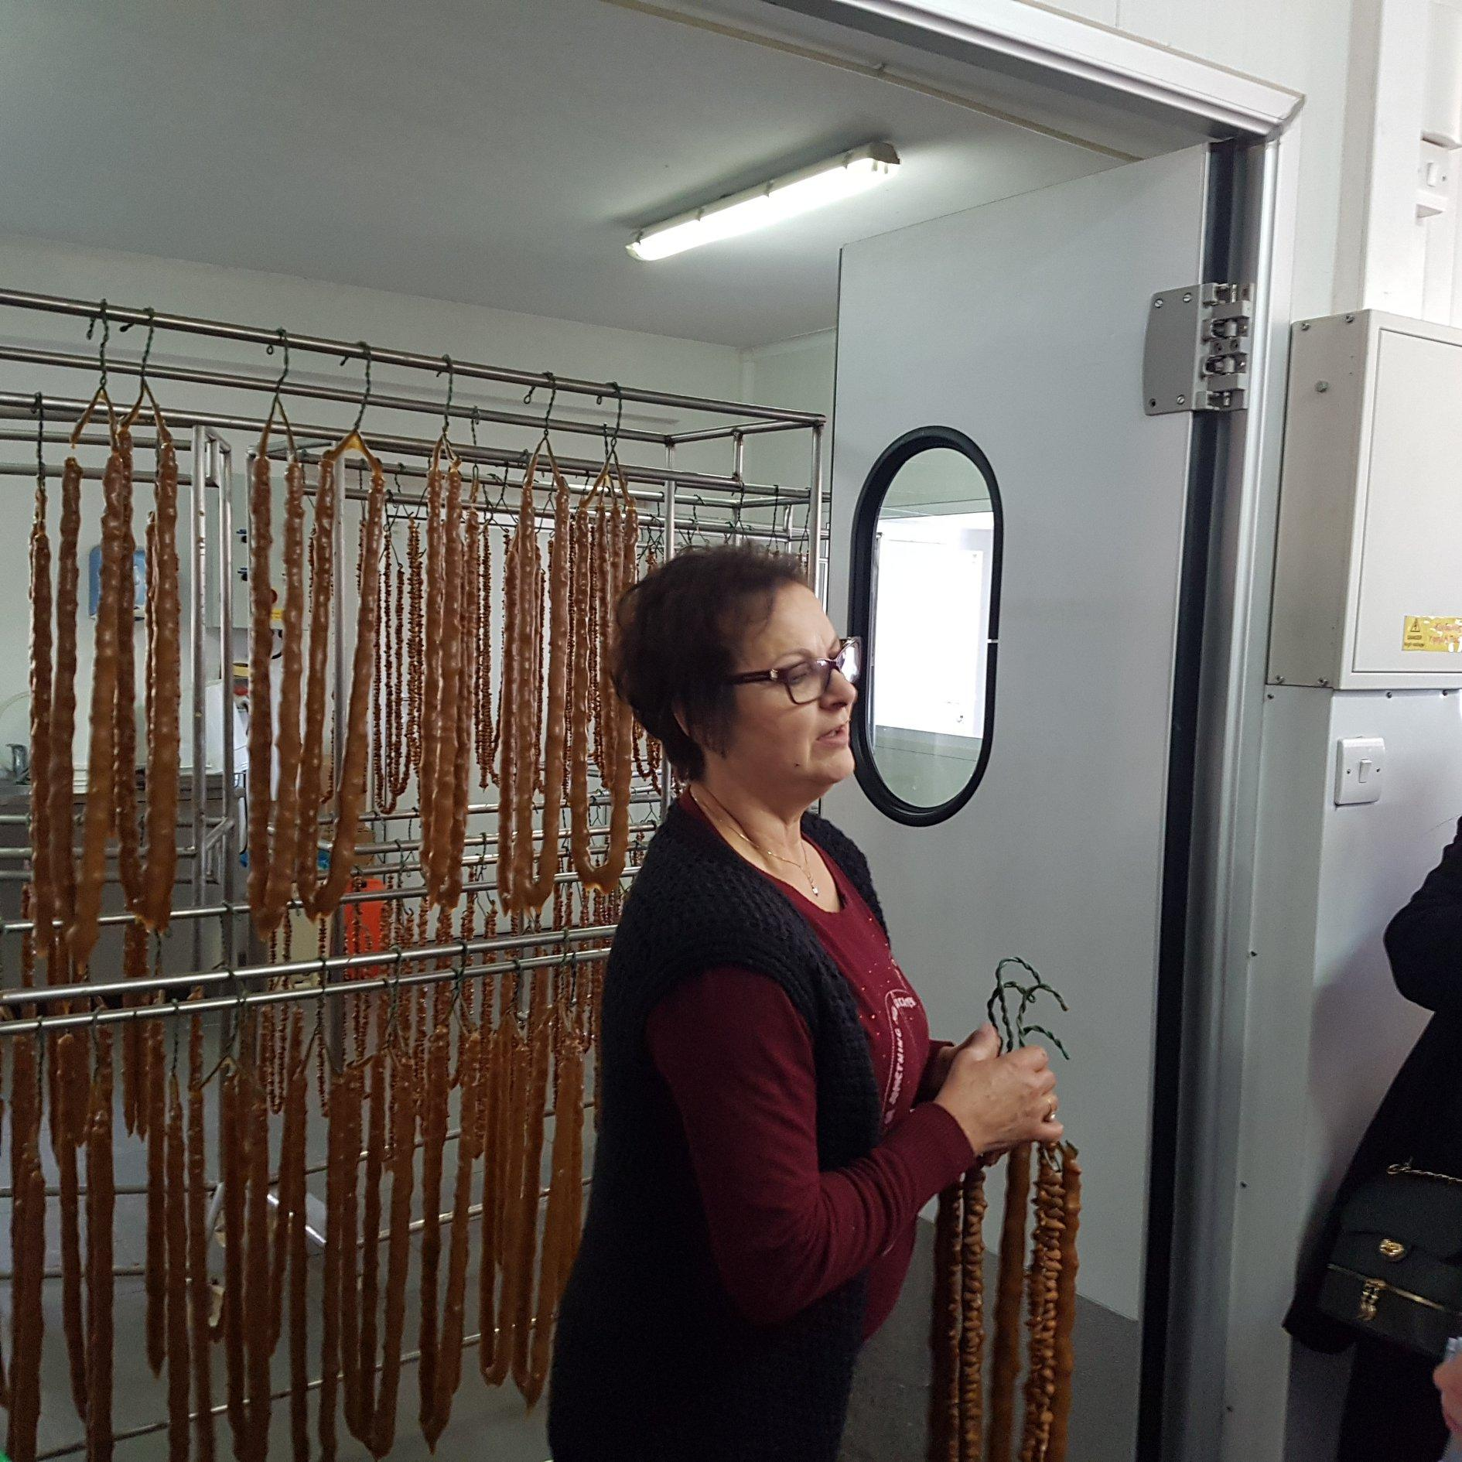
Visitors Benefits and Impact
WHERE HERITAGE
MEETS COMMUNITY
#CreativeEurope

Slide 12
Visitors Benefits and Impact
Behavioral Impact on Visitors
The event inspired visitors to adopt more responsible tourism behaviors and support local economies, directly aligning with SDG goals.
Supporting Small, Local Businesses: Visitors purchased handmade and organic products directly from producers, boosting Agros’ rural economy (SDG 8: Decent Work & Economic Growth).
Raising Awareness on Sustainable Consumption: The fair and discussions encouraged eco-conscious choices by promoting zero-waste and sustainable production methods (SDG 12: Responsible Consumption & Production).
Climate Awareness & Conservation Efforts: By engaging in tree planting and sustainability talks, visitors learned about environmental conservation and sustainable rural development (SDG 13 & 15: Climate Action & Life on Land).
Fostering Sustainable Travel Habits: - Choosing eco-conscious tourism experiences.
- Supporting artisanal and traditional businesses instead of chain stores.
- Practicing waste reduction and responsible consumption in tourism.
WHERE HERITAGE
MEETS COMMUNITY
#CreativeEurope

Slide 13
Visitors Benefits and Impact
Immersive experience
Rather than being passive observers, visitors were active participants in Agros' cultural and environmental landscape, creating genuine connections with the local community.
Hands-On Workshops & Tastings: Visitors didn't just learn about local products; they participated in traditional cooking, organic farming demonstrations, and hands-on craft workshops.
Guided Tours & Village Exploration: Walking through Agros, visitors experienced daily life, historic landmarks, and the natural beauty of the village, making the experience authentic and personal.
Contributing to Sustainability & Community Development: Some participants purchased products directly from local artisans, supporting the rural economy.
Others expressed interest in returning for future agrotourism experiences, increasing long-term engagement with the village.
WHERE HERITAGE
MEETS COMMUNITY
#CreativeEurope

Slide 14
Sustainability Measures
The event placed a strong emphasis on celebrating and safeguarding local traditions. Through live demonstrations, traditional food tastings and hands-on workshops, visitors engaged with artisans and producers who showcased centuries-old craftsmanship. The tour of Agros Village via the local train immersed participants in the village’s cultural identity, allowing them to visit local producers (i.e. Niki Sweets, Chris N. Tsolakis Rose Factory, Cyprus Traditional Products Kafkalia). By directly engaging with these businesses, the event reinforced the value of tradition in a modern tourism landscape and encouraged the continued practice of local crafts.
Cultural Preservation
The AGM created a lasting economic impact by bridging the gap between small-scale rural producers and the tourism industry. Farmers, winemakers and artisans were given direct access to key tourism stakeholders, allowing them to explore business partnerships and new revenue streams. By promoting local over mass-produced, the initiative encouraged sustainable tourism models that benefit small businesses and rural communities beyond the event itself.
A key aspect of this commitment to local economic sustainability was the choice of venue (i.e. Rodon Hotel), a locally operated establishment built with the specific goal of creating jobs and supporting Agros’ economy. By hosting the event at a community-driven business, the AGM reinforced the importance of investing in local enterprises and ensuring that tourism revenue remains within the region, benefiting the people who live and work there.
Economic Sustainability
Sustainability efforts extended to the event’s environmental footprint, with a focus on responsible consumption, waste reduction and energy efficiency.
Electronic invitations and digital materials replaced printed documents, while recycling bins and a strict plastic-free policy minimized waste.
Food services sourced ingredients locally, eliminated single-use plastics and donated leftovers to charities, reducing both waste and environmental impact.
A tree-planting initiative with the Agros Friends of the Forest Association resulted in 100 new trees, reinforcing efforts toward climate action and biodiversity conservation.
Attendees were encouraged to carpool, reducing carbon emissions and promoting sustainable travel habits.
Resource Preservation
WHERE HERITAGE
MEETS COMMUNITY
#CreativeEurope

Slide 15
Community Involvement
Role of Local Community
Local communities play a crucial role in the success of sustainable tourism and event planning. Their direct involvement in decision-making, planning and execution ensures that tourism initiatives align with local values, preserve cultural heritage and provide meaningful benefits to residents. By actively engaging with local stakeholders, sustainable tourism efforts create opportunities for economic growth, cultural exchange and environmental stewardship.
One of the most effective ways to engage communities is through participatory decision-making. In sustainable event planning, local councils, community groups and small businesses are often consulted and directly involved in shaping event logistics. This ensures that activities reflect community priorities and that local voices are heard. For example, the organization of events in Agros Village involved collaboration with the Agros Friends of the Forest Association and local authorities, ensuring that sustainability initiatives (i.e. tree planting, responsible waste management) were fully integrated into the event framework.
Local communities are involved in showcasing their heritage and traditions. Sustainable events frequently incorporate guided tours to local producers and artisans, providing visitors with an immersive cultural experience while generating direct economic benefits for small businesses. Tours to sites allow participants to witness traditional craftsmanship, interact with local producers and develop a deeper appreciation for the region’s heritage. These interactions not only support local businesses but also foster ongoing community engagement, encouraging repeat visits and long-term relationships between visitors and hosts.
Education and networking also serve as critical tools for strengthening community involvement. Sustainable events create platforms where tourism professionals, local business owners and policymakers can connect, facilitating knowledge-sharing and collaboration. By organizing networking sessions, panel discussions and training programs, communities gain the necessary resources to further develop their sustainable tourism strategies.
WHERE HERITAGE
MEETS COMMUNITY
#CreativeEurope

Slide 16
Community Involvement
Ownership and Management
A key challenge in sustainable tourism is ensuring that economic benefits remain within the local community, rather than being extracted by foreign corporations or large commercial entities. Sustainable event planning prioritizes community ownership, co-management and leadership, creating structures that empower locals and minimize financial leakage.
One example of community-driven ownership is the selection of locally managed venues for hosting sustainable events. The Rodon Hotel in Agros Village serves as a model of community-based tourism infrastructure, as it was built with the specific goal of creating jobs and supporting Agros’ economy. By hosting large gatherings, conferences and tourism-related activities, the hotel generates employment opportunities and stimulates surrounding businesses, ensuring that financial gains stay within the community rather than being diverted to international chains.
Local businesses and artisans also play a key role in sustainable tourism management. Events that prioritize direct engagement with local producers create new economic opportunities while strengthening the community’s cultural identity. By providing a platform for producers to showcase and sell their goods, events stimulate local trade and encourage visitors to support community-based businesses. Moreover, repeated exposure to authentic local experiences increases the likelihood of long-term engagement, as visitors often return to purchase products or recommend the region to others.
WHERE HERITAGE
MEETS COMMUNITY
#CreativeEurope

Slide 17
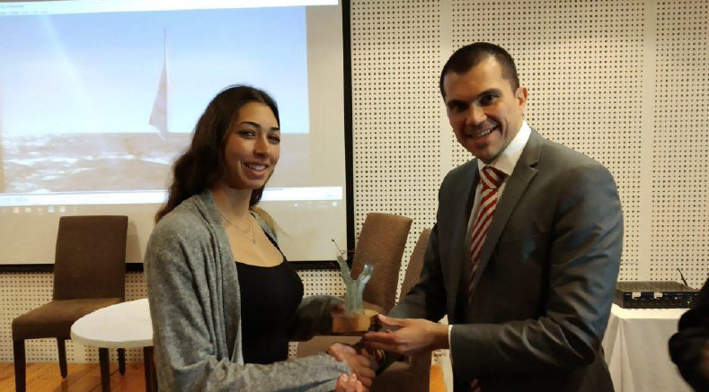
Community Involvement
Ownership and Management (contin’d)
To further prevent the drain of benefits out of the community, sustainable event planning focuses on local sourcing and responsible procurement. This includes:
Using locally produced food and beverages, reducing dependence on imported goods while supporting regional agriculture.
Encouraging carpooling and sustainable transportation options to minimize environmental impact and travel costs.
Avoiding large-scale external catering services in favor of local food vendors and sustainable service providers.
Another essential component of community-based tourism management is recognition and incentives. To encourage continued participation and leadership in sustainability efforts, awards and public acknowledgments are given to individuals and businesses that contribute to eco-friendly and socially responsible tourism. For example, the Community Sustainability Award, the Business Tourism Sustainability Award and the CSTI Youth Ambassador Award recognized and celebrated local efforts in promoting sustainability.
These initiatives helped build community pride, reinforce commitment to responsible tourism and inspire future projects.
By integrating local voices into every stage of tourism planning and ensuring that financial and social benefits remain within the community, sustainable tourism creates a balanced, inclusive and self-sustaining model. Rather than treating locals as passive participants, successful sustainability initiatives empower them as decision-makers, stakeholders and leaders, ensuring that tourism remains a force for economic stability, cultural preservation and environmental protection.
WHERE HERITAGE
MEETS COMMUNITY
#CreativeEurope

Slide 18
Monitoring, Evaluation and Financing
Evaluation Metrics
To measure the success of the event, key performance indicators (KPIs) were tracked, including:
Attendance & Engagement: The event hosted 150-200 participants, including local producers, tourism stakeholders, policymakers, and sustainability advocates.
Economic Impact: The level of business networking, new partnerships, and local product sales were assessed to determine the event’s contribution to the rural economy.
Environmental Impact: The use of eco-friendly materials, waste reduction strategies, and the tree-planting initiative were tracked to ensure alignment with sustainable event principles.
Knowledge Transfer & Awareness: The effectiveness of panel discussions, sustainability workshops and networking sessions was measured through post-event feedback forms and stakeholder surveys.
WHERE HERITAGE
MEETS COMMUNITY
#CreativeEurope

Slide 19
Monitoring, Evaluation and Financing
Feedback Mechanisms
CSTI collected qualitative and quantitative feedback from attendees to improve future AGMs:
Post-Event Surveys: Participants provided insights on session quality, networking opportunities and logistical aspects.
Stakeholder Meetings: Follow-up discussions with local producers, tourism authorities, and policymakers helped identify key takeaways and areas for improvement.
Social Media & Online Engagement: Reactions, comments and discussions from the event’s digital outreach provided additional insights into participant experiences and public perception.
WHERE HERITAGE
MEETS COMMUNITY
#CreativeEurope

Slide 20
Monitoring, Evaluation and Financing
Continuous Improvement
Based on feedback, CSTI identified areas for enhancement in future AGMs:
More Hands-On Experiences: Expanding interactive demonstrations with local artisans and producers to deepen visitor engagement.
Greater Policy Engagement: Strengthening the involvement of government officials and EU representatives to enhance policymaking efforts in rural and sustainable tourism.
Broader Outreach & Promotion: Increasing marketing efforts to attract international participants and eco-tourism professionals.
More Frequent Events: While such events to marginalized villages were conducted from 2008-2020, there are plans to revive the initiative and host more regional meetings to support local communities.
WHERE HERITAGE
MEETS COMMUNITY
#CreativeEurope

Slide 21
Monitoring, Evaluation and Financing
Funding Sources and budget information
The CSTI AGM in Agros was financed through a combination of public and private funding:
CSTI’s Own Resources: Covered operational and logistical costs.
Sponsorships & Partnerships: Support from tourism organizations, local businesses and sustainability-focused sponsors.
EU & Government Grants: Funding aligned with sustainable tourism development programs.
In-Kind Contributions: Local producers, venues and municipalities contributed resources, such as event spaces, catering and transportation.
WHERE HERITAGE
MEETS COMMUNITY
#CreativeEurope

Slide 22
Replicability and Scalability
Transferability
Sustainable event practices can be successfully replicated in different locations by tailoring them to local resources, cultural heritage, and infrastructure.
Key takeaways include:
Community-Driven Planning: Engaging local councils, producers and small businesses ensures sustainability.
Local Economic Impact: Highlighting regional specialties (food, crafts, traditions) promotes cultural preservation.
Sustainable Logistics: Using eco-friendly venues, digital invitations and zero-waste strategies minimizes environmental impact.
Scalable Approach: Similar models can be easily adapted to other rural or urban communities seeking to develop sustainable tourism.
🡪Proven Model: First initiated in 2008, CSTI’s AGMs have been hosted in marginalized rural villages, such as Anogyra, Droushia, Simou, Troodos, Platres, Vavatsinia, Sotira, Phoini and Skarinou. By bringing together local producers, tourism professionals and community stakeholders, these events have enhanced village recognition, boosted economic activity and promoted sustainable tourism.
WHERE HERITAGE
MEETS COMMUNITY
#CreativeEurope

Slide 23
Replicability and Scalability
Transferability
How to adapt?
Identify local suppliers and producers to support the economy.
Collaborate with local councils, municipalities, NGOs and tourism boards for regulatory support.
Use hybrid event models (virtual and in-person) to increase accessibility.
WHERE HERITAGE
MEETS COMMUNITY
#CreativeEurope

Slide 24
Replicability and Scalability
Challenges and Barriers
Challenge | Barrier Faced | Solution Implemented
Venue Selection in Rural Areas | Limited infrastructure, accessibility and capacity in smaller villages. | Chose community-run venues, improved local transport options and partnered with local councils for better facilities.
Limited Participation & Engagement | Difficulty attracting tourism professionals, stakeholders and policymakers to rural events. | Diverse Programming & Invitations; Included local producer showcases, sustainability awards and key government representatives (e.g., Deputy Minister of Tourism).
Funding & Budget Constraints | Hosting large-scale events in small communities can be costly and sustainable alternatives are perceived as expensive. | Secured sponsorships & grants, collaborated with local businesses and bulk-purchased eco-friendly materials.
Balancing Tradition & Modernization | Some locals resisted changes that could alter traditional event formats (e.g., digital invites instead of printed materials). | Kept cultural heritage central by integrating local producers, traditional performances and community-driven planning.
Stakeholder Coordination | Bringing together local authorities, producers and tourism industry professionals required extensive planning. | Established early communication channels, scheduled pre-event planning meetings and used local ambassadors to bridge gaps.
WHERE HERITAGE
MEETS COMMUNITY
#CreativeEurope

Slide 25
Replicability and Scalability
Potential For Expansion
The success of CSTI’s model in Cyprus proves that sustainable event practices can be scaled to other regions with similar community-based tourism goals.
Phase 3: National & International Adoption
- Advocate for policy integration, governments can adopt sustainability criteria for events
- Scale to large festivals, tourism expos and international conferences
- Leverage digital transformation (virtual/hybrid events, carbon offset programs)
Phase 1: Local Expansion
- Replicate such an even in other villages to increase rural recognition & economic benefits.
- Strengthen public-private partnerships for long-term event sustainability.
Phase 2: Regional Growth
- Encourage other Mediterranean rural communities to adopt this model. - Establish regional sustainability networks to share best practices.
WHERE HERITAGE
MEETS COMMUNITY
#CreativeEurope

Slide 26
Key Conclusions & Takeaways
This event in Agros demonstrated how resource preservation, cultural heritage protection and economic resilience can be integrated into sustainable tourism, offering a transferable model that can be adapted by other rural communities seeking to balance tourism development with environmental and cultural sustainability.
Sustainability as a Core Principle: The event in Agros integrated resource conservation, waste reduction and eco-conscious travel into every aspect of the event.
Cultural & Economic Impact: By supporting local producers and artisans, the event reinforced heritage preservation and rural economic resilience.
Resource Preservation in Action: Plastic-free policies, digital materials and recycling initiatives minimized waste, while local food sourcing and tree planting promoted sustainability.
Community & Visitor Engagement: The event fostered genuine connections between visitors, producers and policymakers, creating long-term awareness and commitment to sustainable tourism.
A Model for Sustainable Rural Tourism: Eco-friendly event planning, demonstrating how tourism can be a driver for cultural preservation and environmental responsibility.
WHERE HERITAGE
MEETS COMMUNITY
#CreativeEurope

Slide 27
Key Conclusions & Takeaways
For more information regarding this event, please see below:
Facebook post for the event
Tourist press video
Press Release
WHERE HERITAGE
MEETS COMMUNITY
#CreativeEurope

Slide 28
Thank You !
WHERE HERITAGE
MEETS COMMUNITY

