Slide 1


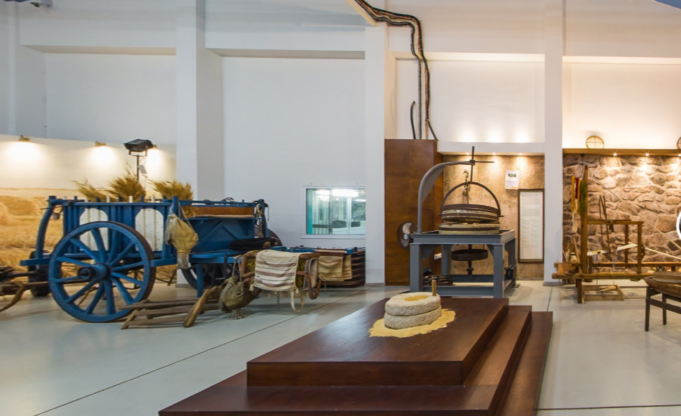
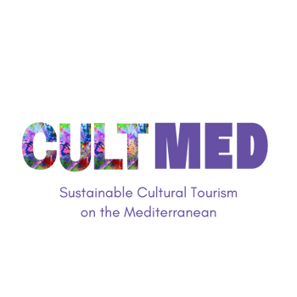

Hadjigiorkis Flourmill Museum
Subtitle: Frenaros, Famagusta and Museum
#CreativeEurope

Slide 2

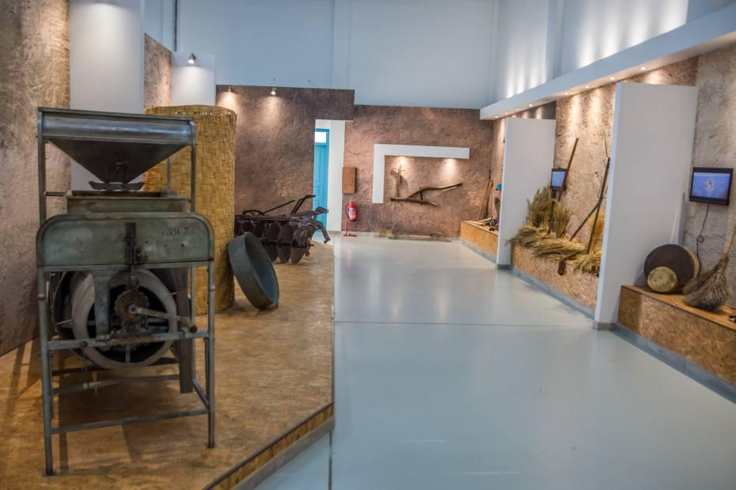





Introduction
Name of the Practice: Hadjigiorkis Flourmill Museum
Location: Frenaros, Famagusta
Type: Cultural Heritage Museum, Educational & Interactive Experience
Initiating Organization: Cyprus Millers by Hadjigiorkis
Year of Establishment: 2010 (museum created) / 2016 (renovation for an interactive experience)
Current Status: Ongoing, actively hosting educational programs, workshops and tourism activities
Picture1: Hadjigiorkis Flourmill Museum (click to see VR tour of the museum)
WHERE HERITAGE
MEETS COMMUNITY
#CreativeEurope

Slide 3
Introduction
The Hadjigiorkis Flourmill Museum’s primary goals are to:
Preserve and Promote Cyprus' Milling & Baking Heritage: Showcasing the evolution of wheat production, flour milling and bread-making over the centuries.
Educate and Engage Visitors: Offering interactive experiences where visitors grind wheat, feel fresh flour and bake traditional Cypriot sourdough bread.
Bridge Past and Future: Demonstrating how traditional milling techniques meet modern innovations while maintaining the same dedication to quality and craftsmanship.
Support Sustainable Tourism: Contributing to rural tourism, vocational learning and cultural heritage conservation through exhibitions, workshops and theatrical program.
Key Focus Areas:
Cultural Preservation: Protecting traditional milling & baking knowledge.
Educational & Vocational Learning: Hosting school visits, theatrical plays and hands-on workshops approved by the Ministry of Education.
Sustainable Rural Tourism: Part of Heartland of Legends and Endless Sun initiative, Cyprus’ authentic tourism route that promotes experiential travel & local heritage.
Award-Winning Tourism Destination:
- Cyprus Hotel Association – Famagusta Recognition (2018)
- Cyprus Tourism Award (2020) – Gold Medal in Museums/Historical Sites, Cultural Sites, Events & Routes
WHERE HERITAGE
MEETS COMMUNITY
#CreativeEurope

Slide 4
The Practice
The Hadjigiorkis Flourmill Museum preserves and promotes the heritage of milling, wheat production and bread-making in Cyprus, offering an interactive and educational experience for visitors. Established in 2010 by Cyprus Millers by Hadjigiorkis, the museum was inspired by Costas Koshis, the eldest son of the founder, who saw a growing interest in traditional flour milling among students and visitors.
In 2016, the museum was renovated to create a more immersive experience, integrating hands-on workshops, live demonstrations and cultural storytelling to showcase both historical and modern milling techniques. The museum plays a key role in sustainable rural tourism, attracting visitors who seek authentic cultural experiences, while also engaging with local communities, schools and tourism initiatives.
Hadjigiorkis Flourmill Museum also supports educational initiatives in partnership with the Ministry of Education, integrating cultural heritage learning into school programs and adult vocational seminars. Its recognition in tourism and heritage awards further highlights its impact in cultural conservation and sustainable tourism development.
WHERE HERITAGE
MEETS COMMUNITY
#CreativeEurope

Slide 5
The Practice
Activities involved
The museum offers hands-on, educational and cultural activities that connect visitors with Cyprus’ agricultural and culinary heritage.
Interactive Milling & Baking Experiences
Visitors grind wheat using hand mills like in Neolithic Cyprus.
Experience freshly milled flour from the original 1940s stone mill.
Bake traditional sourdough Cypriot bread, using age-old techniques.
Thematic Exhibitions & Educational Programs
Museum displays artefacts, photographs and historical tools related to wheat production and milling.
Annual themed calendars with Cypriot proverbs about wheat and flour.
Vocational learning seminars on traditional food production.
Theatrical & Storytelling Workshops
Collaborations with Pocket Theatre, featuring traditional fairy tales about agriculture & bread-making.
Educational performances approved by the Ministry of Education.
Sustainable Tourism & Rural Development
Participates in “Heartland of Legends”, an initiative promoting authentic rural tourism.
Hosts school visits, guided tours and heritage tourism programs.
WHERE HERITAGE
MEETS COMMUNITY
#CreativeEurope

Slide 6


The Practice
The Hadjigiorkis Flourmill Museum engages a diverse audience, from students and tourists to local businesses and policymakers, fostering a collaborative approach to cultural preservation and sustainable tourism.
Key Target Groups
Tourists & Cultural Travelers: Seeking authentic experiences in Cyprus' rural heritage and culinary traditions.
Local Communities & Farmers: Benefiting from heritage conservation and increased rural tourism.
Students & Educators: Learning about traditional Cypriot agriculture through educational workshops & performances.
Sustainability & Tourism Advocates: Engaged in heritage-based tourism models that promote rural cultural preservation.
Stakeholder Involvement
Cyprus Millers by Hadjigiorkis: Founder and primary operator, ensuring historical continuity and industry expertise.
Ministry of Education: Supporting educational programs and integrating them into school curricula.
Theatre (i.e. Pocket Theatre): Partnering on storytelling and theatrical workshops for cultural education.
Local Tourism Networks (Heartland of Legends): Promoting the museum as part of authentic rural tourism routes.
WHERE HERITAGE
MEETS COMMUNITY
#CreativeEurope

Slide 7
Local Benefits and Impact
Economic Impact
The museum directly and indirectly supports the local economy by generating opportunities for businesses, artisans and tourism-related services:
Job Creation & Local Employment: The museum supports local guides, educators and artisans, creating jobs in heritage tourism and cultural education. Increased Visitor Spending: Tourists visiting the museum contribute to local businesses, including nearby bakeries, restaurants and craft shops. Stronger Links with Local Producers: The museum’s focus on traditional bread-making and milling helps promote local grain farmers and bakers, strengthening Cyprus’ rural economy. Sustainable Tourism Growth: As part of the "Heartland of Legends" tourism route, the museum attracts heritage-focused visitors, contributing to regional tourism revenue.
WHERE HERITAGE
MEETS COMMUNITY
#CreativeEurope

Slide 8
Local Benefits and Impact
Cultural Impact
The Hadjigiorkis Flourmill Museum is a living testament to Cyprus’ milling and bread-making traditions, ensuring that these practices are not lost to modernization. Through interactive experiences and educational programs, the museum plays a crucial role in:
Preserving Traditional Milling & Baking Practices: By allowing visitors to grind wheat using hand mills, bake sourdough bread and experience old milling techniques, the museum safeguards centuries-old knowledge. Educating Future Generations: Collaborations with the Ministry of Education ensure that students, teachers and researchers learn about Cyprus’ agricultural and food heritage. Promoting Cultural Narratives: Annual themed calendars with Cypriot proverbs, along with theatrical performances on agricultural folklore, keep oral traditions alive. Recognition as a Cultural Heritage Hub: The museum’s awards and certifications, including the 2020 Cyprus Tourism Award (Gold Medal), highlight its role in safeguarding cultural identity.
WHERE HERITAGE
MEETS COMMUNITY
#CreativeEurope

Slide 9
Local Benefits and Impact
Environmental Impact
The museum is committed to sustainability and resource conservation, incorporating eco-friendly practices into its operations:
Sustainable Restoration & Energy Efficiency: The museum's 2016 renovation preserved historical structures while incorporating modern, energy-efficient features. Waste Reduction & Sustainable Packaging: Workshops promote minimal-waste food production and local suppliers are encouraged to use sustainable materials Eco-Friendly Tourism Practices: As part of "Heartland of Legends“ and Endless Sun initiative, the museum supports low-impact, rural tourism that encourages visitors to explore in an environmentally responsible manner, while maintaining EMAS-compliant environmental practices. Local Sourcing & Agricultural Conservation: The museum’s focus on traditional grain milling promotes sustainable farming methods and responsible agricultural practices, preserving Cyprus' rural heritage while supporting local producers. The company’s ISO 14001 framework ensures responsible resource management.
Additional Initiatives: The museum encourages the use of reusable water bottles and mugs and it avoids plastic in its workshops. It also provides filtered water in glass bottles, further promoting eco-friendly practices.
WHERE HERITAGE
MEETS COMMUNITY
#CreativeEurope

Slide 10
Local Benefits and Impact
Social Impact
Beyond its economic and cultural benefits, the Hadjigiorkis Flourmill Museum fosters social inclusion, education and community well-being:
Empowering Local Communities: The museum provides a platform for local bakers, grain farmers and artisans to showcase their work, reinforcing rural entrepreneurship. Inclusive Learning Experiences: Educational programs cater to students, adults and visitors of all ages, ensuring widespread cultural engagement. Stronger Community Ties: By hosting workshops, storytelling events and theatrical performances, the museum strengthens local identity and pride. Tourism Accessibility & Inclusivity: The museum welcomes both domestic and international visitors, making Cyprus’ rural heritage more accessible to a global audience.
WHERE HERITAGE
MEETS COMMUNITY
#CreativeEurope

Slide 11
Visitors Benefits and Impact
Cultural Engagement & Education
Hands-on workshops: Visitors grind wheat, touch fresh flour and bake traditional sourdough bread.
Heritage exhibits: Antique milling tools, historical photographs and storytelling panels.
Cultural programs: Themed calendars, theatrical performances and folklore storytelling.
Educational recognition: Programs approved by the Ministry of Education, attracting students and researchers.
Behavioral Impact on Visitors
Respect for traditions: Visitors gain appreciation for small-scale producers and local craftsmanship.
Sustainable food awareness: Learning about organic farming & traditional baking encourages conscious consumption.
Eco-conscious travel: Part of Heartland of Legends, promoting slow tourism and local business support.
Immersive Experience & Community Contribution
Live demonstrations: Visitors actively participate in traditional food-making alongside artisans.
Direct support to locals: Engaging with bakers, farmers and craftspeople strengthens the rural economy.
Multi-sensory immersion: The combination of touch, taste, smell and storytelling makes the visit deeply memorable.
WHERE HERITAGE
MEETS COMMUNITY
#CreativeEurope

Slide 12
Sustainability Measures
The museum preserves Cyprus’ milling and bread-making heritage by restoring and maintaining historical milling equipment, including original stone mills from the 1940s, ensuring these traditional methods remain accessible for future generations.
Visitors engage in hands-on experiences, such as grinding wheat and baking traditional bread, allowing them to connect with Cyprus’ centuries-old food production techniques.
The museum collaborates with the Ministry of Education to integrate milling heritage into school curricula, ensuring students learn about Cyprus’ agricultural past.
Storytelling initiatives, including annual calendars featuring Cypriot proverbs and theatrical workshops, help preserve oral traditions and cultural narratives related to wheat production and bread-making.
Cultural Preservation
The museum supports the local economy by creating jobs for guides, artisans and educators, ensuring that tourism revenue benefits the local community.
By connecting farmers, bakers and millers with tourists and businesses, the museum helps sustain small-scale agricultural enterprises and promotes traditional food production.
As a key attraction on the "Heartland of Legends" tourism route, the museum draws cultural travelers who also visit local restaurants, markets and accommodations, generating additional economic activity.
The museum’s recognition in the 2020 Cyprus Tourism Award (Gold Medal) has increased its visibility, leading to a rise in visitor numbers and greater financial benefits for the region.
Economic Sustainability
Resource Preservation
The museum’s 2016 renovation preserved its original architecture while integrating modern energy-efficient facilities, ensuring both historical authenticity and environmental responsibility.
By educating visitors about organic farming and traditional grain production, the museum reinforces sustainable food systems and encourages support for local eco-conscious agriculture.
As part of Heartland of Legends, the museum promotes eco-tourism and responsible travel, reducing the environmental impact of mass tourism while supporting sustainable rural tourism.
WHERE HERITAGE
MEETS COMMUNITY
#CreativeEurope

Slide 13
Community Involvement
The Hadjigiorkis Flourmill Museum is a community-driven initiative that actively involves local residents, businesses and cultural organizations in its operations. By maintaining local ownership, prioritizing community participation and ensuring that economic benefits remain within the region, the museum plays a vital role in preserving heritage while fostering sustainable rural development.
Role of Local Communities
From its inception, the museum has been shaped by community engagement, beginning with Costas Koshis' vision to safeguard Cyprus’ milling traditions for future generations. Recognizing a growing interest from students and visitors, he worked alongside local stakeholders to create a space where the public could connect with Cyprus’ rich agricultural history. Today, the museum continues this mission by actively involving local residents as tour guides, workshop instructors and demonstrators, ensuring that knowledge is passed down through hands-on experiences.
WHERE HERITAGE
MEETS COMMUNITY
#CreativeEurope

Slide 14
Community Involvement
Beyond its core exhibitions, the museum collaborates with local farmers, bakers and millers, incorporating their expertise and products into educational workshops, storytelling sessions and artisanal demonstrations. This direct engagement not only enhances the visitor experience but also supports local livelihoods, reinforcing the economic sustainability of traditional professions. The museum’s vocational training programs and sustainability workshops further empower artisans and entrepreneurs, providing them with the skills to integrate heritage-based business models into the wider tourism sector.
Community engagement extends to educational partnerships, with the museum working closely with the Ministry of Education, cultural organizations and local schools. Through school visits, curriculum integration and interactive learning initiatives, the museum fosters an appreciation for Cyprus’ milling and baking heritage, ensuring that younger generations remain connected to their cultural roots.
WHERE HERITAGE
MEETS COMMUNITY
#CreativeEurope

Slide 15
Community Involvement
Ownership and Management
The Hadjigiorkis Flourmill Museum is privately owned and operated by Cyprus Millers by Hadjigiorkis, ensuring that management remains locally controlled and aligned with community interests. Unlike large-scale commercialized attractions, the museum prioritizes local economic circulation, ensuring that revenue directly benefits the region rather than external stakeholders. To prevent economic leakage, it sources products, services and staff locally, strengthening the link between tourism, agriculture and cultural industries.
The museum being an integral part of the Heartland of Legends tourism network, promotes authentic rural experiences in Cyprus. This initiative helps position the museum as a key driver of sustainable tourism, ensuring that local businesses such as bakeries, artisanal shops and traditional eateries benefit from visitor spending. By incorporating community input into tourism planning, the museum ensures that growth aligns with the needs of the people who live and work in the area, maintaining an inclusive and culturally sensitive approach to tourism.
WHERE HERITAGE
MEETS COMMUNITY
#CreativeEurope

Slide 16
Monitoring, Evaluation and Financing
Evaluation Metrics
The museum tracks multiple indicators of success to assess its social, economic and educational impact:
Visitor Numbers: Since its foundation in 2016, the museum has welcomed approximately 40,000 – 50,000 visitors, averaging 10,000 per year (excluding the COVID period). Around 90% are Cypriot visitors, with 50% being elementary school students.
Educational Engagement: The museum is a key part of the Ministry of Education’s DRASE program, hosting school visits and workshops. In the last year alone, 23 schools and 50 students of each school participated in educational experiences.
Tourism Contribution: As part of the Heartland of Legends and Famagusta Tourism Board’s Endless Sun initiative, the museum attracts visitors during off-peak tourism seasons, supporting sustainable tourism.
Visitor Experience & Ratings: The museum has been highly rated in the Heartland of Legends program through online reviews, surveys and social media engagement and from which has also won on a competition amongst others based on the good feedback of visitors. A visitor comment book at the museum further collects direct feedback.
Interactive & Cultural Value: The museum is recognized as one of the few interactive cultural experiences in the region, combining VR demonstrations with traditional food-making activities (e.g. fresh pasta workshops etc).
WHERE HERITAGE
MEETS COMMUNITY
#CreativeEurope

Slide 17
Monitoring, Evaluation and Financing
Feedback Mechanisms
The museum collects visitor input through various channels to continuously improve its offerings:
On-Site & Online Feedback: Visitors can leave written feedback in a comment book or rate their experience through digital surveys on tourism platforms and social media.
Stakeholder Evaluations: The museum collaborates with educators, tourism authorities and local businesses to refine programs and improve visitor experience.
Seminar Questionnaires: Participants in educational programs and workshops fill out feedback forms to assess content quality and engagement levels.
Verbal Interviews & Direct Interaction: The museum director and staff personally engage with visitors, conducting informal discussions to gather insights.
WHERE HERITAGE
MEETS COMMUNITY
#CreativeEurope

Slide 18
Monitoring, Evaluation and Financing
Continuous Improvement
The museum continuously enhances its offerings based on evaluation results to ensure a more sustainable, engaging and impactful visitor experience. As part of its sustainability efforts, the museum has strengthened its commitment to waste reduction by eliminating plastic from workshops and educational activities. Instead of single-use plastic bottles, it has installed filtered water stations for visitors and staff, encouraging more eco-friendly consumption practices.
In terms of technological advancements, the museum has already implemented virtual reality (VR) tours, allowing remote visitors to experience its rich milling heritage. Looking ahead, plans include the introduction of interactive digital displays and enhanced online educational content, making the museum’s exhibits more immersive and accessible to a wider audience.
In addition, the museum is expanding its industry partnerships to strengthen its role in sustainable tourism. A recent cooperation agreement with TUI aims to boost international visibility, attracting more visitors and integrating the museum into broader culinary and cultural tourism experiences. These ongoing improvements reflect the museum’s dedication to preserving heritage while adapting to modern visitor expectations.
WHERE HERITAGE
MEETS COMMUNITY
#CreativeEurope

Slide 19
Monitoring, Evaluation and Financing
Funding Sources and budget information
The Hadjigiorkis Flourmill Museum is financially sustained through a combination of corporate support, tourism revenue and external funding, ensuring its long-term viability as a non-commercial cultural initiative. Unlike traditional museums that rely solely on ticket sales, the Hadjigiorkis Museum operates under a Corporate Social Responsibility (CSR) model, funded by Cyprus Millers. As part of its commitment to giving back to society, the company established the museum not as a commercial venture but as a way to preserve Cyprus’ milling heritage and promote cultural education. This initiative allows the museum to function as a community-driven space, enriching local culture without financial pressures.
Another key source of funding comes from educational initiatives, specifically the Ministry of Education’s DRASE program. Through this program, school visits are financially supported, covering costs such as hands-on workshops and refreshments, making the museum more accessible to students and promoting cultural education.
While entry is free for select organized groups, such as retirees and community associations, the museum also generates revenue through guided tours, hands-on educational experiences and product showcases. Visitors who participate in these activities contribute to the museum’s sustainability, helping maintain its exhibits and programs.
WHERE HERITAGE
MEETS COMMUNITY
#CreativeEurope

Slide 20
Replicability and Scalability
Transferability
The Hadjigiorkis Flourmill Museum serves as a replicable model for other heritage-based museums in Cyprus and internationally. Its success demonstrates how traditional industries, such as milling and bread-making, can be transformed into engaging, sustainable tourism experiences.
Museums in other countries with strong agricultural, milling or other artisanal traditions could adapt this best practice by creating interactive visitor experiences, incorporating hands-on workshops as well as fostering strong community involvement. European countries with rich rural food heritage could particularly benefit from adopting this cultural preservation model.
By integrating education, sustainability and local entrepreneurship, museums and heritage sites beyond Cyprus can develop similar initiatives that not only protect their traditional crafts and food production methods but also generate economic opportunities for rural communities. The Hadjigiorkis model proves that small-scale cultural heritage projects can become financially viable tourism attractions while maintaining authenticity and sustainability.
WHERE HERITAGE
MEETS COMMUNITY
#CreativeEurope

Slide 21
Replicability and Scalability
Challenges and Barriers
Challenge | Barrier Faced | Solution Implemented
Preserving Traditional Milling Techniques | Maintaining and showcasing traditional flour milling methods while integrating modern innovations. | Created an interactive museum experience where visitors can engage with both historic and modern milling techniques, ensuring authenticity while embracing technological advancements.
Attracting Visitors Beyond Locals | Limited awareness among international tourists and younger generations about the museum’s cultural significance. | Partnered with tourism boards and travel agencies, incorporated the museum into thematic routes like the "Heartland of Legends" and developed educational programs for schools.
Financial Sustainability | Maintaining the museum’s operations and interactive experiences requires continuous funding. | Secured funding through Cyprus Millers, sponsorships and government grants while generating revenue through guided tours, educational programs and souvenir sales.
Balancing Commercial & Cultural Integrity | Expanding visitor experiences while ensuring the museum remains an authentic cultural and educational space. | Maintained a strong educational focus by offering hands-on workshops, traditional bread-making sessions and storytelling events to deepen visitor engagement.
Adapting to Modern Educational Trends | Engaging younger audiences in an era dominated by digital entertainment and short attention spans. | Introduced interactive digital displays, hands-on milling experiences and theatrical educational programs to make learning more engaging and immersive.
WHERE HERITAGE
MEETS COMMUNITY
#CreativeEurope

Slide 22
Replicability and Scalability
Potential For Expansion
The Hadjigiorkis Flourmill Museum has strong potential for further expansion, both within Cyprus and internationally. With its existing Virtual Reality (VR) tours, the museum can enhance its digital presence by developing multilingual virtual experiences to attract a broader global audience. Interactive live-streamed workshops on traditional bread-making could also connect international visitors with Cypriot heritage in real time.
By forming international partnerships, Hadjigiorkis could also collaborate with global food heritage museums to create joint exhibitions or knowledge-sharing initiatives. Locally, the museum could expand its impact by offering educational programs in schools and universities, integrating traditional milling into history, food science and sustainability curricula. Seasonal festivals and culinary tourism events, focused on Cypriot bread-making traditions, could also boost visitor engagement while supporting the local economy.
To ensure long-term sustainability, collaborations with travel agencies, tourism boards and gastronomy networks could position the museum as a key stop on cultural and agro-tourism routes. Corporate sponsorships and EU cultural heritage grants could also support new exhibit developments and outreach programs.
WHERE HERITAGE
MEETS COMMUNITY
#CreativeEurope

Slide 23
Key Conclusions & Takeaways
The Hadjigiorkis Flourmill Museum successfully preserves Cyprus’ milling heritage while engaging both local and global audiences through interactive experiences, digital innovation and community-driven sustainability.
The museum effectively blends heritage preservation with modern innovation, offering hands-on activities and VR experiences to educate diverse audiences.
Cultural sustainability is at the core of the initiative, ensuring that traditional bread-making and milling practices are passed down to future generations.
Economic and social benefits extend beyond tourism, supporting local businesses, educational programs and vocational training.
Digital expansion through VR tours has broadened accessibility, allowing international audiences to engage with Cyprus’ milling history.
The replicability of this model presents an opportunity for museums worldwide to adapt similar interactive and educational approaches to preserve their own food heritage.
Sustainable tourism strategies, including community involvement, responsible visitor management and environmental practices, ensure the museum's long-term viability.
Future growth could focus on expanding partnerships, integrating milling history into educational curriculums and enhancing international collaborations.
WHERE HERITAGE
MEETS COMMUNITY
#CreativeEurope

Slide 24
Thank You !
WHERE HERITAGE
MEETS COMMUNITY

