Slide 1


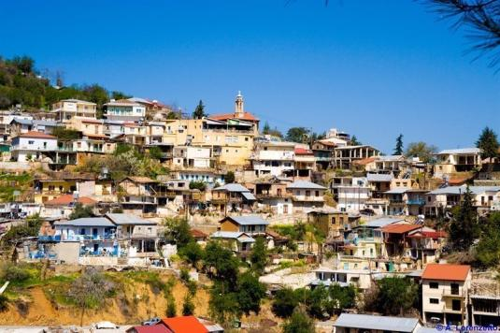
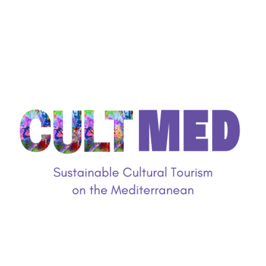

Kalopanayiotis: A model village for Sustainable Cultural Tourism in Cyprus
Subtitle: Kalopanayiotis and Villages
#CreativeEurope

Slide 2
Introduction
Kalopanayiotis is a picturesque village located in the evergreen Setrachos River valley on the northern slopes of the Troodos Mountains. It is one of the fourteen villages of the Marathasa area, the most mountainous area of Cyprus. It sits 70 km from both Nicosia and Limassol and is the first village visitors encounter when traveling up from Nicosia into the Marathasa valley.
The area, known since ancient times, was originally a hydrotherapy center dedicated to the god Asklepios, with mineral springs that attracted visitors for healing. By the 4th century AD, after the Edict of Milan ended the persecution of Christians, the site transformed into a Christian monastery near the church of St. Irakleidios, where Saint Herakleidios baptized St. Paul and St. Barnabas on their journey to Paphos.
Kalopanayiotis developed around the monastery and its surrounding religious sites, with its first resident, Panagiotis, arriving in the 11th century and establishing a house near the monastery. His devotion inspired other settlers, leading to the creation of small churches and parishes, with each family aspiring to build its own chapel and have a member serve as priest. Over time, the village, once known as "Village of Panagiotis," became known as Casale Panayiotis and later Kalopanayiotis. Its growth was influenced by the destruction of nearby Troullinou in 1614, which prompted the dispersion of its inhabitants, further shaping the village into the cohesive community it is today. Many of the original churches are still standing, preserved by the Antiquities Department.
WHERE HERITAGE
MEETS COMMUNITY
#CreativeEurope

Slide 3
Introduction
According to the ‘‘Statistical Service of Cyprus’’, Kalopanayiotis village has experienced a dramatic decline in population over the past decades. While the village experienced steady growth from 1881 to 1946, reaching its peak at 1,099 residents, a significant downward trend began in 1960.
From 1960 onward, the population steadily declined, with notable drops in 1982 (-43.7%) and 1992 (-43.4%), reflecting the widespread rural depopulation trend in Cyprus. Economic shifts, urban migration and declining birth rates have played a major role in this decline. It is notable that people left their villages to find work in cities and abroad.
The most recent census in 2021 recorded only 201 residents, marking a further -23.57% decrease since 2011. This highlights the need for sustainable rural development initiatives to counteract depopulation and revitalize the local community.
Census Year | Population | %±
1881 | 488 | -
1891 | 524 | 7,38%
1901 | 631 | 20,42%
1911 | 811 | 28,53%
1921 | 767 | -5,43%
1931 | 900 | 17,34%
1946 | 1.099 | 22,11%
1960 | 920 | -16,29%
1973 | 738 | -19,78%
1976 | 1.031 | 39,70%
1982 | 580 | -43,74%
1992 | 328 | -43,45%
2001 | 275 | -16,16%
2011 | 263 | -4,36%
2021 | 201 | -23,57%
WHERE HERITAGE
MEETS COMMUNITY
#CreativeEurope

Slide 4
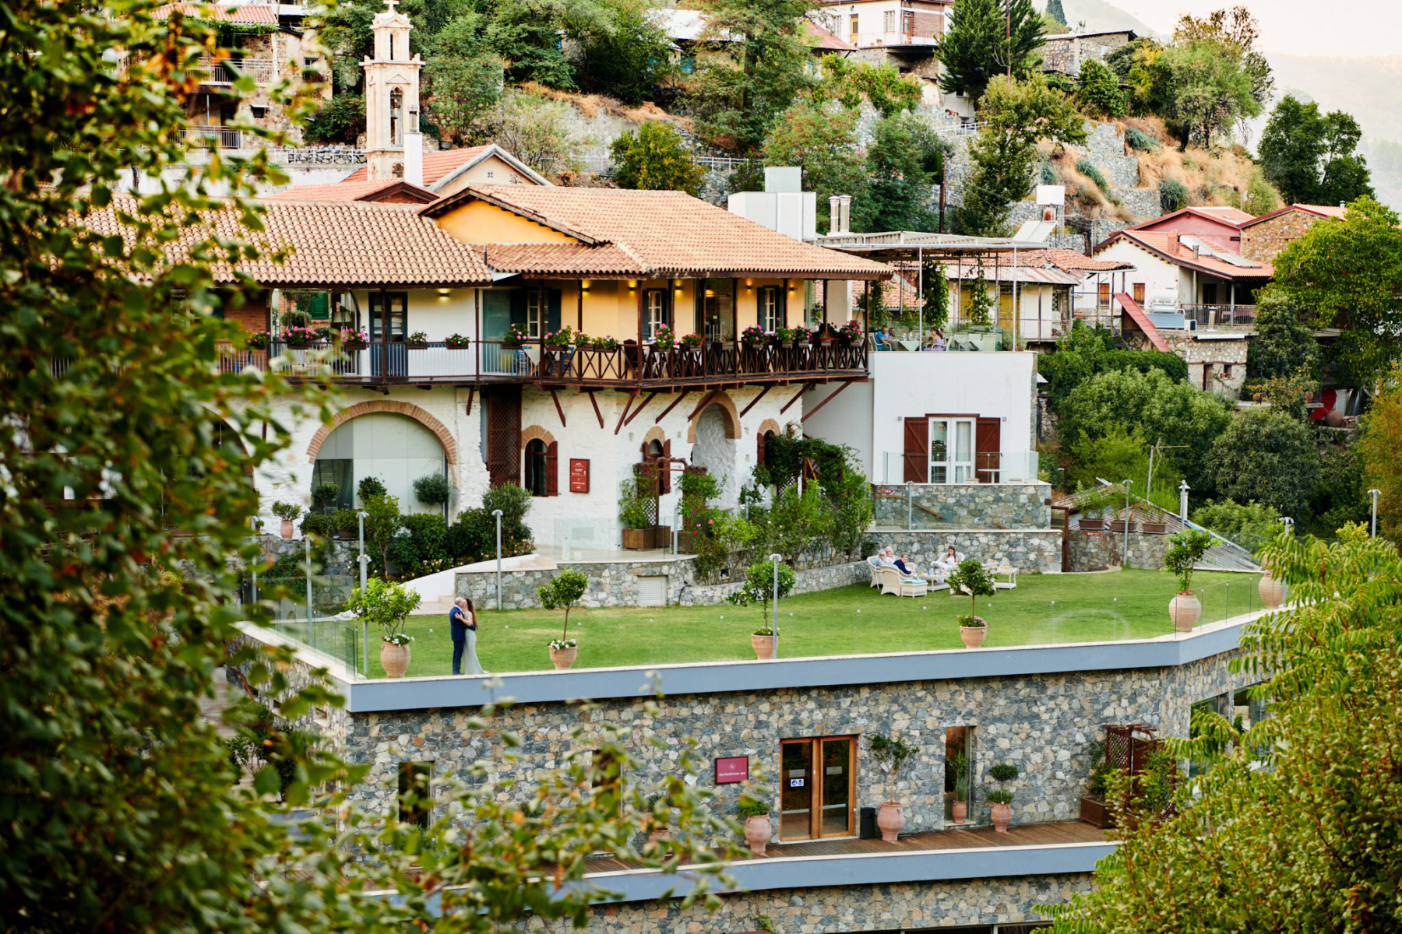
Introduction
The opening of the hotel “Casale Panayiotis” hotel in December 2009 marked the beginning of a remarkable transformation for Kalopanayiotis village, successfully balancing economic revitalization with cultural and environmental sustainability. The initiative sparked a shift in the village’s trajectory, proving that rural communities could thrive through heritage-driven tourism.
This transformation was led by John Papadouris, a native of Kalopanayiotis village who, after decades abroad, returned with a vision “not to start a business, but to revive the village”. Witnessing the decline of his community, he embarked on an ambitious restoration project to safeguard the mountain culture and traditional way of life.
Figure 1: Casale Panayiotis Hotel
Rather than building a modern resort, Papadouris focused on restoring traditional village homes, seamlessly blending authenticity with luxury. The result was Casale Panayiotis, a hospitality project that became the cornerstone of the village’s revival, attracting visitors while preserving local heritage. This initiative inspired further development, encouraging investment in eco-tourism, cultural preservation and community-driven enterprises, securing Kalopanayiotis' place as a model for sustainable rural tourism.
WHERE HERITAGE
MEETS COMMUNITY
#CreativeEurope

Slide 5



Introduction
The success of Casale Panayiotis and Kalopanayiotis’ tourism model has earned prestigious awards, recognizing its contribution to sustainable tourism, cultural preservation and community development. In particular:
In 2011, Kalopanayiotis was honored as a European Destination of Excellence (EDEN) in recognition of its commitment to sustainable rural tourism. This award placed the village on the map as a leading example of responsible tourism in Cyprus and Europe.
The village was later selected as one of Cyprus' Colourful Villages, an initiative that highlights unique, picturesque communities rich in history, culture and tradition. This recognition further solidified Kalopanayiotis as a vibrant and authentic destination, showcasing its well-preserved architecture, cultural events and artistic heritage.
In 2024, Kalopanayiotis was named one of the Best Tourism Villages by UN Tourism. This prestigious global recognition is awarded to villages that demonstrate excellence in tourism development while preserving local culture and sustainability. The UN Tourism designation acknowledges Kalopanayiotis as a benchmark for rural tourism worldwide, emphasizing its successful balance between heritage conservation and economic growth.
WHERE HERITAGE
MEETS COMMUNITY
#CreativeEurope

Slide 6
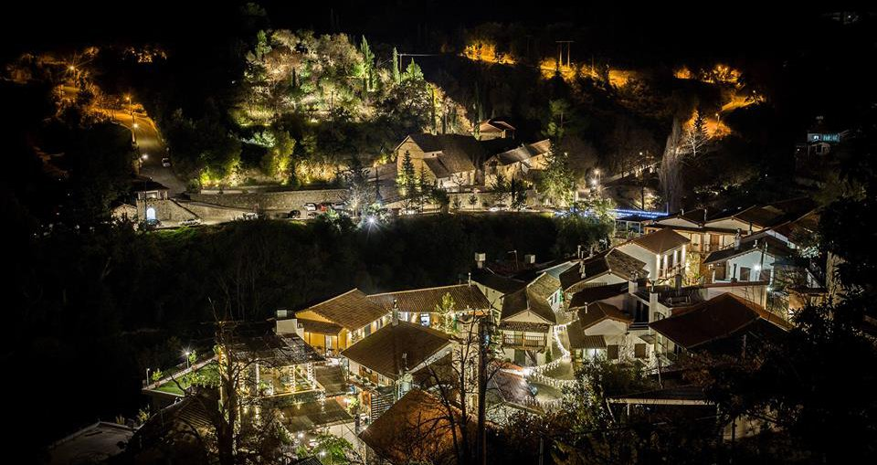
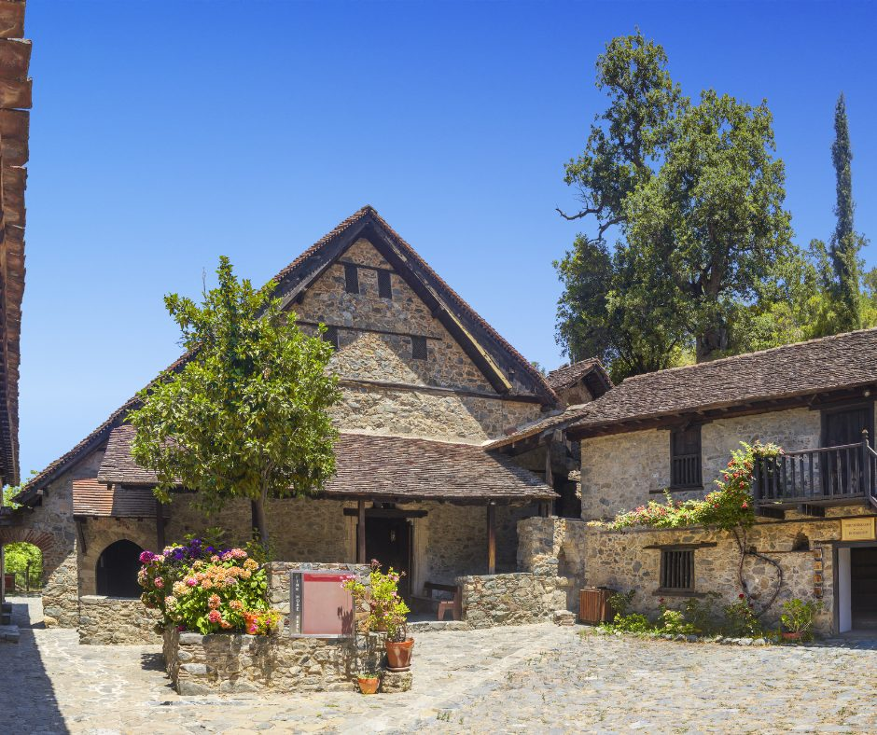
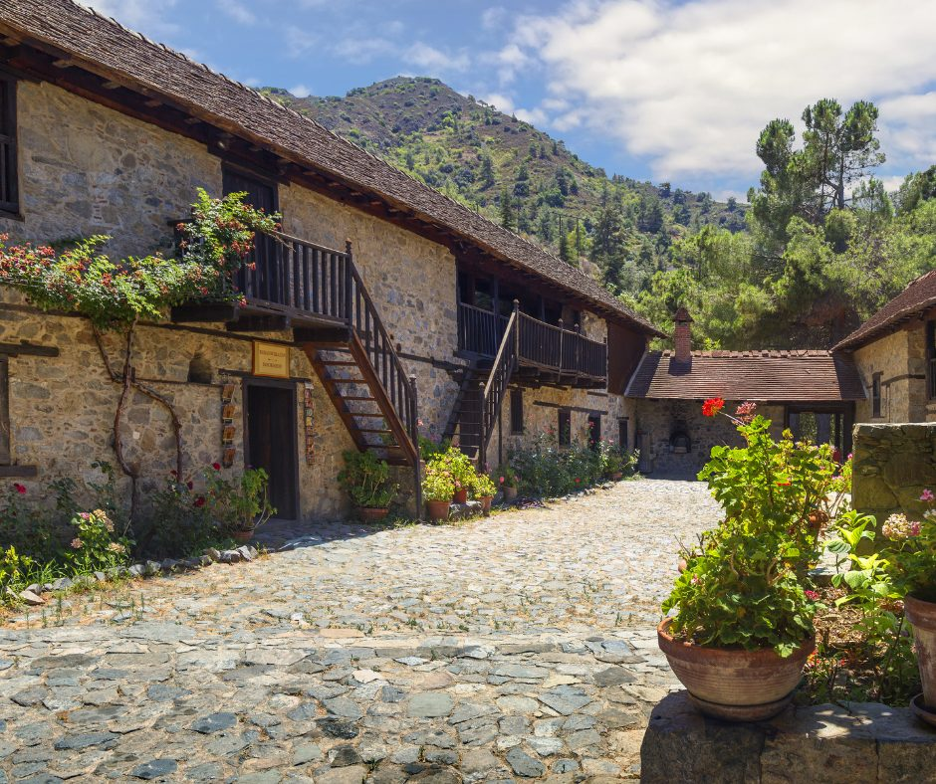
Introduction
Further solidifying its status as a model for cultural sustainable tourism, Kalopanayiotis has also been recognized in various eco-tourism and cultural heritage competitions. The restoration efforts, including the conservation of the Byzantine Monastery of Ayios Ioannis (St. John) Lambadistis, which was inscribed on the UNESCO World Heritage List in 1985, have gained further acknowledgment in cultural heritage preservation awards.
In addition, Kalopanayiotis' success has inspired nationwide initiatives aimed at reviving other rural villages in Cyprus, including the Christmas Villages project, which celebrates local traditions and attracts thousands of visitors annually.
WHERE HERITAGE
MEETS COMMUNITY
#CreativeEurope

Slide 7
Introduction
Kalopanayiotis stands as a great example of how tourism can revitalize rural communities without compromising their authenticity. At its core, the village’s transformation revolves around sustainable tourism that serves both present and future generations, ensuring that economic benefits, cultural heritage and environmental conservation coexist.
Unlike mass tourism destinations that often suffer from over-commercialization, Kalopanayiotis has taken a community-driven approach, prioritizing local entrepreneurship, heritage restoration and eco-friendly development.
The primary goal has always been not just to attract visitors, but to create a thriving, self-sustaining village where locals benefit from tourism without losing their identity. Investments in traditional home restorations, eco-tourism experiences and cultural festivals have helped establish Kalopanayiotis as a model for rural revitalization, inspiring similar efforts in other Cypriot villages. The village has successfully shown that tourism, when done right, can be a force for positive change preserving the past while fostering a sustainable future.
WHERE HERITAGE
MEETS COMMUNITY
#CreativeEurope

Slide 8
The Practice
Kalopanayiotis has embraced a comprehensive approach to tourism that integrates cultural preservation, community involvement and environmental responsibility. This model ensures that visitors experience an authentic connection with the village while contributing positively to its economic and social fabric.
Activities Involved
Restoration and Adaptive Reuse of Traditional Buildings
Development of Eco-Tourism Infrastructure
Promotion of Local Crafts, Gastronomy and Cultural Festivals
Conservation of the Byzantine Monastery of Saint John Lampadistis and Other Heritage Sites
Sustainable Business Practices in Hospitality and Agriculture
Historic stone houses, monasteries and public spaces have been restored and repurposed into boutique hotels (Casale Panayiotis), museums and cultural centers, preserving the village’s character while enhancing tourism.
Investments in hiking trails, riverside walkways, wellness spas using local thermal springs and agrotourism experiences promote low-impact tourism that respects nature while engaging visitors.
The village supports artisans, winemakers and food producers, ensuring that traditional crafts, local cuisine and seasonal festivals (Christmas Villages) remain key attractions.
Efforts focus on preserving UNESCO-listed religious and historical landmarks, keeping them accessible for spiritual and cultural tourism.
Hotels and restaurants prioritize energy efficiency, waste reduction local sourcing, while farmers embrace organic methods and traditional food production, ensuring long-term sustainability.
WHERE HERITAGE
MEETS COMMUNITY
#CreativeEurope

Slide 9







The Practice
Target Groups
The village caters to a variety of tourists who seek authentic, cultural and environmentally responsible experiences:
Cultural and Heritage Travelers: Visitors interested in Byzantine history, traditional Cypriot architecture and cultural festivals. These travelers are drawn to heritage sites like the Byzantine Monastery of Saint John Lampadistis and the village’s traditional stone-built accommodations.
Eco-Tourists and Nature Enthusiasts: Those who appreciate sustainable tourism, hiking and outdoor experiences. The Troodos Mountains, nature trails and agro-tourism activities make Kalopanayiotis ideal for travelers looking for low-impact, nature-based experiences.
Spiritual Visitors: The Byzantine monastery and local chapels attract visitors seeking spiritual enrichment and religious tourism. Kalopanayiotis is an important stop for faith-based travelers exploring Cyprus’ religious heritage.
Wellness and Slow Tourism Seekers: With its natural thermal springs and wellness spas, Kalopanayiotis appeals to those looking for health-focused retreats, relaxation and holistic well-being.
Agrotourists and Food Enthusiasts: Visitors interested in organic farming, traditional food production and local Cypriot gastronomy. Many participate in olive oil tastings, honey-making experiences and vineyard visits.
Educational and Academic Visitors: Researchers, students and professionals studying cultural conservation, sustainability and rural tourism models use Kalopanayiotis as a case study for successful rural revitalization.
Domestic Tourists and Diaspora Cypriots: Locals and Cypriots living abroad visit Kalopanayiotis to reconnect with their roots, experience authentic village life and participate in local cultural events.
WHERE HERITAGE
MEETS COMMUNITY
#CreativeEurope

Slide 10
The Practice
Stakeholders
The success of Kalopanayiotis' revitalization and sustainable tourism model relies on the collaboration of various public and private entities:
Local Community Organizations: Kalopanayiotis community council and local associations ensure that tourism development aligns with community needs and long-term sustainability goals.
Private Entrepreneurs and Local Business Owners: Investors in boutique hotels (e.g., Casale Panayiotis), restaurants, spas and cultural enterprises contribute to economic growth while maintaining a commitment to sustainability.
EU and Governmental Funding Bodies: Support from EU rural development programs, the EDEN Award initiative and national tourism authorities provides financial and strategic assistance for infrastructure improvements, conservation efforts and cultural projects.
Cultural Heritage and Conservation Experts: Specialists in historical restoration, sustainable architecture and UNESCO site preservation contribute to maintaining the authenticity and integrity of heritage landmarks.
Educational Institutions and Research Bodies: Universities, scholars and tourism professionals use Kalopanayiotis as a best-practice model for rural sustainability and cultural tourism.
Tourism Boards and International Recognition Bodies: Organizations like UN Tourism, the Cyprus Deputy Ministry of Tourism and the Colourful Villages of Cyprus Initiative promote the village internationally and advocate for responsible tourism development.
Local Farmers and Artisans: The agriculture and craft sectors play a crucial role in maintaining Kalopanayiotis’ traditional identity through handmade products, organic farming and local food experiences.
WHERE HERITAGE
MEETS COMMUNITY
#CreativeEurope

Slide 11
Local Benefits and Impact
Economic Impact
Kalopanayiotis has become a model for economic revitalization through responsible tourism, proving that rural areas can thrive without mass tourism. By focusing on heritage-driven and eco-friendly tourism, the village has created sustainable income opportunities for locals, encouraged entrepreneurship and attracted long-term investment. Tourism revenue is reinvested into restoration projects, community infrastructure as well as cultural initiatives, ensuring continuous growth without compromising authenticity.
Job Creation: Growth in employment in hospitality, heritage conservation, agro-tourism and eco-tourism services.
Locally Owned Businesses: Casale Panayiotis and restaurants, wellness spas and artisanal shops ensure profits within the community.
Diversified Economy: Income is generated from cultural tourism, wellness tourism (i.e. thermal spas), traditional craftsmanship and organic farming, reducing dependence on a single industry.
Tourism-Driven Investment: The restoration of historical buildings, hiking trails and infrastructure upgrades have been funded through a combination of tourism revenue, EU support (e.g., EDEN Award) and private investments (e.g., Casale Panayiotis).
Sustainable Business Models: Tourism growth is managed to avoid mass tourism, ensuring long-term financial sustainability while maintaining authenticity.
WHERE HERITAGE
MEETS COMMUNITY
#CreativeEurope

Slide 12
Local Benefits and Impact
Cultural Impact
A key goal of Kalopanayiotis' transformation has been to preserve and celebrate its cultural identity, ensuring that its rich traditions, historic sites and local craftsmanship continue to thrive. Unlike many rural areas where cultural heritage is often lost due to urbanization, Kalopanayiotis has successfully integrated tourism with cultural conservation, creating an immersive experience for visitors while strengthening community pride. Its recognition as part of Cyprus’ Colourful Villages initiative and the 2024 Best Tourism Villages by UN Tourism reflects its outstanding commitment to cultural preservation.
Preservation of Heritage Sites: The Byzantine Monastery of Saint John Lampadistis (UNESCO-listed site) has undergone restoration and conservation, maintaining its historical and religious significance. Adaptive Reuse of Traditional Architecture: Stone-built houses, old chapels and historic bridges have been transformed into boutique hotels, museums and cultural centers, ensuring their longevity while integrating them into modern tourism. Promotion of Traditional Crafts and Local Artisans: Visitors engage in weaving, pottery-making and winemaking workshops, helping to sustain and revive endangered Cypriot traditions. Cultural Festivals and Events: The village hosts seasonal festivals, religious celebrations and storytelling events, reinforcing community identity while attracting cultural travelers. Recognition for Cultural Preservation: Kalopanayiotis has received multiple accolades, including its inclusion in the Colourful Villages of Cyprus Initiative and being named one of the Best Tourism Villages by UN Tourism in 2024, acknowledging its exemplary approach to heritage conservation and sustainable tourism.
WHERE HERITAGE
MEETS COMMUNITY
#CreativeEurope

Slide 13
Local Benefits and Impact
Environmental Impact
Kalopanayiotis has prioritized eco-friendly tourism development to ensure that its natural surroundings are protected while welcoming visitors. By promoting sustainable agricultural practices, responsible tourism policies and environmental conservation efforts, the village serves as a model for balancing tourism growth with ecological stewardship. Initiatives such as reforestation, sustainable farming and eco-trails help minimize tourism’s environmental footprint while preserving the Setrachos River valley and surrounding forests.
Eco-Friendly Tourism Infrastructure: Hotels and accommodations follow energy-efficient practices and restored stone houses reduce the need for new construction. Nature Conservation & Responsible Land Use: The Setrachos River valley and surrounding forests are protected through reforestation programs, regulated tourism and controlled land development.
Agrotourism and Sustainable Agriculture: Visitors engage in organic farming experiences, vineyard tours and local food production, promoting eco-friendly farming methods.
Waste Management and Water Conservation: Sustainable initiatives include waste reduction, water recycling and responsible tourism policies to minimize environmental impact. Hiking and Nature-Based Activities: The development of eco-trails, riverside walks and nature excursions provides alternative, low-impact tourism experiences, reducing the pressure on historical sites.
WHERE HERITAGE
MEETS COMMUNITY
#CreativeEurope

Slide 14
Local Benefits and Impact
Social Impact
Tourism also has had a profound social impact on Kalopanayiotis village, strengthening community ties, preserving traditions and improving residents' quality of life. The village’s inclusive tourism model ensures that all generations (i.e. from young entrepreneurs to elderly artisans) benefit from the revival. By attracting visitors, Kalopanayiotis has encouraged younger residents to stay, reversing rural depopulation trends and fostering a vibrant, self-sustaining community.
Community-Driven Tourism Development: Locals are actively involved in decision-making, entrepreneurship and cultural tourism initiatives, ensuring tourism serves their needs.
Revitalization of Village Life: Increased economic opportunities, restoration projects and local business support have encouraged younger generations to stay in or return to Kalopanayiotis instead of migrating to urban areas.
Inclusivity and Intergenerational Engagement: Tourism supports elderly artisans preserving traditional crafts, young entrepreneurs creating new businesses and families running guesthouses and eco-tourism activities.
Strengthened Local Identity: The focus on cultural heritage, sustainable tourism and community-led initiatives has reinforced pride in local traditions and improved the quality of life for residents.
Improved Public Infrastructure: Tourism revenue has contributed to better roads, public spaces, walking trails and cultural venues, benefiting both residents and visitors.
WHERE HERITAGE
MEETS COMMUNITY
#CreativeEurope

Slide 15
Visitors Benefits and Impact
Cultural Engagement and Education
Kalopanayiotis offers visitors an educational and interactive cultural experience, ensuring that they leave with a deeper appreciation of Cypriot history, customs and traditions. Instead of simply observing local life, visitors actively participate in traditional practices, gaining firsthand knowledge of the region’s heritage.
Guided Tours of the Byzantine Monastery of Saint John Lampadistis (UNESCO-listed site): Visitors gain insights into Byzantine religious traditions, historic frescoes and Orthodox monastic life, learning about the role of faith in Cypriot culture.
Traditional Craft Workshops: Sessions in pottery, weaving and icon painting allow visitors to understand the skills behind Cypriot crafts, supporting local artisans and preserving endangered traditional techniques.
Food & Wine Experiences: Visitors engage in farm-to-table dining, olive oil tastings and Cypriot cooking lessons, gaining insight into agricultural traditions, sustainable farming and local gastronomy. Marathasa Winery introduces visitors to traditional winemaking techniques, while Casale Panayiotis provides authentic local dining experiences using seasonal, locally sourced ingredients.
Storytelling & Folklore Evenings: Elders and local historians share oral traditions, myths and legends, passing down generations of Cypriot culture while offering visitors a deeper connection to local history.
Participation in Festivals & Religious Events: Visitors experience Easter celebrations, music and dance festivals as well as the annual Christmas Village, immersing themselves in local customs, religious ceremonies and seasonal traditions.
Through these experiences, visitors become active participants in cultural preservation, ensuring that local knowledge, skills and traditions are passed down and valued.
WHERE HERITAGE
MEETS COMMUNITY
#CreativeEurope

Slide 16
Visitors Benefits and Impact
Behavioral Impact on Visitors
Kalopanayiotis fosters conscious and responsible tourism, influencing visitors to become more mindful of local traditions, sustainability and community well-being. The village’s eco-conscious approach and strong cultural identity encourage visitors to adopt better travel habits and respect local customs.
Increased Awareness of Heritage Preservation: Visitors develop a stronger appreciation for conservation efforts, understanding the importance of protecting traditional architecture, UNESCO sites and historical landmarks with many people leaving with a newfound interest in cultural sustainability.
Encouraging Sustainable Travel Practices: Through eco-friendly accommodations, nature trails and organic farming tours, visitors learn about sustainable tourism and how their choices impact local environments. Many adopt better eco-conscious habits, such as choosing locally owned businesses, reducing plastic waste and engaging in low-impact tourism activities.
Respect for Local Traditions and Customs: By participating in religious ceremonies, cultural festivals and local storytelling sessions, visitors develop a deeper sensitivity to Cypriot traditions, often adjusting their behavior to align with local customs (e.g., modest attire in religious sites, respecting quiet village life and engaging respectfully with locals).
Shift Toward Slow and Experiential Tourism: Kalopanayiotis promotes quality over quantity, encouraging longer stays, deeper engagement with the community and support for local businesses. Many visitors return for repeat stays, choosing more immersive and ethical travel experiences over commercialized tourism.
Through these behavioral shifts, Kalopanayiotis not only educates tourists but transforms them into ambassadors of sustainable and responsible tourism, ensuring that visitors carry these values into future travel experiences.
WHERE HERITAGE
MEETS COMMUNITY
#CreativeEurope

Slide 17
Visitors Benefits and Impact
Immersive Experience
Kalopanayiotis ensures that visitors do not just observe village life, but they become a part of it. Through meaningful interactions, experiences and participation in sustainability efforts, tourists leave feeling connected to the community and aware of their role in supporting local development.
Stay in Restored Traditional Homes: Visitors sleep in restored stone houses, experiencing the village’s architectural heritage while supporting local-owned accommodations such as Casale Panayiotis, which reinvests profits into community restoration projects.
Eco-Tourism Adventures: Guests hike through nature trails, visit the Setrachos River and participate in environmental conservation activities, directly contributing to the preservation of Kalopanayiotis’ natural surroundings.
Spiritual and Wellness Retreats: The village’s thermal spas and monasteries provide a holistic experience combining wellness, nature and spiritual enrichment, making Kalopanayiotis an ideal destination for slow and mindful travel.
Local Engagement and Community-Based Tourism: Visitors interact with residents, support local businesses and participate in agricultural experiences such as helping harvest olives, pressing grapes for wine or baking traditional Cypriot bread.
A True Sense of Place: Visitors develop a personal connection to Kalopanayiotis, often returning or sharing their experiences with others.
By making tourism a two-way exchange, Kalopanayiotis ensures that visitors leave with more than just memories, they leave as active supporters of rural sustainability, cultural preservation and responsible travel.
WHERE HERITAGE
MEETS COMMUNITY
#CreativeEurope

Slide 18
Sustainability Measures
The Byzantine Monastery of Saint John Lampadistis (UNESCO-listed site) is protected through conservation projects, while stone-built homes have been transformed into boutique hotels (Casale Panayiotis), museums and cultural centers.
Visitors engage in weaving, pottery and folklore evenings, actively supporting local traditions and artisans.
Cultural Preservation
The village’s economy is driven by locally owned businesses, ensuring tourism revenue benefits residents.
Income sources include heritage tourism, agrotourism (olive oil, beekeeping, vineyard tours) and wellness tourism (thermal spas, nature retreats).
Awards has supported infrastructure improvements, business growth and restoration projects.
Economic Sustainability
Hotels and guesthouses implement energy-saving systems, solar heating and water recycling.
The Setrachos River Valley and forested areas are protected through reforestation projects and controlled development, while eco-tourism activities (hiking trails, organic farming, sustainable viticulture at Marathasa Winery) promote environmental awareness.
Sustainability initiatives in the village also include the provision of recycling of glass, batteries and potable water for visitors.
Resource Preservation
WHERE HERITAGE
MEETS COMMUNITY
#CreativeEurope

Slide 19
Community Involvement
Role of Local Community
The Kalopanayiotis Village Council works closely with residents, ensuring that infrastructure projects, restoration efforts and tourism policies reflect the community needs. Public meetings and consultations allow for open discussions about tourism development, ensuring that locals have a voice in the process. Initiatives such as agrotourism programs, cultural workshops and guesthouse accommodations are run by villagers, reinforcing a bottom-up approach to tourism management.
A major example of local leadership in action is the role of John Papadouris, a Kalopanayiotis native who spearheaded the restoration of traditional homes and the creation of Casale Panayiotis. His vision was not simply to develop a profitable business but to revive the village as a sustainable cultural tourism destination. His project inspired other residents to restore their own properties, open small businesses and participate in tourism-driven economic activities, creating a ripple effect of a community-driven development.
By investing in heritage-based employment opportunities, Kalopanayiotis prevents rural depopulation, ensuring that younger generations see a future in the village rather than migrating to urban areas.
WHERE HERITAGE
MEETS COMMUNITY
#CreativeEurope

Slide 20
Community Involvement
Ownership and Management
Kalopanayiotis is a village where tourism revenue directly supports its residents. This is achieved through local ownership of businesses, reinvestment in community infrastructure and strict management of tourism development to prevent over-commercialization.
Most tourism-related businesses in Kalopanayiotis, including hotels, restaurants, artisanal workshops and tour services, are owned and operated by local families. The absence of large corporate chains ensures that profits remain within the village, strengthening the local economy. Casale Panayiotis, Marathasa Winery and local craft workshops exemplify community-centered tourism enterprises that directly benefit residents.
The Cyprus Government has established a clear policy framework for regulating development and protecting the environment in rural areas and villages. Kalopanayiotis is listed among the villages of special social, architectural, historical, or cultural significance, ensuring that any tourism-related development aligns with strict heritage conservation and sustainability standards. This designation guarantees that modern interventions respect the village’s traditional character and that any economic activity enhances its social fabric.
Kalopanayiotis has also encouraged local farmers, beekeepers and winemakers to become part of the tourism experience. Visitors can take part in olive oil pressing, wine tasting at Marathasa Winery and farm-to-table experiences, which provide direct economic benefits to local producers. This ensures that agriculture remains a viable and profitable industry, supporting both tourism and traditional livelihoods.
WHERE HERITAGE
MEETS COMMUNITY
#CreativeEurope

Slide 21
Monitoring, Evaluation and Financing
After conducting the Kalopanayiotis' council, the Sustainability Consultant of Casale Panayiotis and other local stakeholders, information regarding evaluation metrics, feedback mechanisms, funding sources etc has been gathered.
Kalopanayiotis village employs several key indicators to measure the success of its sustainable tourism initiatives, including:
Visitor Satisfaction: The village council collects feedback through interviews and online review monitoring to assess tourist experiences.
Economic Impact: Metrics such as changes in local employment rates, business growth and income distribution are analyzed to understand tourism's economic contributions.
Community Involvement: Local businesses and residents actively participate in decision-making processes regarding tourism-related projects, ensuring that community feedback is integrated into tourism planning.
To prevent tourism growth from negatively impacting residents' daily lives, the village manages it’s carrying capacity, especially during peak periods like the Christmas season, by implementing measures to balance tourist influx with local needs such as parking regulations and event slots for guests.
WHERE HERITAGE
MEETS COMMUNITY
#CreativeEurope

Slide 22
Monitoring, Evaluation and Financing
Funding for tourism and infrastructure development in Kalopanayiotis comes from a mix of public sources, such as government grants, European Union programs and private investments (i.e. Casale Panayiotis). EU programs have significantly contributed financially to these initiatives.
Biggest financial challenges include:
Seasonality and Revenue Fluctuations: Tourism in Kalopanayiotis is subject to seasonal variations, leading to inconsistent revenue streams. Addressing this requires financial strategies to manage periods of low tourist influx.
Infrastructure Development: Enhancing infrastructure to accommodate tourists, such as improving transportation and utilities, demands significant capital investment.
Environmental Sustainability Costs: Implementing eco-friendly practices, including waste management and conservation projects, involves ongoing expenses.
While specific percentages of funding sources and detailed feedback points from tourists are not provided in the available information, the village's approach emphasizes a balanced and inclusive strategy for sustainable tourism development.
WHERE HERITAGE
MEETS COMMUNITY
#CreativeEurope

Slide 23
Monitoring, Evaluation and Financing
The success of Kalopanayiotis as a sustainable rural tourism destination is also measured through a combination of international recognitions, visitor feedback, economic performance and conservation outcomes. These indicators ensure that the village maintains its high standards in tourism development while continuously improving its sustainability efforts.
A key metric validating Kalopanayiotis’ achievements is its international recognition through awards, including:
European Destinations of Excellence (EDEN) Award (2011)
UN Tourism "Best Tourism Villages" Award (2024)
Colourful Villages of Cyprus Initiative (2022)
Acknowledged by the European Commission for its commitment to sustainable tourism, heritage preservation and economic impact.
Selected among 55 winning villages from over 260 applications submitted by more than 60 UN Tourism Member States, recognizing cultural preservation, economic sustainability and environmental protection.
Recognized by the Deputy Ministry of Tourism for its social, architectural, historical and environmental significance, promoting heritage-based tourism.
WHERE HERITAGE
MEETS COMMUNITY
#CreativeEurope

Slide 24
Replicability and Scalability
Transferability
The success of Kalopanayiotis highlights key aspects that can be applied in other rural areas with rich cultural and natural heritage. The importance of local communities in promoting change is among the most significant lessons discovered. In contrast to top-down tourism models, Kalopanayiotis' development was led by locals who shaped its identity, services and conservation efforts. This ensured that tourism remained authentic and aligned with community interests rather than becoming over-commercialized. Other villages looking to follow this model must involve residents in planning and decision-making, ensuring they benefit directly from tourism.
Another replicable aspect is the adaptive reuse of heritage buildings. Kalopanayiotis preserved the past while incorporating it into the contemporary travel experience by restoring old houses and historic places into boutique hotels, museums and cultural hubs rather than letting them decay. This approach can be adopted by other villages with historical or architectural significance, as also seen in other Colourful Villages of Cyprus that focus on maintaining traditional aesthetics and community-based tourism.
WHERE HERITAGE
MEETS COMMUNITY
#CreativeEurope

Slide 25
Replicability and Scalability
Transferability (cont’d)
In addition, Kalopanayiotis successfully diversified its tourism offerings, combining cultural, agrotourism, wellness and eco-tourism experiences. By integrating tourism with agriculture, craft production and nature-based activities, the village ensured long-term economic stability. Other villages can replicate this by leveraging their own unique assets, whether it be winemaking, artisan workshops, or religious heritage. However, for this model to succeed elsewhere, it is crucial to have access to funding, strategic partnerships and sustainable business practices.
WHERE HERITAGE
MEETS COMMUNITY
#CreativeEurope

Slide 26
Replicability and Scalability
Challenges and Barriers
Challenge | Barrier Faced | Solution Implemented
Resistance to Change | Some locals feared tourism would disrupt traditional life or lead to over-commercialization. | Community meetings, inclusive decision-making and gradual development reassured residents and showcased economic benefits.
Securing Funding | Restoration and infrastructure improvements required significant investment. | Leveraging award recognitions to access EU rural development funds, government grants and private investments.
Maintaining Cultural Authenticity | Risk of losing traditional identity due to tourism expansion. | Enforced national heritage protection policies, prioritized small, locally-owned businesses and restricted large-scale commercial development.
Ensuring Local Economic Benefits | Potential for economic leakage to outside investors or corporate chains. | Encouraged community ownership of businesses, reinvested tourism revenue into local enterprises and integrated agrotourism experiences.
Balancing Visitor Numbers & Sustainability | Risk of over-tourism impacting the environment and daily life. | Managed visitor flow through seasonal scheduling, eco-tourism experiences and controlled development policy frameworks.
WHERE HERITAGE
MEETS COMMUNITY
#CreativeEurope

Slide 27
Replicability and Scalability
Potential for Expansion
Kalopanayiotis has significant potential for further sustainable growth, both within the village and as a model for other destinations. Locally, there are opportunities to expand eco-tourism and wellness offerings, including new hiking trails, conservation projects and agrotourism experiences. Seasonal festivals, cultural workshops and educational tourism programs can attract visitors year-round, ensuring continued economic benefits while preserving the village’s cultural and environmental integrity.
Kalopanayiotis has gained European, National and International recognition for its sustainable tourism model, receiving the European Destinations of Excellence (EDEN) Award, inclusion in the Colourful Villages of Cyprus initiative and the prestigious UN Tourism "Best Tourism Villages" Award in 2024. These recognitions reinforce the villages status as a leading example of rural tourism development, making it highly transferable to Mediterranean and European villages with historical, architectural and environmental value. Destinations in Italy, Greece, Spain and Portugal, which face similar challenges of rural depopulation and economic decline, can adapt Kalopanayiotis' approach to community-led tourism, heritage conservation and agrotourism. Through EU tourism networks, cross-border collaborations and knowledge-sharing initiatives, Kalopanayiotis can play a key role in guiding other villages toward sustainable, locally-driven tourism economies.
WHERE HERITAGE
MEETS COMMUNITY
#CreativeEurope

Slide 28
Key Conclusions & Takeaways
Kalopanayiotis is a wonderful example of sustainable cultural tourism, since it takes a well-rounded strategy that benefits both locals and tourists.
Sustainable rural tourism works: Kalopanayiotis proves that economic growth, cultural preservation and environmental sustainability can coexist.
Community-driven tourism is key: Local involvement in planning, decision-making and business ownership ensures long-term benefits.
Heritage restoration creates opportunities: Repurposing historic buildings and cultural landmarks enhances tourism appeal while protecting identity.
Diversified tourism supports resilience: A mix of eco-tourism, wellness tourism, agrotourism and cultural experiences prevents reliance on a single sector.
Recognition strengthens credibility: Awards and recognitions like EDEN, UN Tourism’s "Best Tourism Villages" (2024) and Colourful Villages of Cyprus boost visibility and funding access.
A replicable model for other villages: Kalopanayiotis’ approach can inspire Mediterranean and European rural communities in Italy, Greece, Spain and Portugal.
Balanced growth is essential: Managing visitor numbers preventing mass tourism, infrastructure development and environmental impact ensures long-term sustainability.
WHERE HERITAGE
MEETS COMMUNITY
#CreativeEurope

Slide 29
Thank You !
WHERE HERITAGE
MEETS COMMUNITY

