Slide 1
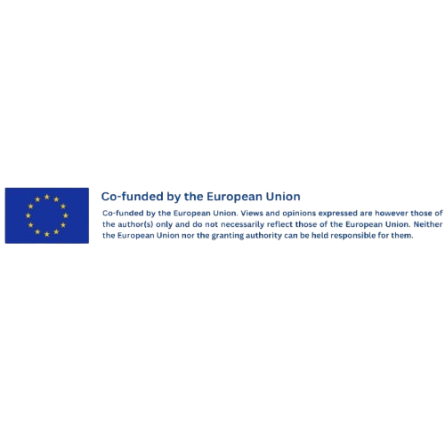




Bordeaux Smart Tourism – Bordeaux Métropole
Location: Bordeaux, France Focus: Data governance, digital inclusion, cultural equity
#CreativeEurope

Slide 2




Introduction
As a recipient of the European Capital of Smart Tourism Award (2022), Bordeaux Métropole has become a reference point for how cities can use data, digital infrastructure, and citizen participation to shape more inclusive, sustainable, and culturally responsive tourism policies.
The CultMed team met with Antoine Bidegain, Deputy Director of Digital and Data at Bordeaux Métropole, to understand how the city leverages ethical data practices, digital rights and participatory tools to enhance the visitor experience while ensuring local benefit.
This best practice explores how digital governance is being used not only to improve cultural service delivery, but also to promote long-term equity, climate adaptation, and cultural accessibility, all key pillars of sustainable cultural tourism.
Name of the Initiative: Bordeaux Smart Tourism
Location: Bordeaux, France
Managing Organization: Bordeaux Métropole
Status: Ongoing
WHERE HERITAGE
MEETS COMMUNITY
#CreativeEurope

Slide 3
The Practice
Description of the Practice
Bordeaux Métropole is the intermunicipal authority governing 28 municipalities in the Bordeaux region. Its digital and data department, comprising over 400 professionals, oversees public IT systems, mobility data, school tech and strategic data policy across sectors, including culture and tourism.
The practice focuses on how Bordeaux uses data-driven tools to promote sustainable, inclusive and experience-based cultural tourism. Rather than relying on volume metrics, the city prioritizes real-time citizen feedback and GDPR-compliant tourism data to inform planning and reduce pressure on overcrowded sites.
Through its participation in the Cities Coalition for Digital Rights (CC4DR), Bordeaux reinforces its model as one where digital innovation serves public values , which is thus making tourism more accessible, sustainable and locally rooted.
WHERE HERITAGE
MEETS COMMUNITY
#CreativeEurope

Slide 4
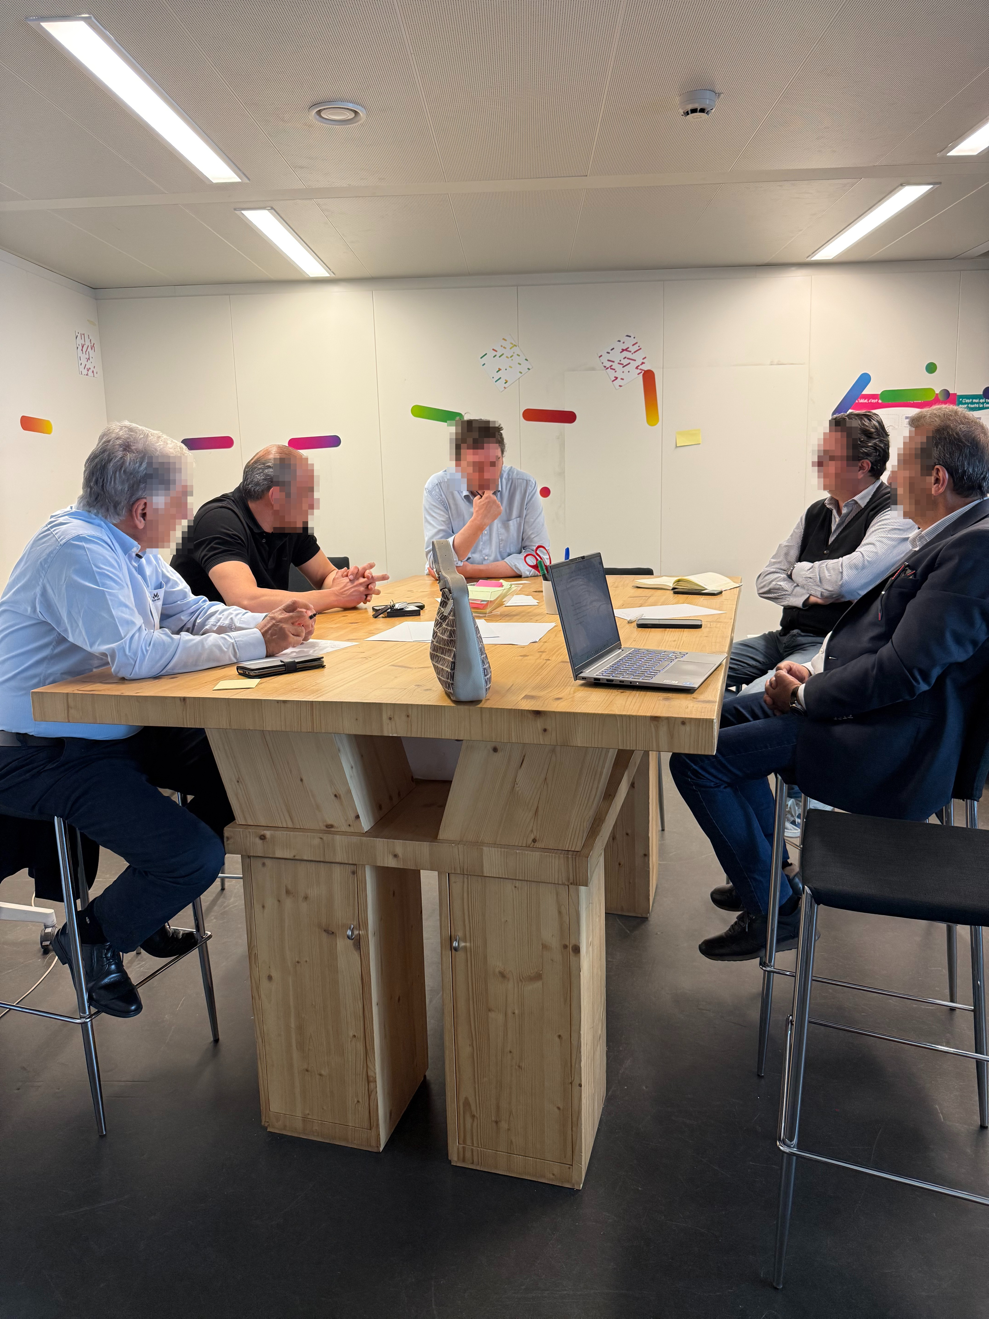
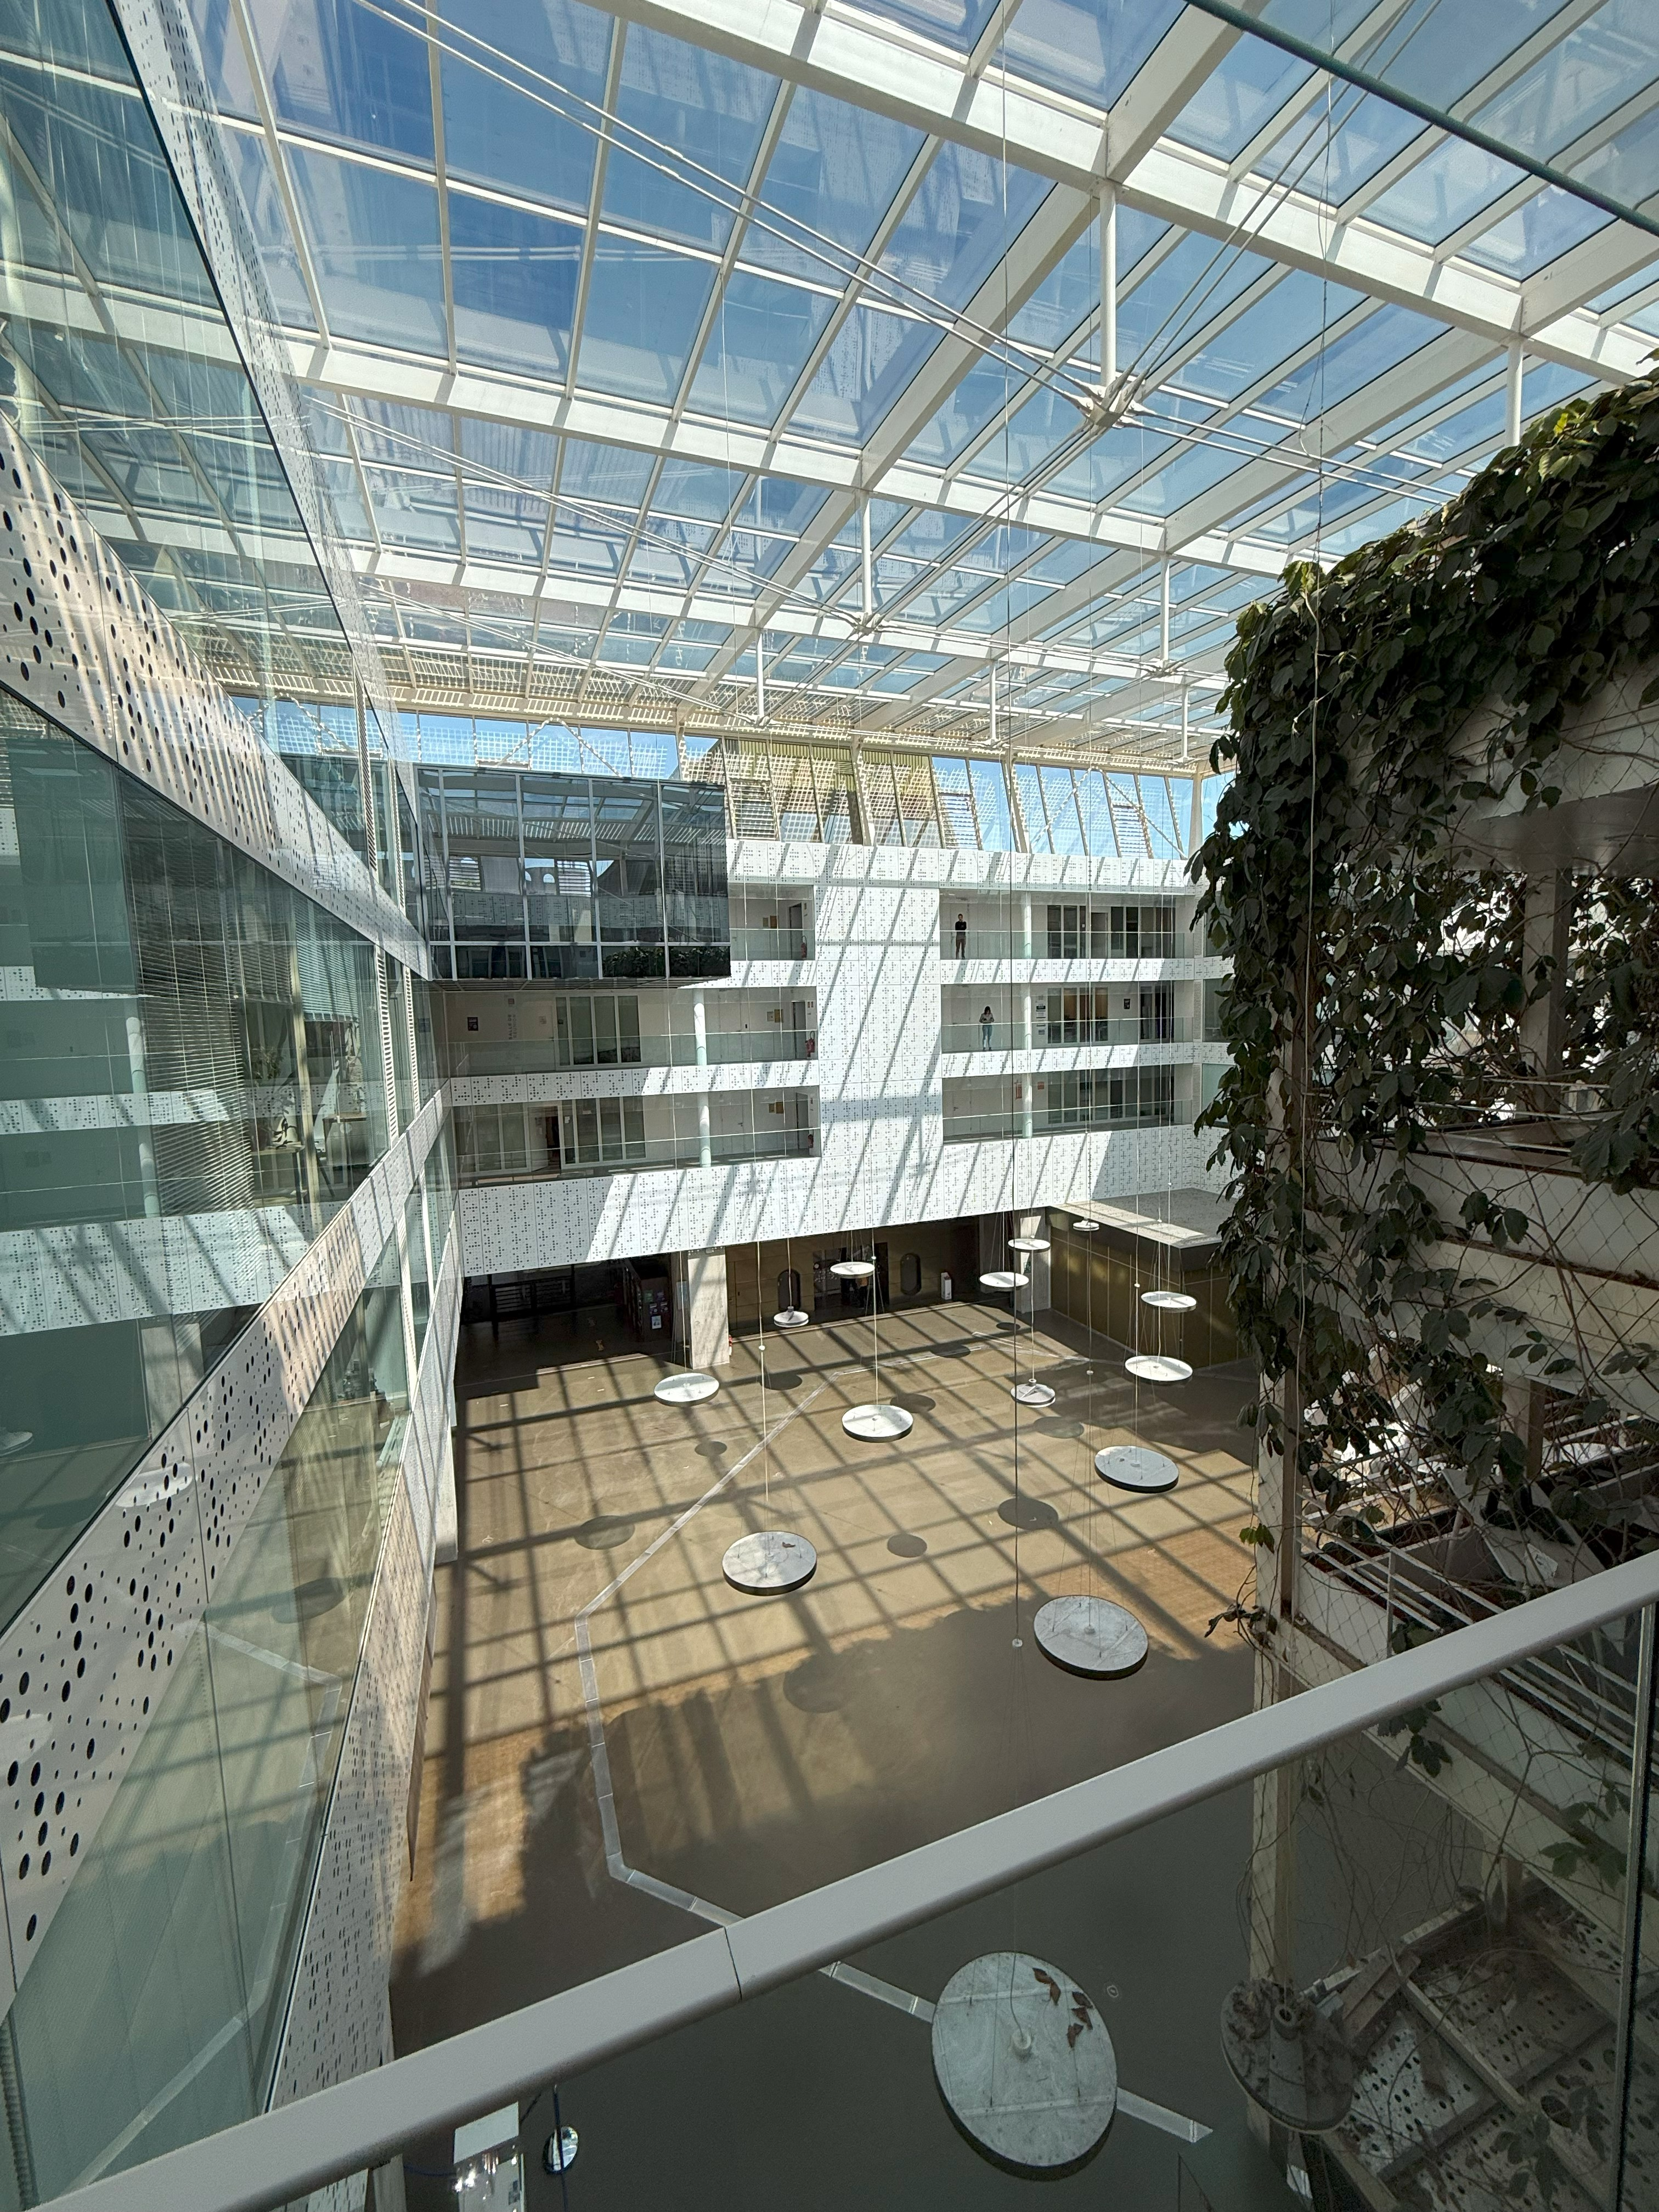
The Practice
The primary objectives of Bordeaux Métropole in terms of Smart Tourism are:
Ensure equitable access to cultural and tourism services through inclusive, data-informed urban planning.
Promote sustainability by using data to manage visitor flows, reduce over-tourism and adapt to climate challenges.
Leverage digital tools (e.g., QR surveys, mobility data) for real-time insights without relying on complex or costly technologies.
Safeguard data sovereignty by maintaining public control over infrastructure and enforcing ethical, GDPR-compliant data use.
Uphold digital rights and public trust through transparent governance and participation in international frameworks like Cities Coalition for Digital Rights (CC4DR).
WHERE HERITAGE
MEETS COMMUNITY
#CreativeEurope

Slide 5
The Practice
Activities Involved:
Urban feedback tools (e.g. QR surveys on comfort perception)
Real-time data use for tourism and mobility planning
Cross-departmental policy integration via internal data lake
Participation in international coalitions like CC4DR
Target Groups:
Residents of Bordeaux Métropole
Local and international visitors
Public sector planners and cultural managers
Policy networks and civic tech actors
Stakeholder Involvement:
Led by Bordeaux Métropole’s digital department in collaboration with municipal services, tech suppliers, telecoms (for mobility data), local universities and global networks (e.g. CC4DR).
WHERE HERITAGE
MEETS COMMUNITY
#CreativeEurope

Slide 6
Local Benefits and Impact
ECONOMIC IMPACT
CULTURAL IMPACT
Promotes broader cultural access by using data to identify gaps in visibility and accessibility
Supports decentralization of tourism, giving exposure to underrepresented cultural sites and events
Enables smarter distribution of tourism flows, supporting local businesses in less-visited areas
Improves efficiency in public investment through targeted, data-backed interventions (e.g., shading, infrastructure)
WHERE HERITAGE
MEETS COMMUNITY
#CreativeEurope

Slide 7
Local Benefits and Impact
ENVIRONMENTAL IMPACT
SOCIAL IMPACT
Real-time urban comfort data informs climate-responsive public space design, reducing heat stress and improving livability
Reduces pressure on overcrowded zones, helping preserve both built and natural heritage
Empowers citizens as co-designers of the urban experience through participatory feedback tools
Builds trust in governance by promoting transparency, responsiveness, and public control of data systems
Supports inclusive planning by combining lived experience with technical data to shape fairer city outcomes
WHERE HERITAGE
MEETS COMMUNITY
#CreativeEurope

Slide 8
Visitors Benefits and Impact
Bordeaux Métropole’s data-driven approach to tourism planning improves the infrastructure, governance, quality, inclusivity and balance of the visitor experience across the metropolitan area.
Key Visitor Benefits:
Better cultural access through the promotion of lesser-known attractions and heritage sites
Improved comfort and usability of public spaces via citizen-informed climate adaptation (e.g., more shaded areas, cooling features)
Less congestion and crowding in overvisited zones, creating a more pleasant and spacious cultural experience
Inclusive design of services driven by data from a wide range of user profiles and demographics
Trustworthy, rights-based digital infrastructure that protects privacy and avoids commercial exploitation of visitor data
WHERE HERITAGE
MEETS COMMUNITY
#CreativeEurope

Slide 9
Sustainability Measures
Cultural Preservation
Economic Sustainability
Resource Preservation
Supports inclusive access to culture by using data to identify under-served areas and audiences
Enhances cultural visibility by promoting lesser-known heritage sites through informed, balanced tourism strategies
Values citizen experience as a cultural resource, integrating lived realities into service design
Public ownership of digital infrastructure (e.g., data lake) reduces reliance on private platforms and enables flexible, long-term planning
Cost-effective, scalable tools like QR-coded surveys replace expensive, opaque digital systems
Smarter distribution of tourism benefits supports local businesses outside typical high-traffic areas
Data informs urban climate adaptation, reducing energy use and enhancing comfort (e.g., shade, cooling features)
Visitor flows are monitored and adjusted to reduce overuse of fragile cultural or urban sites
Low-tech tools enable participation without material or energy-intensive infrastructure
WHERE HERITAGE
MEETS COMMUNITY
#CreativeEurope

Slide 10
Community Involvement
Bordeaux Métropole’s digital strategy is not just a top-down strategy. It also actively integrates citizen participation and lived experience into tourism, public space, and climate planning. While the initiative is institutionally led, it reflects a model where the community acts as a co-producer of urban knowledge and service design.
Participatory Tools and Feedback Loops
Residents are invited to contribute feedback through QR-coded surveys placed in public spaces (e.g. for heat perception in the Urban Comfort Index)
Public insights directly shape interventions such as adding shade, vegetation, or redesigning visitor flows
Inclusive Governance Model
The city prioritizes transparency and interpretability of tools, ensuring citizens understand and trust how their data is used
Citizen involvement supports both visitor wellbeing and resident quality of life
Indirect Empowerment Through Data Ethics
Bordeaux’s commitment to data sovereignty and ethical use ensures citizens are not exploited through surveillance or commercial profiling
Participation in CC4DR reinforces digital rights, including privacy and non-discrimination, for all users of public services
Strengthening Cultural Belonging
By decentralizing cultural access and avoiding tourist saturation, the city helps maintain a sense of place and ownership for local communities
Community input informs how and where cultural services are enhanced or redirected
WHERE HERITAGE
MEETS COMMUNITY
#CreativeEurope

Slide 11
Monitoring, Evaluation and Financing
Monitoring and Evaluation:
Visitor flows are tracked using GDPR-compliant telecom data, enabling responsive tourism strategies
Urban heat perception is measured via QR-coded micro-surveys, contributing to the Urban Comfort Index and guiding real-time interventions
Internal evaluation is conducted through Bordeaux’s central data lake, enabling cross-departmental decision-making
Bordeaux’s approach was externally validated through the European Capital of Smart Tourism Award (2022), awarded by the European Commission for excellence in sustainability, accessibility, digitalization, and cultural heritage
Financing
Supported by Bordeaux Métropole’s investment in public digital infrastructure
Operated through in-house teams and partnerships with academic and technical institutions
Focus on open, ethical, and cost-effective tools reduces long-term financial dependency
WHERE HERITAGE
MEETS COMMUNITY
#CreativeEurope

Slide 12
Replicability and Scalability
Bordeaux Métropole’s smart tourism model is transferable because it combines ethical governance, low-cost tools, and scalable infrastructure. It demonstrates how cities can enhance cultural accessibility, visitor management, and climate responsiveness using data they already collect, with strong public oversight.
Transferable elements:
QR-coded surveys: Simple, low-tech method for gathering citizen feedback, adaptable to many public settings
Data sovereignty model: Suitable for municipalities aiming to retain control over data while working with private vendors
Cross-sectoral data lakes: Can be developed incrementally and tailored to local administrative structures
Participation in networks (e.g., CC4DR): Encourages policy sharing and peer learning among cities
WHERE HERITAGE
MEETS COMMUNITY
#CreativeEurope

Slide 13
Replicability and Scalability
Who can replicate it?
Mid-sized and large cities with fragmented tourism flows
Regional authorities balancing visitor growth with resident well-being
Cities undergoing climate stress and needing better public space planning
The Bordeaux Métropole model demonstrates that:
Data-informed tourism planning enhances fairness, resilience and accessibility in cultural services
Participatory digital tools such as QR-coded surveys can drive inclusive, real-time policy responses
Data sovereignty ensures strategic autonomy and long-term flexibility for public institutions
Digital rights frameworks (e.g., CC4DR) provide a replicable ethical foundation for smart tourism policy
Cross-sector data integration supports more agile, climate-aware and citizen-focused city management
WHERE HERITAGE
MEETS COMMUNITY
#CreativeEurope

Slide 14
Key Conclusions & Takeaways
Bordeaux’s digital strategy offers a human-centered model of smart tourism, using data not to track people for commercial gain, but to inform more inclusive, comfortable, and culturally equitable city planning.
The city’s tools are practical and scalable. QR-coded surveys and GDPR-compliant mobility data enable real-time insight, without relying on high-cost or complex technologies. This makes Bordeaux’s approach replicable by cities of different sizes and resources.
Data sovereignty is a cornerstone of the model, ensuring that public institutions retain control over their digital infrastructure, prevent vendor lock-in, and maintain the flexibility to serve public goals over time.
Citizen participation is embedded, not just consulted. Residents contribute directly to how public spaces and cultural access points are shaped, reinforcing transparency and civic trust.
Bordeaux shows that sustainable cultural tourism can be driven by smart governance, where digital innovation is ethically grounded, climate-responsive and designed for long-term public value.
WHERE HERITAGE
MEETS COMMUNITY
#CreativeEurope

Slide 15
Bibliography
Cities Coalition for Digital Rights. (n.d.). City: Bordeaux. Retrieved May 2025, from https://citiesfordigitalrights.org/city/bordeaux
Bordeaux Métropole. (n.d.). Les 28 communes de la Métropole. Retrieved May 2025, from https://www.bordeaux-metropole.fr/metropole/linstitution-territoire/28-communes-metropole
European Commission. (2022). Bordeaux – European Capital of Smart Tourism 2022. Retrieved May 2025, from https://smart-tourism-capital.ec.europa.eu/bordeaux-european-capital-smart-tourism-2022_en
WHERE HERITAGE
MEETS COMMUNITY
#CreativeEurope

Slide 16
Thank You !
WHERE HERITAGE
MEETS COMMUNITY
#CreativeEurope

