Slide 1


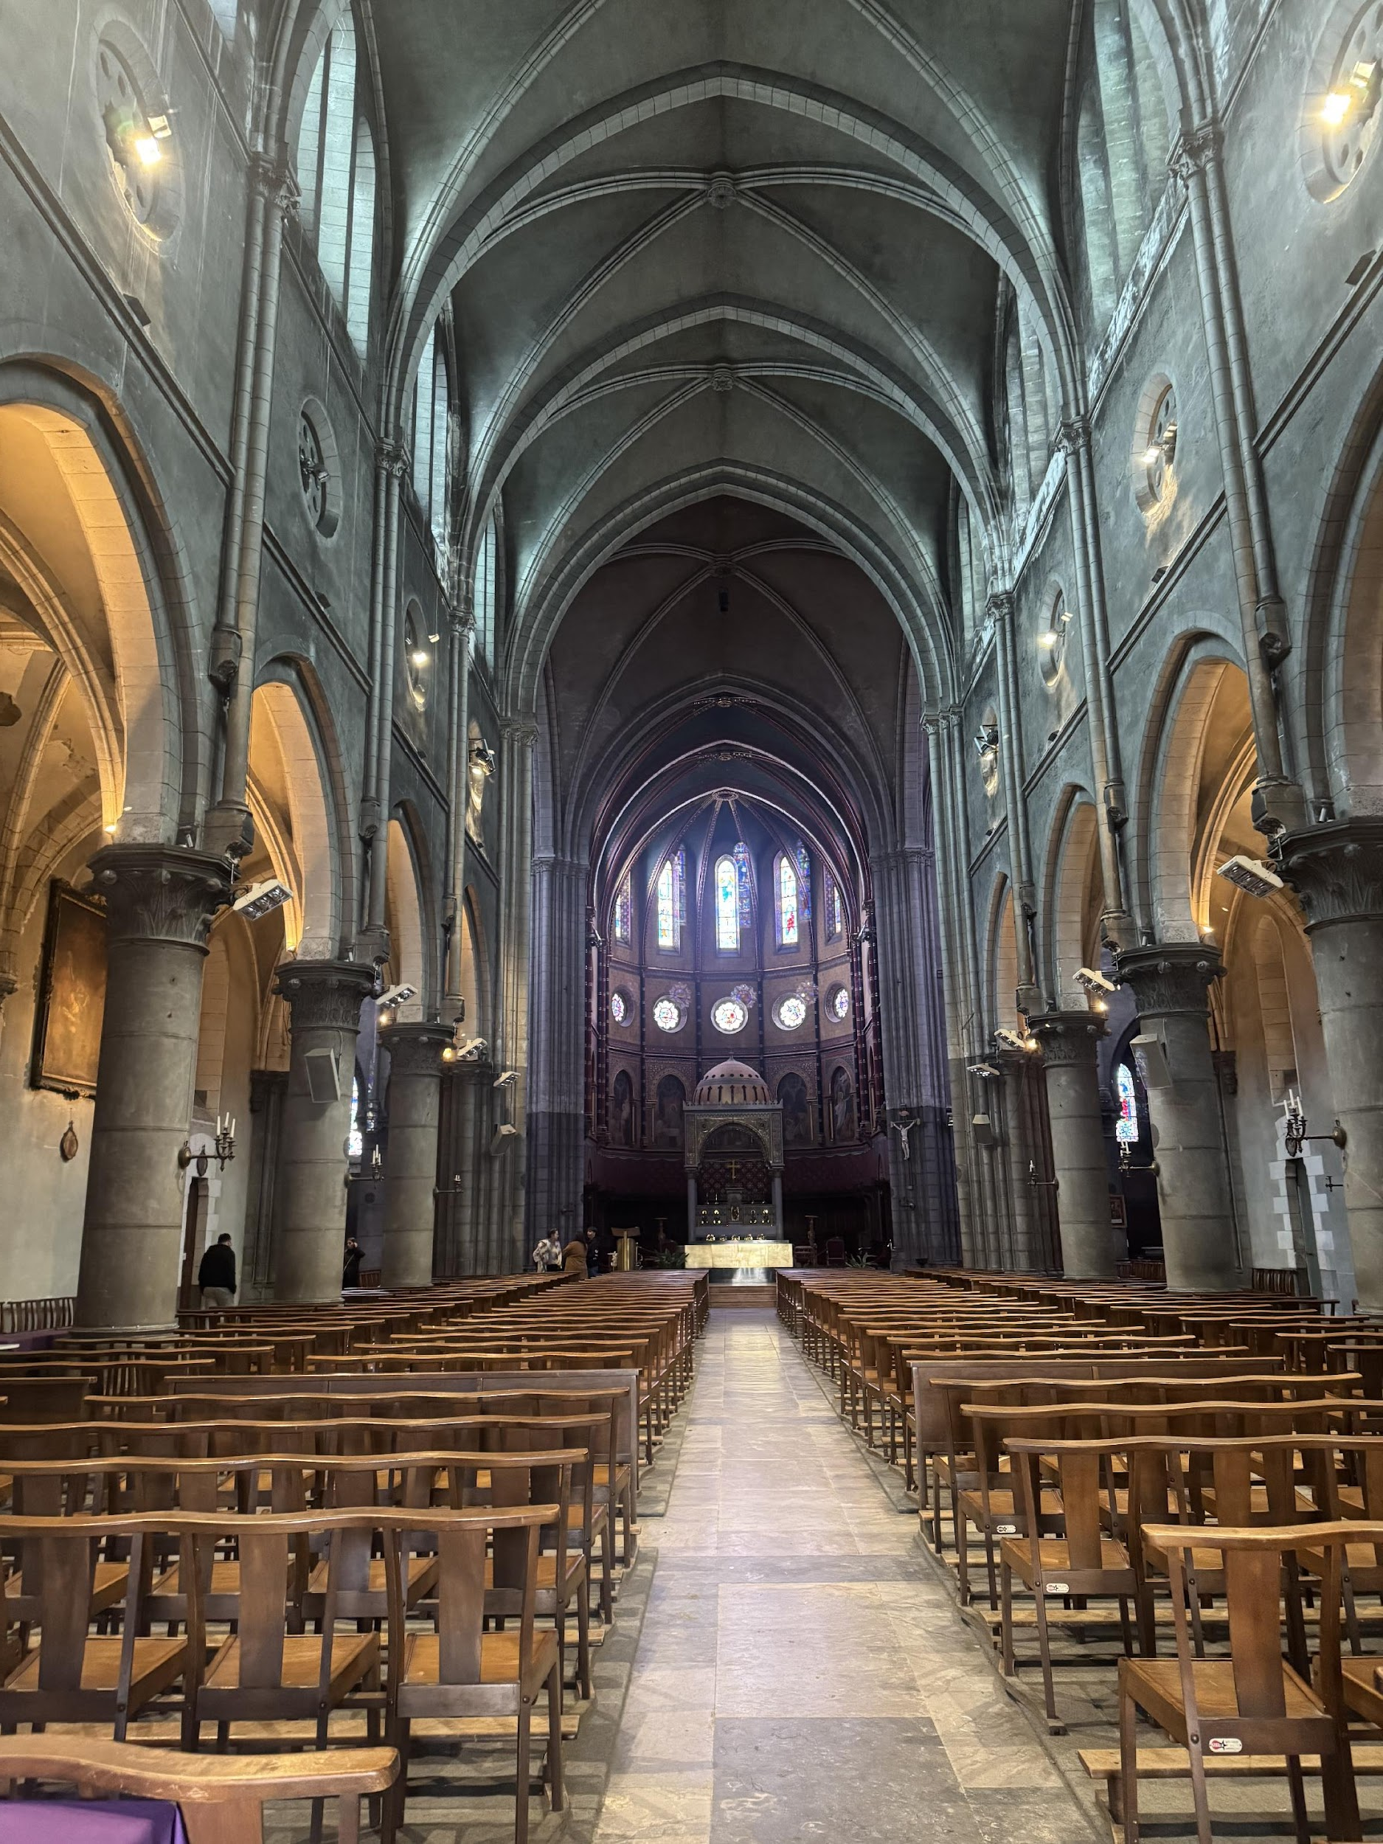
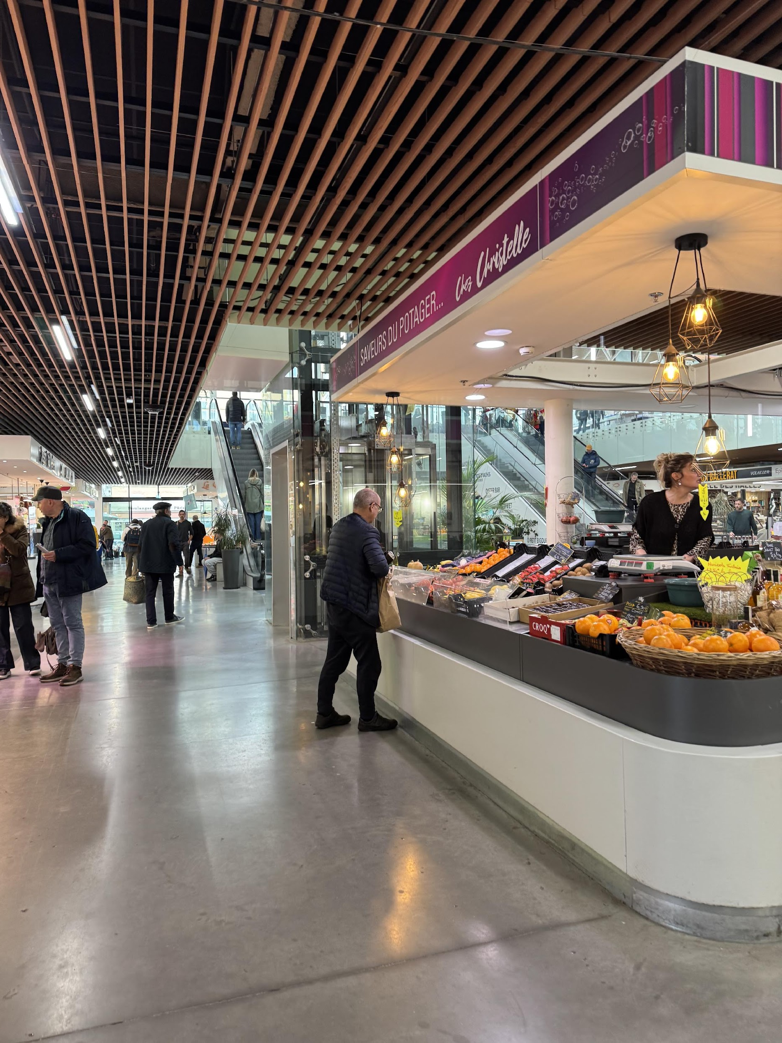


Pau and Its Market: A Model of Food Tourism and Village Tourism
Enhancing Local Heritage through Culture, Food and Community
WHERE HERITAGE
MEETS COMMUNITY
#CreativeEurope

Slide 2






Introduction
Name of the Practice: Pau and Its Market: A Model of Food Tourism and Village Tourism
Location: Pau, Bearn, France.
Type: Promotion of food tourism and village tourism
Initiating Organization: Local tourism office, agricultural and craft associations, food cooperatives
Year of Establishment: initiated in 2020
Current Status: Active and growing
WHERE HERITAGE
MEETS COMMUNITY
#CreativeEurope

Slide 3
Initial stage & Study trip
The identification of this best practice was based on initial research involving local tourism offices, agricultural cooperatives and rural development experts. Selection criteria included the uniqueness of local food traditions, engagement of rural communities, scalability of the model and impact on the regional economy.
A study visit was carried out in Pau and surrounding villages to explore local markets, food festivals and guided culinary tours. Participants engaged with farmers, winemakers, and food artisans, and attended community events. The visit demonstrated how food-based tourism can foster cultural transmission and stimulate sustainable local development. Lesson learned: combining gastronomy with rural heritage builds deeper connections between tourists and the territory.
WHERE HERITAGE
MEETS COMMUNITY
#CreativeEurope

Slide 4
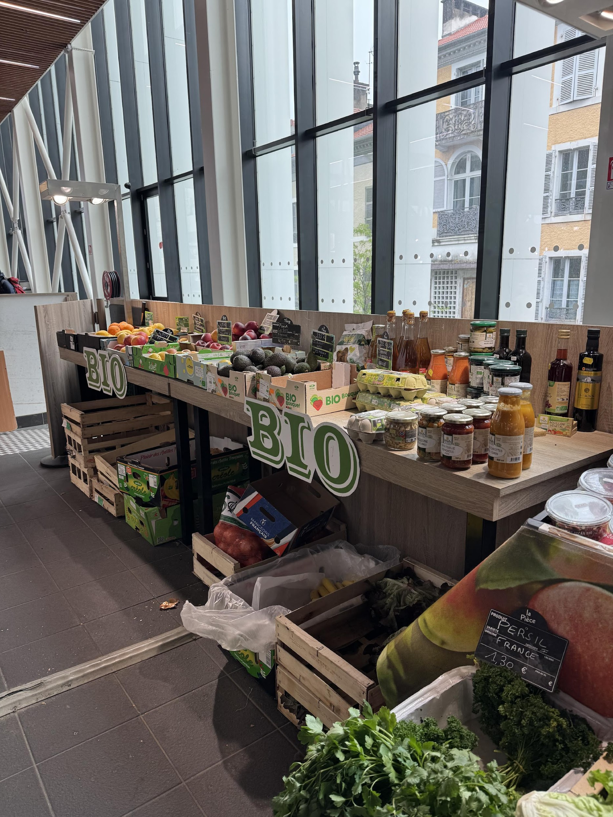
Primary Goals
Promote local culinary culture and food traditions
Support local farmers, winemakers, and food artisans
Encourage tourism in small villages and rural communities
Foster community involvement and preservation of rural heritage
Stimulate responsible and sustainable tourism
Key Focus Areas
Valorization of local markets and typical products
Organization of food festivals and guided tours in villages
Cooking workshops and tastings with local producers
Promotion via digital channels and territorial collaborations
Conservation of rural landscape and environmental respect
Support for small businesses and local artisans

Slide 5
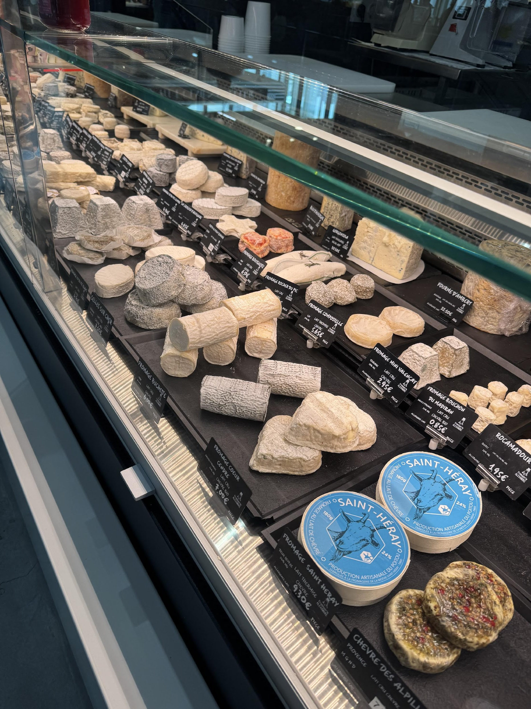
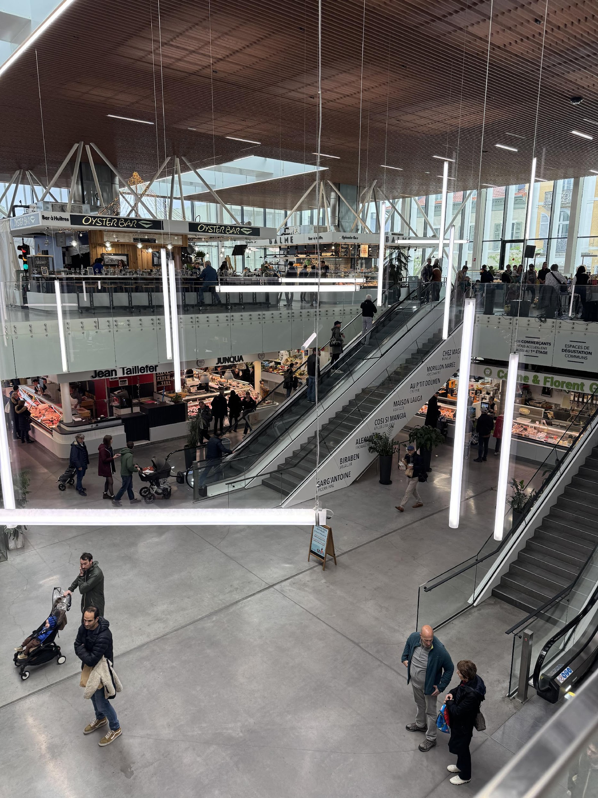
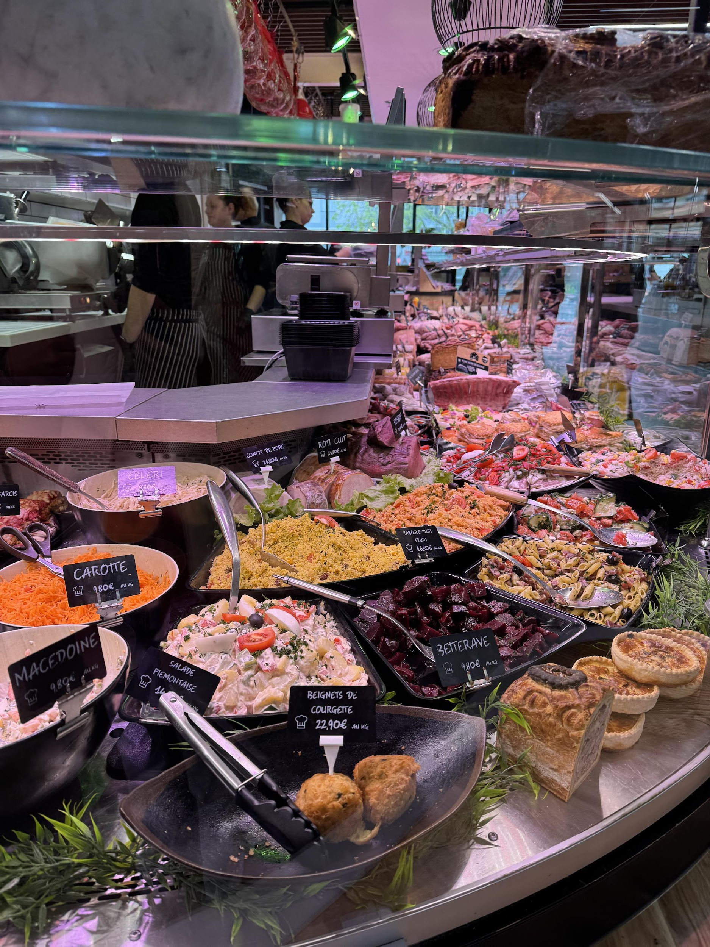
The practice
Activities Involved:
Weekly markets with fresh and typical products
Festivals and fairs dedicated to local specialties (cheese, wine, honey)
Food and wine tours and guided visits to nearby villages
Traditional cooking workshops and guided tastings
Cultural events linked to food and craft traditions
WHERE HERITAGE
MEETS COMMUNITY
#CreativeEurope

Slide 6
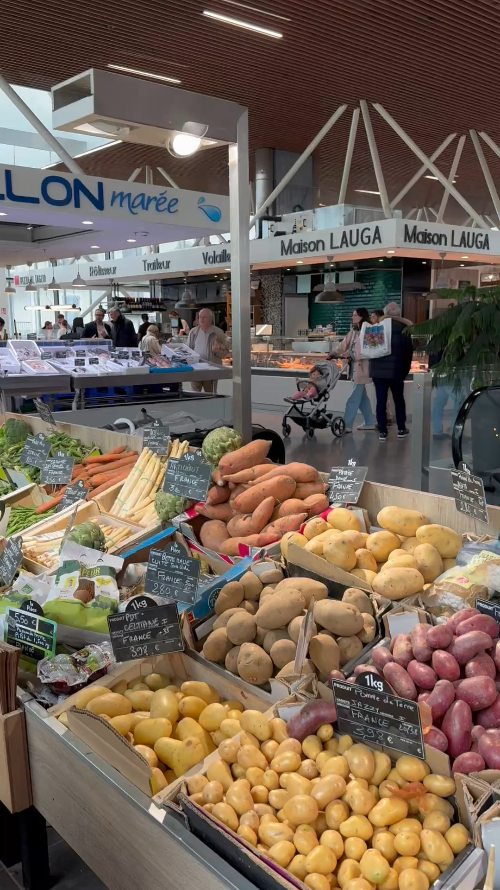
The Practice
Target Groups:
Food tourists interested in discovering authentic flavors
Local residents and regional visitors
Families and groups looking for immersive cultural experiences
Enthusiasts of rural culture and architectural heritage of villages
Professionals in the food and tourism sectors
WHERE HERITAGE
MEETS COMMUNITY
#CreativeEurope

Slide 7
Local Benefits and Impact
ECONOMIC IMPACT
CULTURAL IMPACT
ECONOMIC IMPACT
Increase in demand for local and artisanal products
Support for rural economy and small businesses
Creation of seasonal and permanent jobs
Enhancement of the territory as a niche tourist destination
Preservation of culinary and artisanal traditions
Strengthening of cultural identity and sense of belonging
Education and awareness of sustainable food practices
WHERE HERITAGE
MEETS COMMUNITY
#CreativeEurope

Slide 8
Local Benefits and Impact
ENVIRONMENTAL IMPACT
SOCIAL IMPACT
ECONOMIC IMPACT
Promotion of sustainable, low-impact farming practices
Conservation of rural landscapes and local biodiversity
Reduction of food waste through responsible consumption initiatives
Active involvement of the local community
Creation of opportunities for meeting and cultural exchange
Inclusion of diverse age groups and cultural backgrounds
WHERE HERITAGE
MEETS COMMUNITY
#CreativeEurope

Slide 9
Monitoring, Evaluation and Financing
Evaluation Metrics to Track the Impact
Number of visitors and event participants
Sales of local products and bookings for food tours
Feedback from tourists, producers, and community members
Presence and interaction on social media
WHERE HERITAGE
MEETS COMMUNITY
#CreativeEurope

Slide 10
Monitoring, Evaluation and Financing
Financing
Even though there is no publicly available data about the budget for the festival, the stakeholders that have made it possible to hold it are the following:
The local government
Tourism organizations, including the Office de Tourisme Pau Pyrénées.
Private businesses and food stakeholders
WHERE HERITAGE
MEETS COMMUNITY
#CreativeEurope

Slide 11
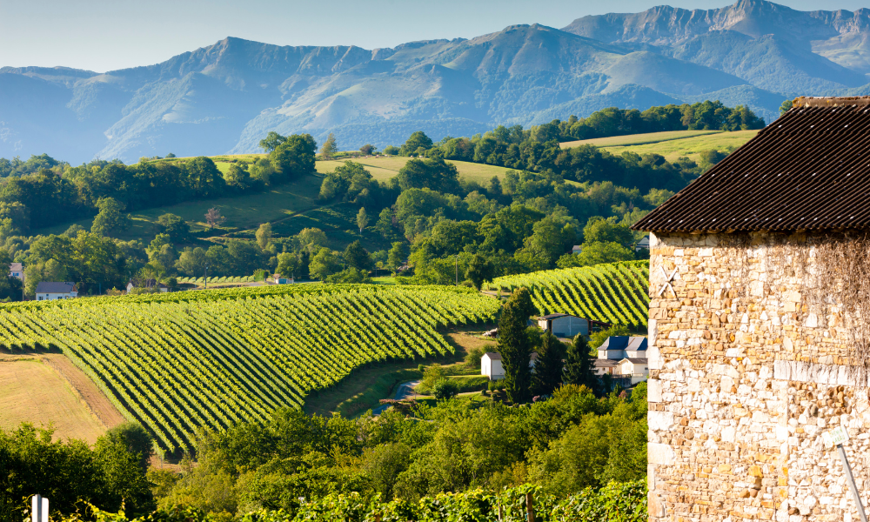
Replicability and Scalability
Transferability
Model adaptable to other towns and regions with historic markets and food traditions
Scalability through expansion of events, duration, and tourism offer
Collaborations to strengthen network and territorial visibility
Integration with other forms of rural and cultural tourism
WHERE HERITAGE
MEETS COMMUNITY
#CreativeEurope

Slide 12
Key Conclusions & Takeaways
Local markets and culinary traditions are powerful tools for sustainable rural tourism.
Community engagement ensures authenticity and reinforces cultural identity.
Food tourism can drive rural development by supporting small producers and artisans.
Educational and tasting events foster awareness about sustainable food practices.
The model is easily replicable in other regions with strong food heritage and community ties.
WHERE HERITAGE
MEETS COMMUNITY
#CreativeEurope

Slide 13
Thank You !
WHERE HERITAGE
MEETS COMMUNITY

Slide 14

WHERE HERITAGE
MEETS COMMUNITY
#CreativeEurope

