Slide 1


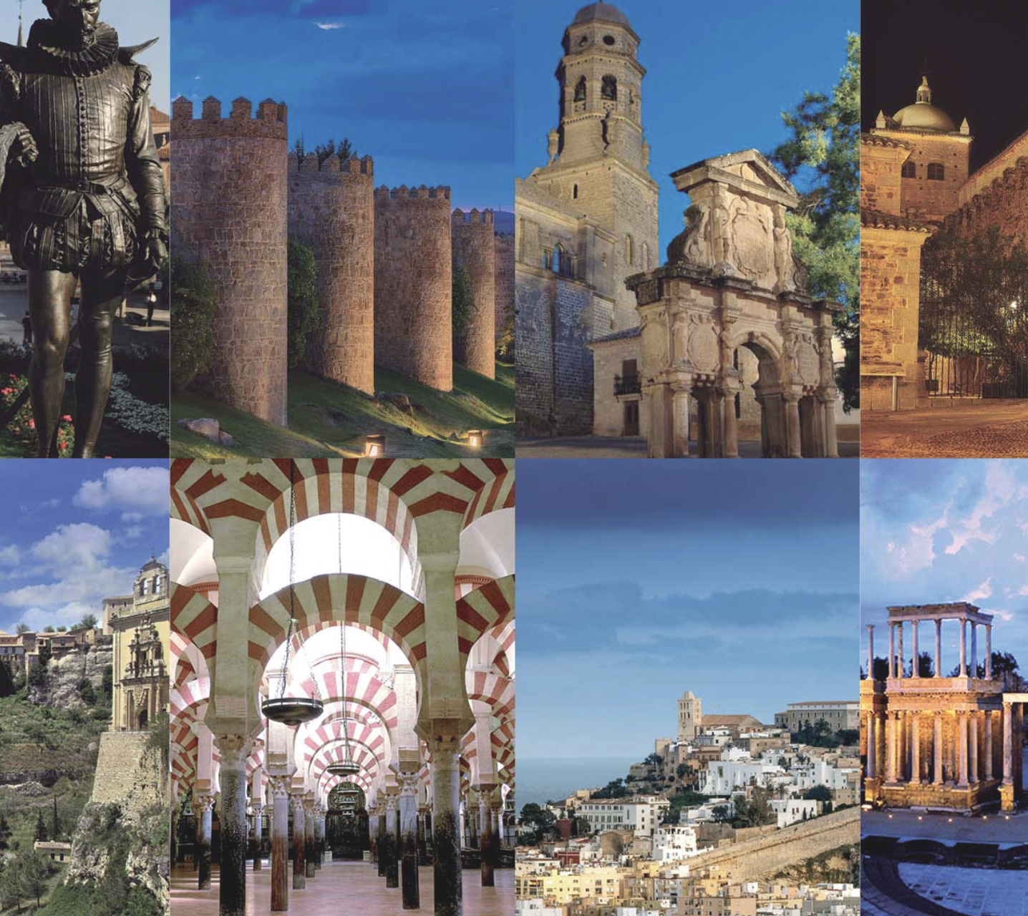
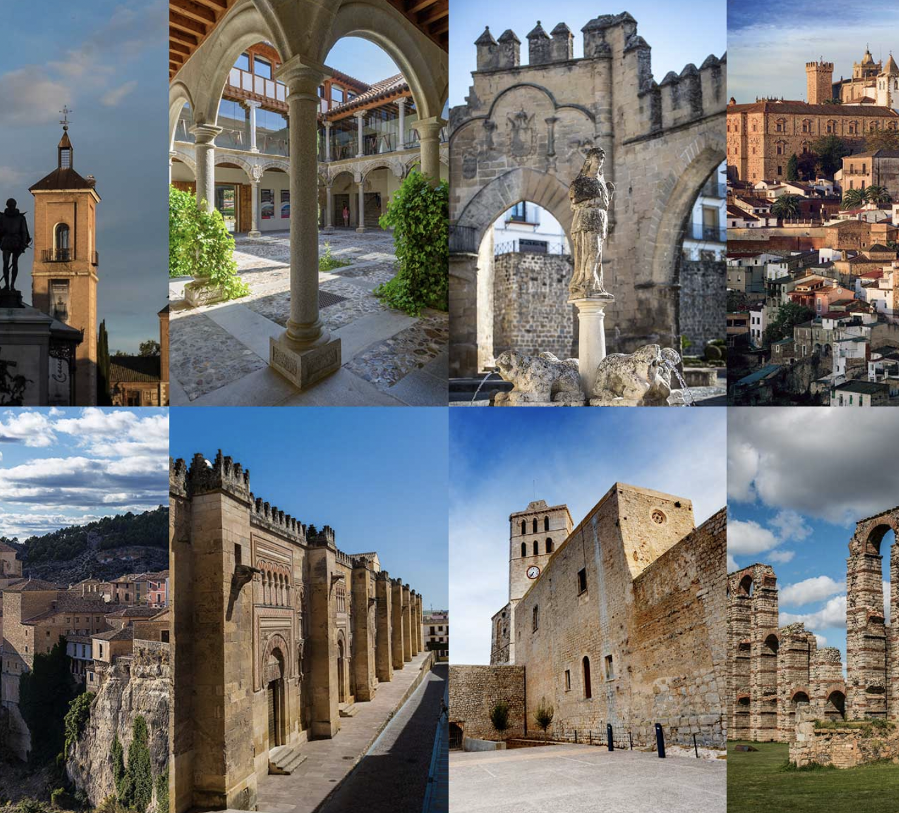


La Noche del Patrimonio
#CreativeEurope

Slide 2






Introduction
Name of the Practice: ‘La Noche del Patrimonio’
Location: 15 World Heritage cities in Spain (Alcalá de Henares, Ávila, Baeza, Cáceres, Córdoba, Cuenca, Ibiza, Mérida, Salamanca, San Cristóbal de La Laguna, Santiago de Compostela, Segovia, Tarragona, Toledo and Úbeda)
Type: Cultural Heritage and identity, Educational Experience
Initiating Organization: Town Councils and Ministry of Tourism
Year of Establishment: 2018
Current Status: Ongoing
WHERE HERITAGE
MEETS COMMUNITY
#CreativeEurope

Slide 3

Introduction
‘La Noche del Patrimonio’ is a national event organised by the Association of World Heritage cities in Spain and celebrated in 15 cities in Spain (Alcalá de Henares, Ávila, Baeza, Cáceres, Córdoba, Cuenca, Ibiza, Mérida, Salamanca, San Cristóbal de La Laguna, Santiago de Compostela, Segovia, Tarragona, Toledo y Úbeda).
Launched in 2018, this initiative was developed to strengthen heritage governance and promote cultural tourism through a sustainable and community-centered approach. By providing unique nighttime access to historical sites, live performances, and interactive experiences, the event fosters deeper connections between visitors and the cultural identity of each city while ensuring the long-term preservation of their heritage.
WHERE HERITAGE
MEETS COMMUNITY
#CreativeEurope

Slide 4


The Practice
Key Target Groups
Tourists & Cultural Travelers: Seeking unique experience experience in the cultural heritage of the city, learning about its traditions and monuments.
Local Communities : Rediscovering their cultural heritage and actively participating in preserving their historical identity.
Youth & Students: Enrich their knowledge of the history, culture and heritage of their environment through educational visits and workshops.
Stakeholder Involvement
Local Communities: Participate through volunteering and support to activities
Cultural and educational institutions: Organization and execution of the event.
WHERE HERITAGE
MEETS COMMUNITY
#CreativeEurope

Slide 5
The Practice
As a major initiative in cultural tourism, La Noche del Patrimonio integrates historical preservation with community engagement and sustainable management. The event opens the doors of World Heritage sites for special activities, allowing both locals and visitors to rediscover their cultural significance in an immersive way. See the complete programme of 2024 here.
Escena Patrimonio (Heritage Scene)
Abierto Patrimonio (Open Heritage)
Vive Patrimonio (Live Heritage)
Streaming organisation of different cultural events focused on giving visibility to and highlighting the traditional dance of each of city. In this section, national and international artists organise artistic performances in UNESCO World Heritage sites.
Open days for the most emblematic monuments and heritage resources of the cities in the group.
Guided and dramatised tours, conferences, thematic days and exhibitions in the most emblematic buildings and spaces of each of the cities participating in this initiative.
WHERE HERITAGE
MEETS COMMUNITY
#CreativeEurope

Slide 6
Local Benefits and Impact
Economic Impact
Direct Economic Benefits: The Noche del Patrimonio generates a direct increase in local economic activity, especially in sectors such as catering, hotel trade and commerce. Tourists and local visitors, when participating in the activities, consume products and services (such as meals, transport and tickets to other events).
Job Creation: The organization of the event creates temporary employment, from tour guides, security staff, to artists and organizers of cultural activities. These events also generate new opportunities for local tourism businesses and related services.
Revenue Generation: Although many activities are free, the services associated with the event generate additional income. Increasing the visibility of the city can attract more tourists throughout the year, contributing to sustained growth in the tourism sector.
Business Opportunities: Local businesses, especially small businesses, benefit from an increase in the number of visitors coming to the city to participate in the event, leading to additional business opportunities, as collaborations with event organization or specific promotions.
WHERE HERITAGE
MEETS COMMUNITY
#CreativeEurope

Slide 7
Local Benefits and Impact
Cultural Impact
Cultural Preservation: The Noche del Patrimonio plays a key role in preserving cultural heritage by making historical spaces more accessible to the public and enhancing their importance. In addition, educational and awareness-raising activities help to protect local traditions and customs.
Promotion of local heritage: The event highlights the cultural richness of the region by presenting its monuments, historical sites and local art. Visitors have the opportunity to learn about the history and traditions of the place, strengthening their connection with the community and generating a greater appreciation for the local culture.
Strengthening cultural identity: By involving residents in the organization and execution of activities, the event contributes to reinforcing a sense of cultural identity and belonging, allowing locals to take pride in their heritage and culture.
Cultural Exchange: The participation of tourists and citizens from different regions or countries also promotes cultural exchange, diversity and mutual understanding between different communities.
WHERE HERITAGE
MEETS COMMUNITY
#CreativeEurope

Slide 8
Local Benefits and Impact
Environmental Impact
Sustainable Practices: Sustainable practices such as the use of recycled materials, promotion of public transport and responsible waste management are adopted during the event. The event’s ecological footprint is minimized through the efficient use of resources.
Energy Conservation: Energy-saving measures are implemented, such as efficient lighting of monuments and the use of renewable energies in event activities to reduce environmental impact.
Eco-friendly Promotion: The event promotes responsible tourism practices, such as the use of public transport, respect for natural areas and care for the environment, encouraging both locals and tourists to adopt more sustainable habits.
Environmental Awareness: The Noche del Patrimonio itself is an opportunity to educate people about the importance of conserving environmental and cultural heritage, and how small gestures can make a difference in protecting the environment.
WHERE HERITAGE
MEETS COMMUNITY
#CreativeEurope

Slide 9
Local Benefits and Impact
Social Impact
Inclusivity: The Noche del Patrimonio is an event accessible to all types of public, regardless of their age, origin or economic situation. Providing free access to everybody, contributing to cultural and social inclusion.
Community Well-being: The active involvement of residents in organizing the event contributes to social welfare by strengthening community cohesion. In addition, the event serves as a meeting point for people of different ages and backgrounds, promoting social integration.
Education and Empowerment: Educational activities for both locals and visitors encourage learning about history, traditions, local values and the role of each in their conservation. This strengthens the relationship between citizens and their environment, generating a greater commitment to the common welfare.
Sense of belonging: Participating in the event also helps residents feel more connected to their community. Through volunteering, supporting activities and celebrating heritage, a greater sense of belonging and local pride is generated.
WHERE HERITAGE
MEETS COMMUNITY
#CreativeEurope

Slide 10
Visitors Benefits and Impact
Cultural Engagement & Education
Visitors have the opportunity to learn about local history and the importance of heritage through guided tours and educational activities, allowing for a deep immersion in local traditions and customs. These experiences enrich the understanding of the culture and promote appreciation for the historical roots of the place, creating a closer connection with the community.
Behavioral Impact on Visitors
The event promotes respect for local heritage and customs, as well as stimulating responsible and sustainable practices in tourism, promoting a conscious attitude towards cultural and environmental conservation. By raising awareness, participants are encouraged to adopt more responsible and respectful travel habits for the communities and environment they visit.
Immersive Experience & Community Contribution
Visitors experience the local culture by interacting with the heritage in a meaningful way, participating in traditional activities, learning from local guides and contributing to community support. They experience the culture in an authentic way, leaving a more lasting mark on their perception and appreciation of the destination.
WHERE HERITAGE
MEETS COMMUNITY
#CreativeEurope

Slide 11
Sustainability Measures
Active conservation of monuments and cultural spaces through restoration and maintenance activities.
Protection of local traditions and customs through community involvement.
Development of an economic model that ensures long-term benefits for the community by promoting sustainable tourism and integrating local businesses into the event.
Use of sustainable resources to reduce the environmental impact of the event.
Implementation of measures for waste reduction and energy efficiency.
Cultural Preservation
Economic Sustainability
Resource Preservation
WHERE HERITAGE
MEETS COMMUNITY
#CreativeEurope

Slide 12
Community Involvement
Role of Local Community
The local community plays a key role in the organization and execution of the event, participating as volunteers, guides, artists and promoters. Their involvement strengthens the sense of belonging, preserves traditions and creates economic and social opportunities. In addition, their active participation ensures that the event truly reflects the cultural identity of the place.
Ownership and Management:
The event is managed by local and national authorities, with strong community participation to ensure that benefits remain in the region. Collaboration between institutions and residents allows for equitable and sustainable management, avoiding the externalization of benefits and promoting reinvestment in heritage conservation and local development.
WHERE HERITAGE
MEETS COMMUNITY
#CreativeEurope

Slide 13
Monitoring, Evaluation and Financing
Evaluation Metrics
Level of participation in activities: Collecting data on attendance and interest in the various initiatives.
Feedback from visitors and local actors:: Feedback from visitors and local actors is collected through surveys and discussion forums.
Conservation Outcomes : The actions for preservation of cultural and environmental heritage promoted by the event are monitored such as the restoration or maintenance of historical sites, the promotion of sustainable practices in tourism and awareness raising on environment conservation.
Economic indicators: Economic indicators such as growth in tourism and local consumption are analysed to assess the financial impact on the community.
WHERE HERITAGE
MEETS COMMUNITY
#CreativeEurope

Slide 14
Monitoring, Evaluation and Financing
Feedback Mechanisms
Surveys to visitors and contributors: Surveys directed to visitors and contributors are used as feedbacks to know their experiences and suggestions.
Feedback meetings with local organizations and stakeholders: Feedback meetings are organized with local organizations and stakeholders to discuss improvements and evaluate the management of the event in a participatory manner.
WHERE HERITAGE
MEETS COMMUNITY
#CreativeEurope

Slide 15
Monitoring, Evaluation and Financing
Continuous Improvement
Adapting activities: Each edition of the event is adjusted according to the needs and suggestions identified in the previous evaluations.
Optimization of logistics and accessibility: Changes are being implemented in programming, logistics and activities to improve the experience and ensure a positive impact on both the community and visitors.
Incorporation of new sustainable initiatives: To minimize environmental impact and strengthen heritage preservation, energy saving measures are implemented in event activities to promote responsible practices among visitors.
WHERE HERITAGE
MEETS COMMUNITY
#CreativeEurope

Slide 16
Monitoring, Evaluation and Financing
Funding Sources and budget information
Funded through local and national government grants: The event is funded through local and national government grants, ensuring its long-term viability.
Collaboration with private sponsors to fund specific activities.: Collaboration with private sponsors that support the financing of specific activities to diversify sources of income and expand cultural offerings.
WHERE HERITAGE
MEETS COMMUNITY
#CreativeEurope

Slide 17
Replicability and Scalability
Transferability
‘La Noche del Patrimonio’ model is adaptable to other cities or countries, especially those with a rich cultural heritage and the willingness of local authorities to support cultural events. Its flexible structure allows it to be adapted to different contexts, incorporating the particularities of each destination. In addition, its combination of cultural activities, community participation and focus on sustainability makes it replicable in urban and historical environments that seek to enhance their heritage and promote responsible tourism.
To ensure success elsewhere, it is essential to build partnerships between cultural institutions, local authorities and community organizations that can provide resources and local knowledge. The dissemination of case studies and good practices derived from the event can serve as a reference for their implementation in new regions. The ability to adapt programming to each city’s history and traditions also ensures that the initiative maintains its authenticity and cultural appeal.
WHERE HERITAGE
MEETS COMMUNITY
#CreativeEurope

Slide 18
Replicability and Scalability
Challenges and Barriers
Coordination between multiple stakeholders, including local authorities, cultural organizations, sponsors and communities, requiring clear planning and effective communication.
Logistical challenges, such as crowd management, security in heritage spaces and the need for adequate infrastructure for visitor flow.
Sustainability of the event, ensuring that activities are environmentally friendly, minimizing the impact on historic sites and promoting responsible practices among attendees.
Long-term funding is a major challenge as the event requires constant resources to maintain its quality and reach. Reliance on grants and sponsorships can affect their continuity, so developing diversified funding strategies such as selling exclusive experiences or collaborating with private entities is key.
Adaptation to external factors, such as climatic conditions or health crises, also requires the implementation of innovative solutions to ensure that the event is held in different scenarios.
WHERE HERITAGE
MEETS COMMUNITY
#CreativeEurope

Slide 19
Replicability and Scalability
Potential for Expansion
There are opportunities to expand the event internationally, promoting cultural exchange between cities and strengthening the European heritage network. Collaboration with other cities with a similar cultural heritage would create a global platform for heritage celebration, facilitating transnational cooperation and the exchange of good practices in cultural preservation and promotion. In addition, the integration of new technologies such as virtual tours and interactive digital experiences could broaden their reach and attract an even more diverse audience.
To achieve this expansion, it is key to encourage agreements between cities, creating cultural circuits that connect different heritage under the same initiative. The inclusion of new activities, such as international artistic residencies or collaborations with educational institutions, could enrich the event’s offer. Also, its promotion in social networks and digital platforms would help to capture the attention of a wider audience, strengthening its impact and consolidating it as a reference in the valorization of heritage worldwide.
WHERE HERITAGE
MEETS COMMUNITY
#CreativeEurope

Slide 20
Key Conclusions&Takeaways
An adaptable and scalable model: La Noche del Patrimonio can be implemented in other cities with cultural heritage, providing there institutional and community support.
Positive impact in multiple areas: The event boosts tourism, local economy, cultural preservation and environmental awareness.
Active community participation: Local involvement strengthens the authenticity of the event and creates a sense of belonging.
Logistical challenges and financial sustainability: Event management requires planning to ensure its long-term viability.
Opportunity for expansion and digitization: International cooperation and the use of technology can broaden your reach and improve the visitor experience.
WHERE HERITAGE
MEETS COMMUNITY
#CreativeEurope

Slide 21
Thank You !
WHERE HERITAGE
MEETS COMMUNITY

Slide 22
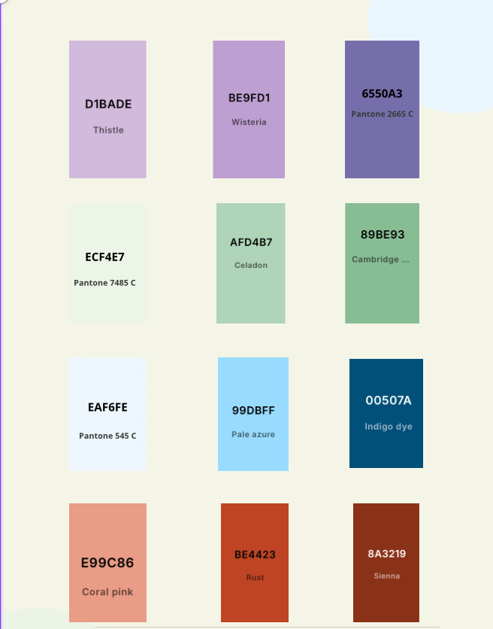
WHERE HERITAGE
MEETS COMMUNITY
#CreativeEurope

