Slide 1


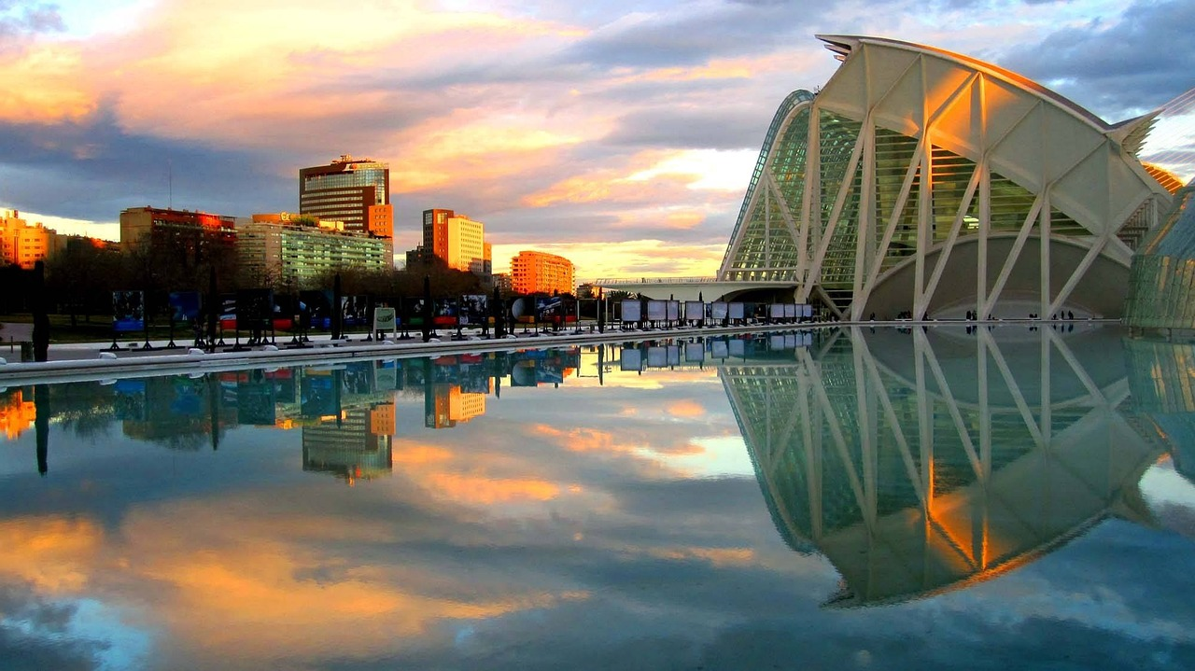
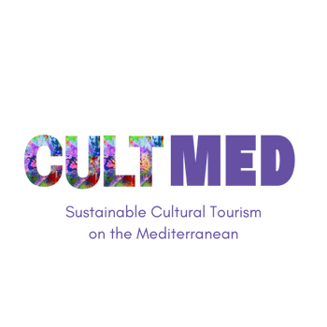

Geocaching experience ‘On the trail of the Holy Grail in Valencia
#CreativeEurope

Slide 2






Introduction
Name of the Practice: Geocaching Experience ‘On the trail of the Holy Grail’
Location: Valencia, Spain
Type: Cultural Heritage, Educational and Interactive Experience
Initiating Organization: Valencia townhouse and Visit Valencia Foundation
Year of Establishment: 2021
Current Status: Ongoing
WHERE HERITAGE
MEETS COMMUNITY
#CreativeEurope

Slide 3
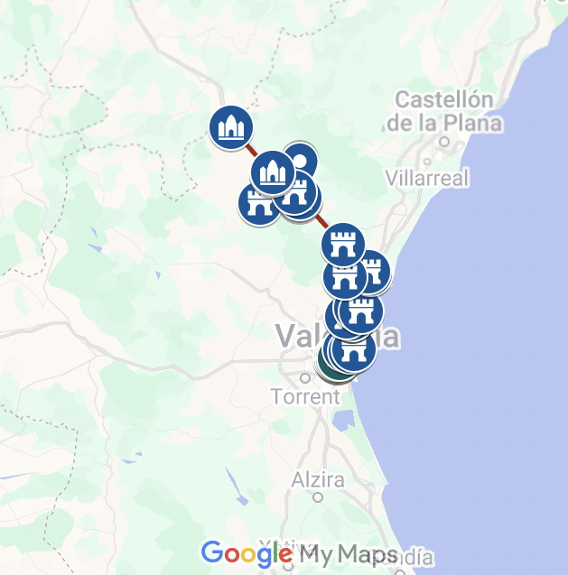
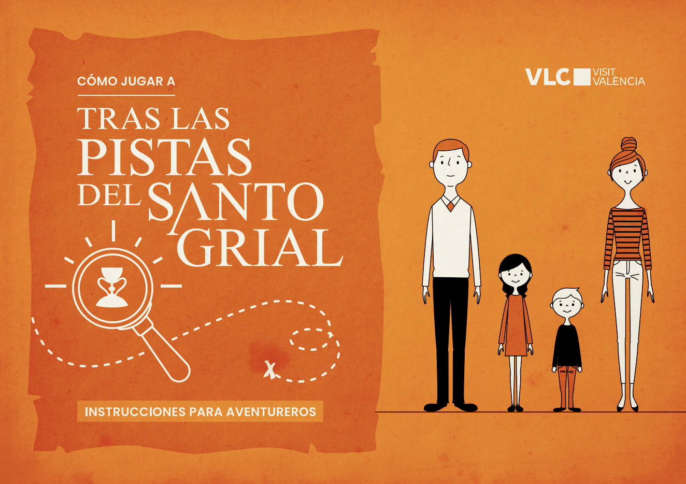
Introduction
With the aim of enhancing the value of heritage, especially the intangible cultural heritage, Valencia townhouse and Visit Valencia have created a geocaching trail and an app with which visitors can explore and learn in a playful way about the history of the city of Valencia and its relationship with the emblematic Holy Grail, recognised by the Vatican and kept in the Cathedral.
Discover more here.
Complete route of the Saint Grail through the region of Valencia
WHERE HERITAGE
MEETS COMMUNITY
#CreativeEurope

Slide 4


The Practice
Key Target Groups
Tourists & Cultural Travelers: Seeking unique experience in Valencia’s material and immaterial cultural heritage and learning about it through a gamified experience.
Students & Educators: Learning about Valencia’s culture through gamified experiences.
Local Communities : Benefiting from heritage preservation and increased tourism.
Stakeholder Involvement
Visit Valencia foundation: Co-founder and primary operator
Valencia townhouse: Co-founder and primary operator.
WHERE HERITAGE
MEETS COMMUNITY
#CreativeEurope

Slide 5
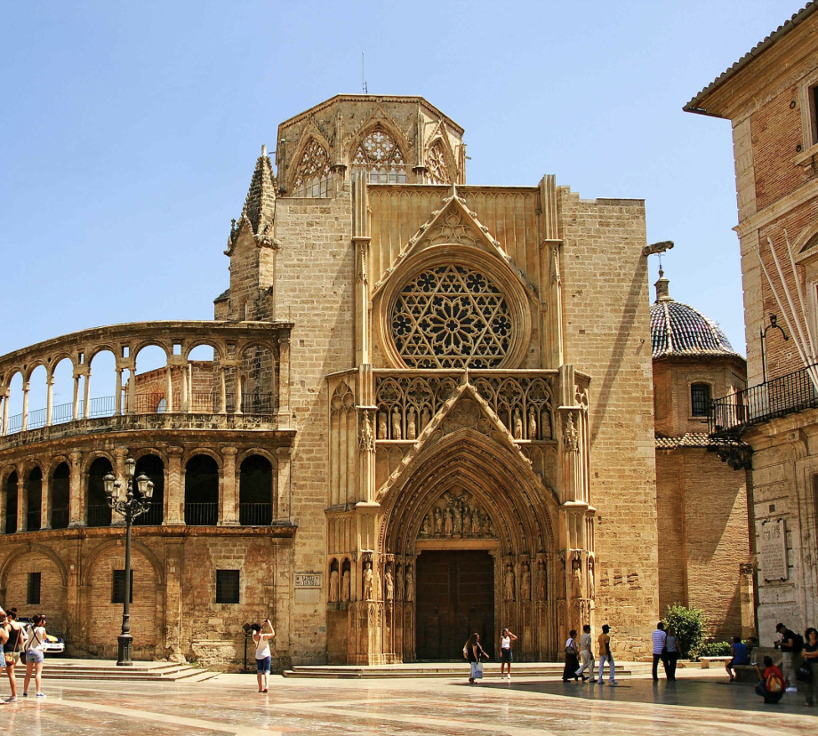

The Practice
The visitors take the fictional role of Sabina’s Buey heir and have to solve puzzles and enigmas on a mobile phone app that takes them to different towns in the region of Valencia searching for a treasure: the Saint Grail. Focusing on the city of Valencia, the route includes Valencia’s most important cultural heritage assets: from the Patriarch's Museum to the Royal Gardens, passing through the Church and Palace of the Temple, the Museum of Fine Arts, the Church of San Martín Obispo and San Antonio Abad, to the Valencia Silk Exchange and the Cathedral of Valencia itself, where the Grail is kept.
Once the experience is complete and all puzzles and enigmas have been solved, users obtain aa code that can be exchanged for a set of official items from the experience at the Valencia Tourist Office
The Cathedral of Valencia and the Saint Grail
WHERE HERITAGE
MEETS COMMUNITY
#CreativeEurope

Slide 6
Local Benefits and Impact
Local Benefits and Impact
Increased Sales & Exposure for Local actors: Cultural sites and businesses that are in the trail’s area will have increased visibility, expanding their market reach and business opportunities.
Encouraged Sustainable Tourism Growth: By promoting eco-friendly tourism, the project adopts a sustainability-focused strategy that support long-term economic resilience.
Environmental Impact
Economic Impact
Waste Reduction & Sustainable Packaging: The trail only needs an app that can be downloaded, avoiding any material support.
Eco-Friendly Tourism Practices: By allowing the trail to be only walkable or bikeable, the initiative is promoting eco friendly tourism practices that can last a long time.
WHERE HERITAGE
MEETS COMMUNITY
#CreativeEurope

Slide 7
Local Benefits and Impact
Cultural Impact
Preserving the immaterial cultural heritage of Valencia: By gamifying the history of the Holy grail, visitors are more likely to remember the knowledge and more prone to dig deeper into history.
Educating Future Generations: The trail has been designed for all ages and especially for families, fostering the education of the youngest.
Promoting Cultural Narratives: The purpose of this initiative is to preserve the immaterial heritage of the Holy Grail’s story and its link with Valencia’s city.
Recognition as a Active Tourism product : The application and initiative were awarded the prize of best Active tourism product on the 26th edition of the FITUR Active Tourism Competition.
WHERE HERITAGE
MEETS COMMUNITY
#CreativeEurope

Slide 8
Local Benefits and Impact
Social Impact
Inclusive Learning Experiences: The trail cater to students, adults and visitors of all ages, ensuring widespread cultural engagement.
Stronger Community Ties: By gamifying and creating a strong storytelling components, the app strengthens local identity and pride.
Tourism Accessibility & Inclusivity: The app can be downloaded on any phone and is adapted to people with disabilities.
WHERE HERITAGE
MEETS COMMUNITY
#CreativeEurope

Slide 9
Visitors Benefits and Impact
Gamification : This is the main way visitors get to learn about the history of the holy grail and Valencia’s historic sites and heritage.
Cultural Engagement & Education
Behavioral Impact on Visitors
Respect for traditions: Increased respect for cultural sites on the trail and the history of the city in general.
Fostering sustainable travel habits : Walking or biking through the city and between historical sites encourages people to discover the city in an eco-responsible way.
Shift Toward Slow and Experiential Tourism: The trail avoids large crowds therefore fostering slow tourism.
Immersive Experience & Community Contribution
Gamification : The unique experience offered by the game makes it memorable
A True Sense of Place: Visitors develop a personal connection to Valencia, returning or sharing their experiences with others.
WHERE HERITAGE
MEETS COMMUNITY
#CreativeEurope

Slide 10
Sustainability Measures
Cultural Preservation
The trail makes sure that the geocaching is all virtual, avoiding unnecessary physical searching and erosion of historical monuments.
The initiative doesn’t need a lot of maintenance because once the app is created, there’s very little investment to be done.
Economic Sustainability
The initiative is very low-consuming on resources. It makes sure that the features of the app are low-consuming in terms of storage and battery usage.
Resource Preservation
WHERE HERITAGE
MEETS COMMUNITY
#CreativeEurope

Slide 11
Community Involvement
Role of Local Community
Locals are involved in the execution phase by contributing to the app's content creation, such as sharing stories and legends related to the Holy Grail and other historical landmarks.
Local business and especially those involved in the tourism sector, such as hotels and restaurants, have a direct role on the touristic services that contribute to enrich the visitors’ experience in the city.
Ownership and Management
The project is developed by two local stakeholders : Visit Valencia foundation and Valencia Townhouse. the latest represent the local community and its interests since it’s a public body.
Facilitating the collaboration among other stakeholders, including technology providers for the app and cultural institutions for its content.
WHERE HERITAGE
MEETS COMMUNITY
#CreativeEurope

Slide 12
Monitoring, Evaluation and Financing
Evaluation Metrics:
Visitor Satisfaction: Measured through user reviews and ratings on app stores, as well as feedback forms within the app.
Economic Indicators: Tracking the number of downloads, user engagement, and revenue generated from in-app purchases or partnerships with local businesses.
Conservation Outcomes: Assessing the app's impact on preserving and promoting the historical sites, and its role in educating visitors about Valencia's cultural heritage.
Feedback Mechanisms:
In-App Surveys: Users can provide feedback directly within the app after completing the experience.
Social Media Engagement: Monitoring comments and interactions on social media platforms to gauge user satisfaction and gather suggestions.
Community Meetings: Regular meetings with local stakeholders and community members to discuss the app's impact and gather insights for improvement.
WHERE HERITAGE
MEETS COMMUNITY
#CreativeEurope

Slide 13
Monitoring, Evaluation and Financing
Continuous Improvement:
Adaptations Based on Feedback: Regularly updating the app to address user feedback, such as improving puzzle difficulty, enhancing navigation features, and adding new historical content.
Technological Enhancements: Incorporating advanced technologies like augmented reality (AR) to enrich the user experience and make the historical sites more engaging.
Accessibility Improvements: Ensuring the app is accessible to all users, including those with disabilities, by adding features like text-to-speech and high-contrast displays.
Funding Sources and Budget Information:
Grants and Public Funds: The initiative is supported by grants from the Visit Valencia foundation and Valencia Townhouse.
WHERE HERITAGE
MEETS COMMUNITY
#CreativeEurope

Slide 14
Replicability and Scalability
Transferability:
Lessons Learned: The initiative demonstrated the effectiveness of gamification in engaging visitors with historical and cultural sites. The use of puzzles and interactive elements significantly enhanced user engagement and learning.
Adaptation to Other Contexts: The model can be replicated in other cities with rich historical backgrounds. By customizing the app's content to highlight local landmarks and stories, it can attract tourists and promote cultural heritage in diverse locations.
Key Elements for Adaptation:
Collaboration with local historical societies and tourism boards.
Incorporation of local folklore and legends into the app's narrative.
Utilization of local language options to cater to a broader audience.
WHERE HERITAGE
MEETS COMMUNITY
#CreativeEurope

Slide 15
Replicability and Scalability
Challenges and Barriers:
Technological Issues: Ensuring the app's compatibility across different devices and maintaining smooth functionality was a significant challenge. Regular updates and user testing were crucial in overcoming these issues.
Engagement and Accessibility: Making the app accessible to users of all ages and abilities required thoughtful design and the inclusion of accessibility features.
Funding and Sustainability: Securing continuous funding and partnerships was essential to maintain and update the app. Strategies included seeking grants, forming public-private partnerships, and exploring in-app monetization options.
WHERE HERITAGE
MEETS COMMUNITY
#CreativeEurope

Slide 16
Replicability and Scalability
Potential for Expansion:
Scaling Within the Region: Expanding the app's coverage to include more historical sites within Valencia and nearby regions can attract a wider audience and provide a more comprehensive cultural experience.
Beyond the Region: The initiative can be scaled to other cities in Spain and internationally, adapting the content to showcase each location's unique historical and cultural attractions.
Partnership Opportunities: Collaborating with educational institutions to integrate the app into school curricula can enhance its educational value and reach. Partnerships with tourism agencies can also promote the app to a global audience.
Innovation and Enhancements: Incorporating advanced technologies like augmented reality (AR) and virtual reality (VR) can further enrich the user experience and make the historical sites more immersive and engaging.
WHERE HERITAGE
MEETS COMMUNITY
#CreativeEurope

Slide 17
Key Conclusions&Takeaways
Effective Gamification: The initiative successfully engage visitors with Valencia's cultural heritage through interactive puzzles and storytelling.
Sustainable Tourism: Promoted eco-friendly tourism practices, encouraging walking and biking, and supporting local businesses.
Educational Impact: Enhanced learning about Valencia's history for visitors of all ages, particularly students and families.
Scalability Potential: The model can be adapted to other cities, promoting cultural heritage and tourism globally.
Continuous Improvement: Regular updates and user feedback ensured the app remained engaging and accessible to all users.
WHERE HERITAGE
MEETS COMMUNITY
#CreativeEurope

Slide 18
Thank You !
WHERE HERITAGE
MEETS COMMUNITY

Slide 19
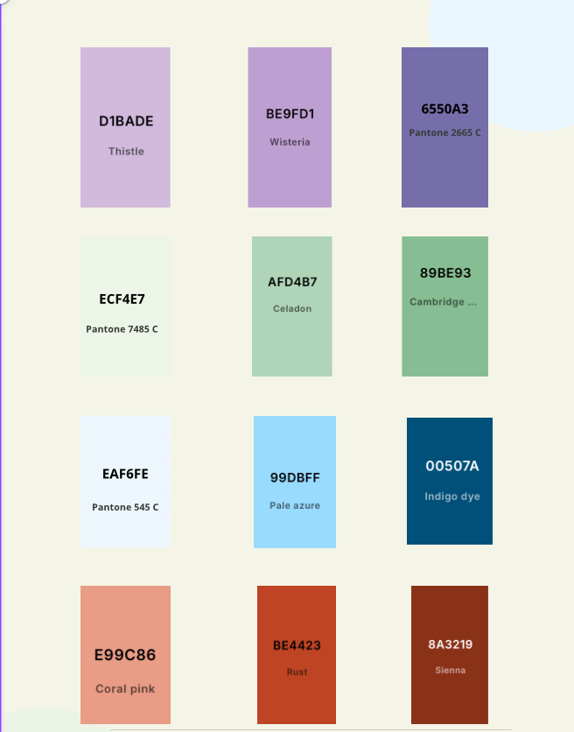
WHERE HERITAGE
MEETS COMMUNITY
#CreativeEurope

