Slide 1
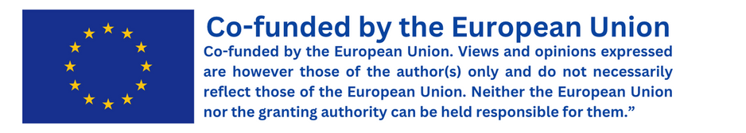

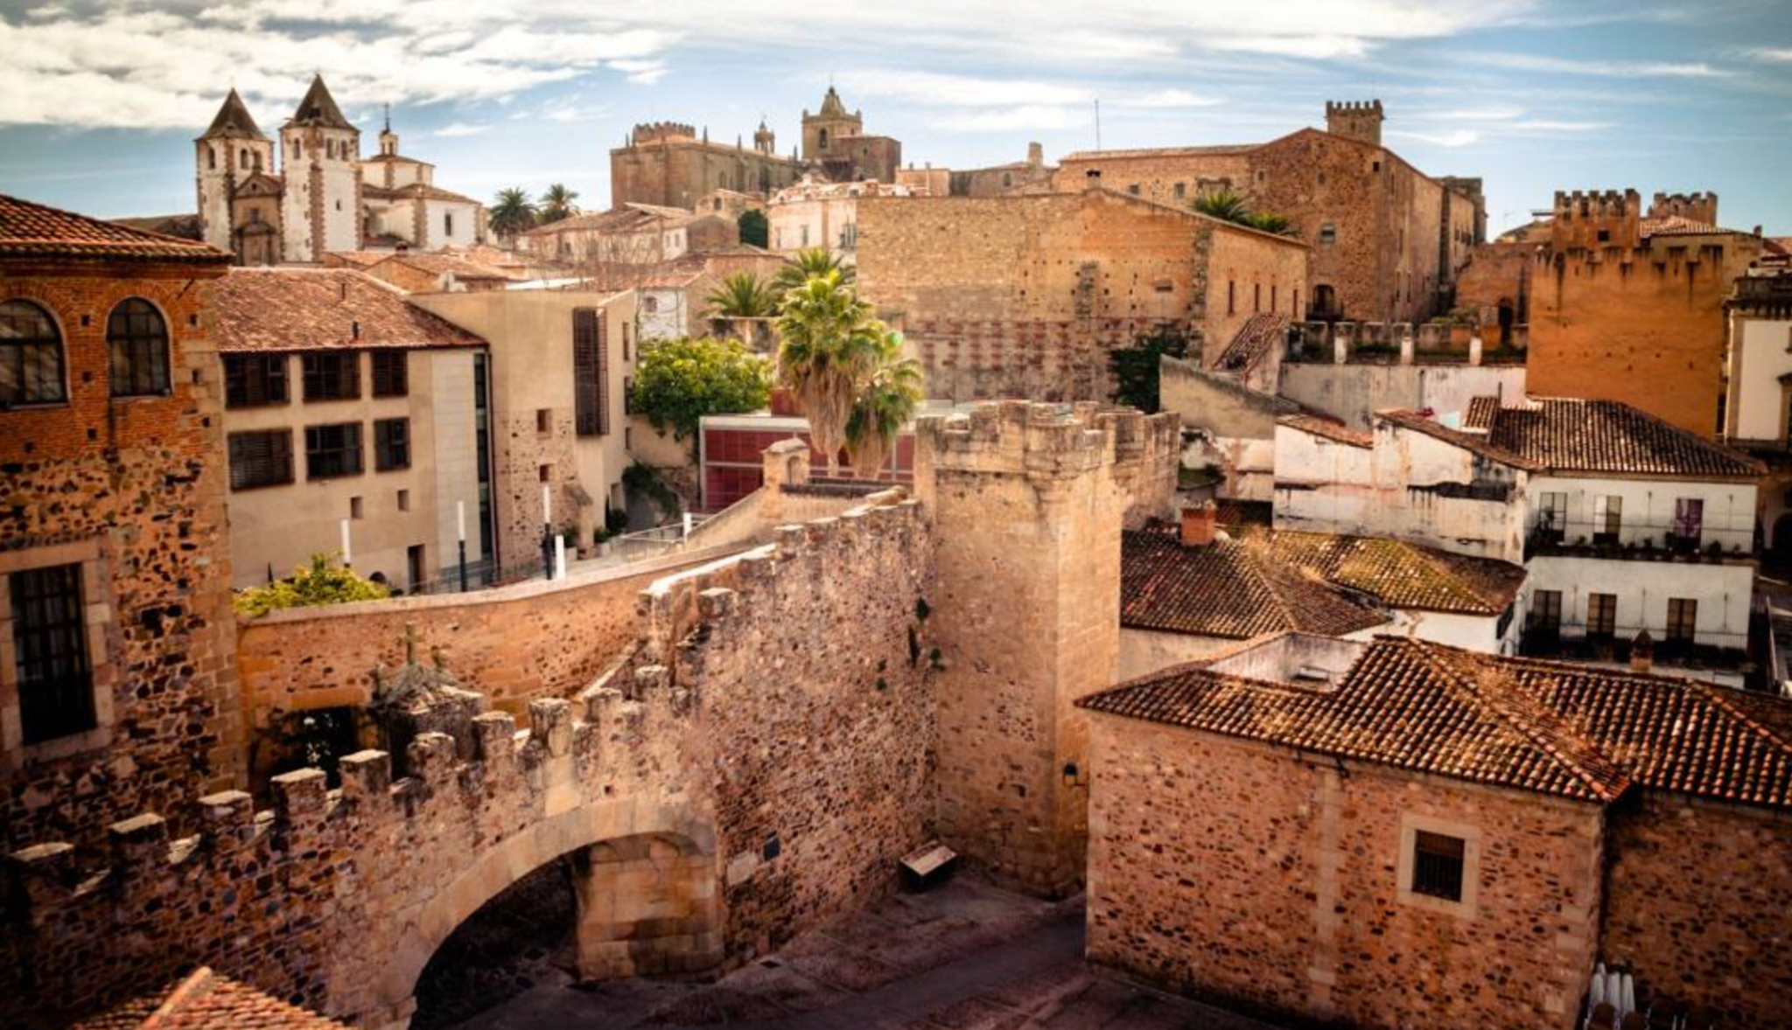
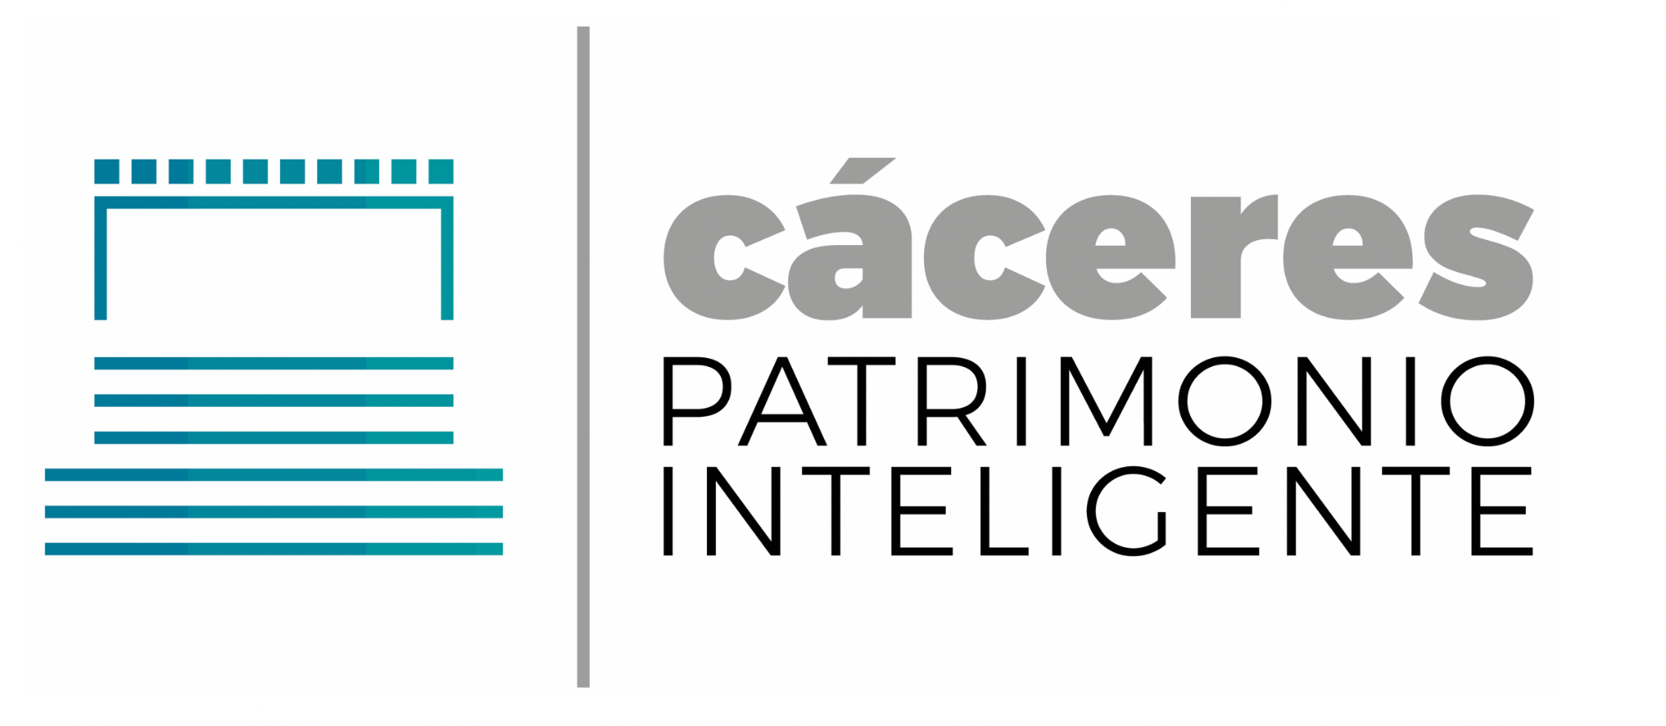
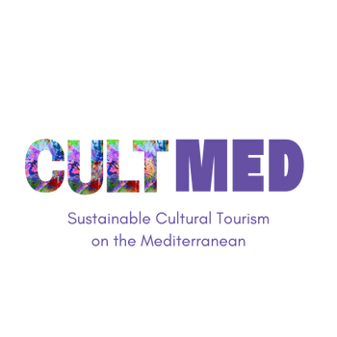

Cáceres Smart Heritage
#CreativeEurope

Slide 2






Introduction
Name of the Practice: Cáceres Smart Heritage (“Cáceres Patrimonio Inteligente”).
Location: Cáceres, Extremadura, Spain.
Type: Cultural promotion, economic and touristic development, smart cultural heritage preservation and management.
Initiating Organization: Cáceres City Council, Ministry of Ministry of Energy, Tourism and Digital Agenda (through Red.es), and co-funded by FEDER (European Funds for Regional Development).
Year of Establishment: initiated in 2017 and completed in 2020.
Current Status: Ongoing.
WHERE HERITAGE
MEETS COMMUNITY
#CreativeEurope

Slide 3
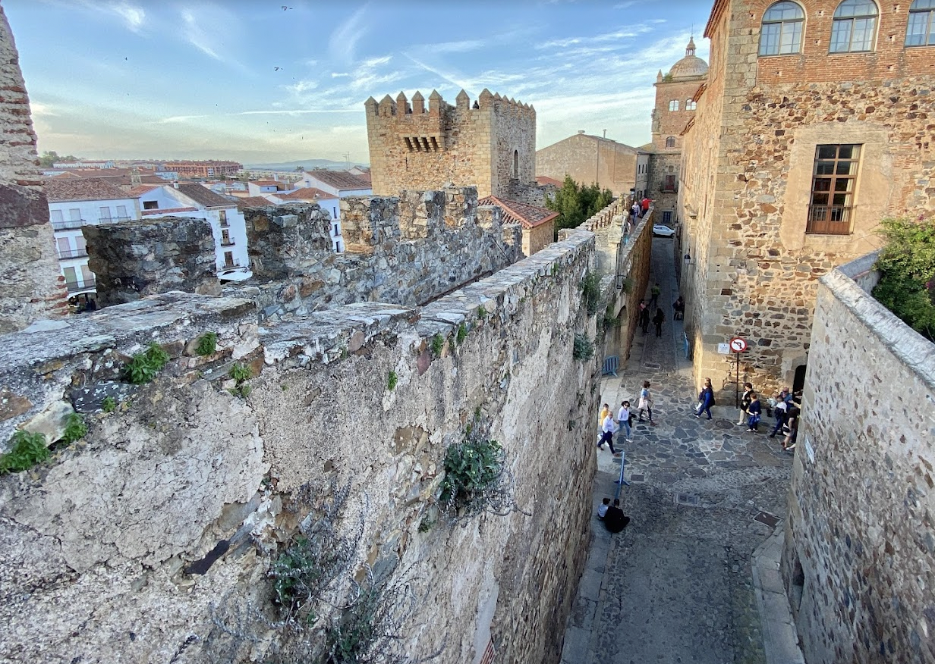
Introduction
Cáceres is a city with an impressive historic and artistic heritage due to its Christian, Islamic and Jewish past. It has a large number of monumental patrimony in a magnificent state of preservation, such as a Roman door known as ‘The Star’s Arch’, ‘Bujaco’s Tower’ -an Almohad tower which has become the main symbol of the city-, or its beautiful old Jewish quarter. All this cultural coalescence has given the city its recognition as a World Heritage City by the UNESCO.
The project ‘Cáceres Smart Heritage’ was presented by Cáceres City Council to the II call for Intelligent Cities launched by the Ministry of Energy, Tourism and Digital Agenda, being selected among all the proposals. The project was developed with the aim of preserving and enhancing the patrimonial legacy of the city by the use of ICTs to collect key data for a more efficient tourism management while boosting the touristic and the economic activity of the city.
Bujaco’s Tower
https://turismo.caceres.es
WHERE HERITAGE
MEETS COMMUNITY
#CreativeEurope

Slide 4


The Practice
Key Target Groups
Tourists and visitors: Enhancing their experience in the city by providing interactive digital tools that facilitate their access to touristic information and help them planning their visit and moving through the city easily.
Local businesses and tourism sector : Benefiting from the effort to attract more visitors and the marketplace where they can offer their products/services..
Local community and Resident: indirect beneficiaries as the project promotes the cultural heritage of the city and stimulates job creation and economic growth.
Stakeholder Involvement
Cáceres City Council: Founder and primary operator, focusing on improving urban services and infrastructure to support the initiatives, tracking their impact.
Cultural and Heritage Institutions: Responsible for managing and preserving the cultural heritage sites using the date provided by the ICTs.
Local business: Participating in the marketplace and Cáceres card initiative by offering their services/discounts.
Technology providers (Red.Es): Offering technological infrastructure to implement the project.
WHERE HERITAGE
MEETS COMMUNITY
#CreativeEurope

Slide 5
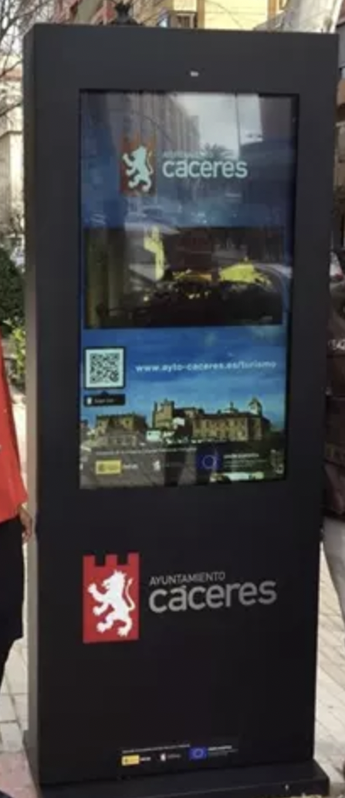
The Practice
Main activities involved in the implementation of this project:
Monitoring systems in the heritage sites of the city: A monitoring system to to control different environmental and structural parameters in four landmarks of the city, including ‘Bujaco’s Tower’ and ‘Cáceres City Museum’.
Flow tracking: counting systems to monitor the number of visitors by means of 18 flow control sensors.
Visitors tracking: analysing the profile of the visitors based on data obtained from their mobile phones (origin,stay…)
Interactive digital kiosks in different spots of the city that provide tourist information.
Optimization of digital contents: creation of new resources and digital tools such as videos, audioguide visits and multimedia brochures.
WHERE HERITAGE
MEETS COMMUNITY
#CreativeEurope

Slide 6
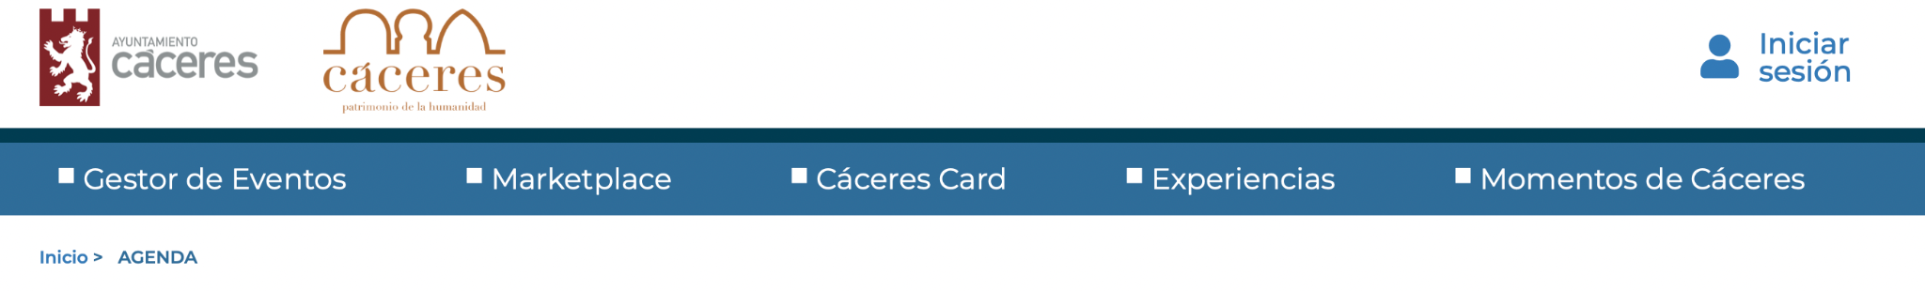
The Practice
Development of a renewed tourism website, to which they can access via app, which provides an integral management of the tourism for the local authorities and cultural institutions by having access to touristic data, and facilitates tourists’ access to helpful information and can plan their visit easily thanks to its user-friendly format. In addition, the platform integrate a local marketplace in which they can filter which products are looking for while local businesses offer their products and services, and connecting businesses and clients/tourists.
https://gestor-eventos.caceres.es/agenda
WHERE HERITAGE
MEETS COMMUNITY
#CreativeEurope

Slide 7
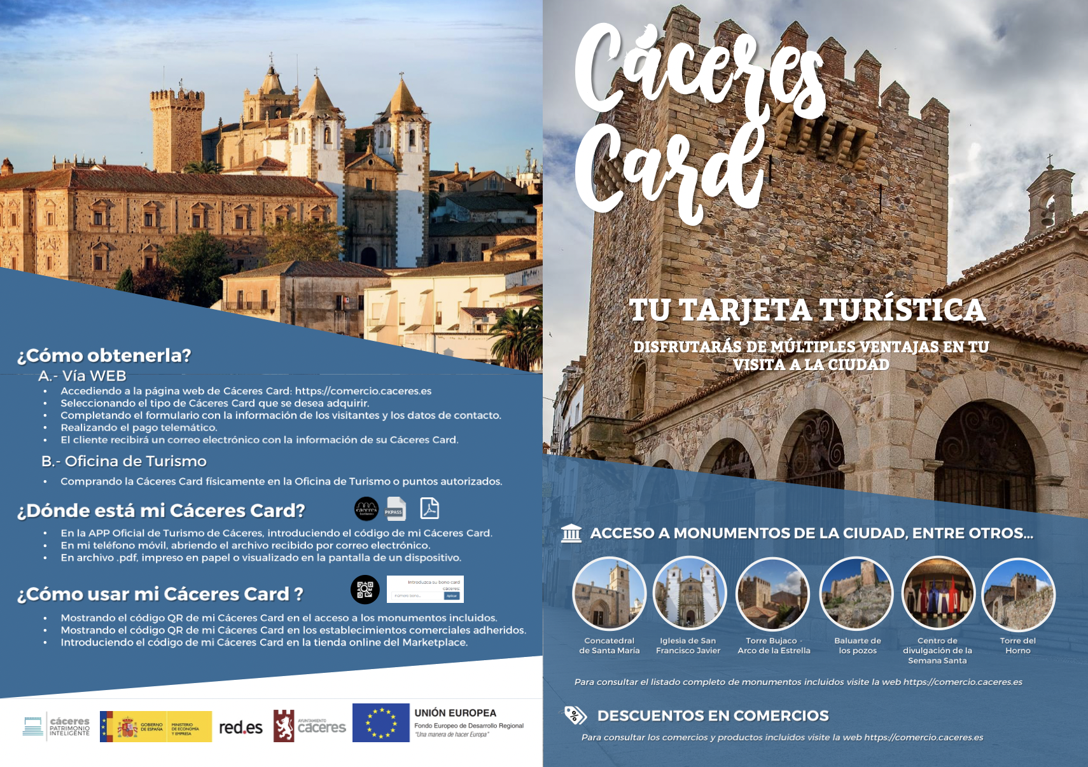
The Practice
Promotion activities which include: renewed promotion videos, social media marketing actions through RRSS, email marketing, or online surveys.
Creation of the ‘Caceres Card’ by which tourists have free access to the main monuments of the city and can get discounts in the local businesses.
Cáceres Card information brochure
https://comercio.caceres.es/caceres-card
WHERE HERITAGE
MEETS COMMUNITY
#CreativeEurope

Slide 8
Local Benefits and Impact
ECONOMIC IMPACT
CULTURAL IMPACT
ECONOMIC IMPACT
Increase in tourism and local economy: An increase in the number of tourists involves a boost in job and business creation and stimulates the local economy.
In addition, local businesses are directly promoted by the creation of the marketplace.
Optimization of public resources. It reduces costs associated with heritage conservation and the execution of the project has resulted in a partial refund of funds to the Cáceres City Council.
Enhanced preservation and Promotion of cultural heritage: The integration of the ICTs ensures the preservation of the historical assets of the city.
Increased accessibility to cultural resources. The digital kiosks and website give visitors access to detailed information about the city’s landmarks, fostering a deeper appreciation of the cultural heritage.
WHERE HERITAGE
MEETS COMMUNITY
#CreativeEurope

Slide 9
Local Benefits and Impact
ENVIRONMENTAL IMPACT
SOCIAL IMPACT
ECONOMIC IMPACT
Sustainable management of Cultural heritage: the systems used in the project ensure the preservation of the cultural heritage while mitigating the potential negative impacts associated with increased tourism.
Implementation of environmental Monitoring systems. The monitoring systems installed are focused on environmental and structural parameters for a sustainable management and risk preventions.
Improved life quality for residents: the integration of technology into the city’s infrastructure has contributed to the social and economic well-being of residents, as well as tourists.
Enhanced visitors experience thanks to the digital kiosks and beacon technology.
Preservation of cultural identity: the project has strengthen the community’s cultural identity, fostering a sense of pride among residents.
WHERE HERITAGE
MEETS COMMUNITY
#CreativeEurope

Slide 10
Visitors Benefits and Impact
CULTURAL
EXPERIENCE
OPTIMIZED
OVERALL EXPERIENCE
EDUCATION
Interactive experience: The digital kiosks and the website allow visitors to explore the city easily and in a more dynamic way, as well as learning more about its heritage.
Real-time information: The visitors have instant access to historical details, fun facts and stories of the city.
Tourist can fully appreciate the richness of the city thanks to the brochures, maps and tools they have access to, as well as avoiding long lines and planning their visit in a more efficient way.
WHERE HERITAGE
MEETS COMMUNITY
#CreativeEurope

Slide 11
Sustainability Measures
Cultural Preservation:
The different environmental and structural sensors track factors like temperature, humidity, and vibrations, helping detect early signs of deterioration. The visitors’ flow tracking helps avoiding congestion points in vulnerable landmarks, and the use of digital contents also reduce physical wear caused by large crowds.
Economic sustainability and resource preservation
The use of ICTs allows for better management of city services and infrastructure, reducing operational costs, including the costs related to heritage preservation activities. In addition the new technological touristic services attract a broader audience and foster economic growth within the community, as local enterprises benefit directly from increased tourism activities.
WHERE HERITAGE
MEETS COMMUNITY
#CreativeEurope

Slide 12
Community Involvement
Role of Local Community
Active participation of residents, local business and cultural organizations to enhance the city’s cultural heritage.
Local business and especially those involved in the tourism sector, such as hotels and restaurants, have a direct role on the touristic services that contribute to enrich the visitors’ experience in the city. In addition, they can access the online marketplace to promote their businesses and catch the attention of tourists easily.
Ownership and Management: City Council’s Role
Aligning the project with broader urban development goals.
Ensuring the project’s financial viability and funding by a good management of the budget and benefits.
Facilitating the collaboration among other stakeholders, including technology providers and cultural institutions.
WHERE HERITAGE
MEETS COMMUNITY
#CreativeEurope

Slide 13
Monitoring, Evaluation and Financing
Evaluation Metrics, Feedback Mechanisms and Continuous Improvement
Online surveys and comments in social networks and websites: The official touristic app and website and social networks are potential sources of information to get feedback and collect visitors’ opinions after their experience in the city. They allow to identify services that can be improved, to detect technical problems with the systems installed in the different landmarks and even to get ideas that could be implemented for a more attractive experience and a continuous improvement of the project.
Funding Sources and budget information: Total Budget: 3.782.805,29€
Co-funded by:
Cáceres City Council
Ministry of Energy, Tourism and Digital Agenda
FEDER (European Funds for Regional Development)
WHERE HERITAGE
MEETS COMMUNITY
#CreativeEurope

Slide 14
Replicability and Scalability
Challenges faced
To install the tracking systems in different monuments and spaces to create a unified tourist experience.
To collect and analyse data for strategic purposes.
To renew and update contents and tools available on the city’s website and touristic institutions.
To foster the use of a new tourism app and increasing the content on social media to promote the city’s heritage.
Transferability and potential for expansion
After the successful implementation of this project in Cáceres, the city could include other monuments and spaces of touristic interest. Furthermore, these same practices could be adopted by other cities of the region considering the challenges mentioned previously as a starting point to implement their own system.
WHERE HERITAGE
MEETS COMMUNITY
#CreativeEurope

Slide 15
Key Conclusions&Takeaways
After having explored this initiative in more depth, Cáceres Smart Heritage is a good example of a practice for sustainable cultural tourism in Spain due to the following reasons:
Local heritage: It enhances the local culture by means of digital interactive contents that engage tourists in an interactive and immersive experience as they learn about the richness of the city.
Cultural preservation: It fosters cultural preservation, as the initiative includes the installation of technological systems in different patrimonial assets aimed at protecting the spaces and controlling the impact of tourism.
Positive economic and social impact: It boosts the economic activity of the community as it attracts more visitors and contributes to build a sense of community among the citizens of the city and includes measures that promote local products and services.
Sustainable use of resources: The implementation of ICTs contributes to waste reduction and energy efficiency and helps to manage the available resources in a more efficient way.
WHERE HERITAGE
MEETS COMMUNITY
#CreativeEurope

Slide 16
Thank You !
WHERE HERITAGE
MEETS COMMUNITY

Slide 17
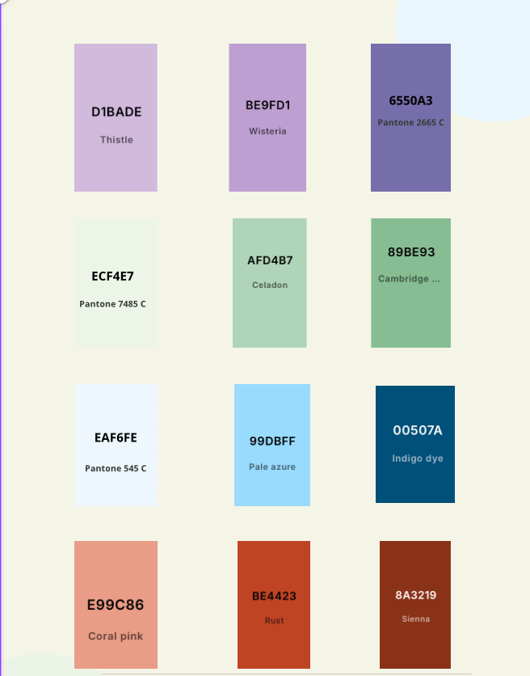
WHERE HERITAGE
MEETS COMMUNITY
#CreativeEurope

